Slide 1
Safe and Sober
Alcohol Interlocks in Europe
July 2017

Slide 2
Agenda
Cenelec standards
Types of applications of alcohol interlocks
How the alcohol interlock works

Slide 3
CENELEC Standards
EN 50436-1 : Instruments for drink-driving-offender programs
EN 50436-2 : Instruments having a mouthpiece and measuring breath alcohol for general preventive use
TR 50436-3 : Guidance for decision makers, purchasers and users
EN 50436-4 : Connectors for the electrical connection between the alcohol interlock and the vehicle
EN 50436-5 : Instruments not having a mouthpiece and measuring breath alcohol for general preventive use
EN 50436-6 : Data security

Slide 4
EN 50436-1 : Instruments for drink-driving-offender programs
Current European Countries with Compliance Programs
Belgium
Demark
Finland
France
Netherlands
Poland

Slide 5
Compliance Monitoring Programs
Developed to prevent individuals from drinking and driving.
Monitors and restricts the behavior of driver that have been convicted of drinking and driving.
Protects the public.
Ensuring the drivers remain in the driving licensing system under the control of the authorities.
Technology has made it very difficult for drivers to circumvent the system.
Devices now have a range of features that can be customized to meet the requirements of the various jurisdictions such as camera and real time reporting.

Slide 6
Effectiveness
How effective is it?
Research shows that alcohol interlocks reduce recidivism among first and repeat offenders including hardcore offenders.
Studies have demonstrated behavioral changes on participants of the alcohol interlock programs.
Reducing re-arrest rates. Studies in the United States have suggested re-arrest rates for alcohol impaired driving was reduced by 67% after alcohol interlocks had been installed compared to those with just a suspended license.

Slide 7
EN 50436-2 : General preventive use
Proactive safety use of alcohol interlocks to prevent drinking and driving.
Mandated in school transportation in France and Finland.
Used in commercial fleets, construction and mining vehicles.
Private personal use for added family safety
Vehicles can be monitored through a web based data management program by the company administrator
Customizable settings for need the requirements of the organization
Presently used in fleets in many European countries

Slide 8
Optional Features
Camera:
  Takes a picture of the driver blowing into the device at the time of the test.
  Stores the image for future reference
Telematics Integration:
  Transmits in real time alcohol results and vehicle location
  Many suppliers of telematics are able to integrate with alcohol interlock manufacturers
WiFi:
  Transmits data to fleet reporting systems upon returning to vehicle depot
  Email or SMS alerts can be sent to fleet managers
GPRS:
  Allows real time transmission of critical events.

Slide 9
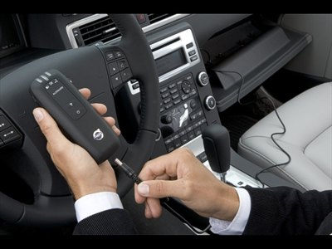
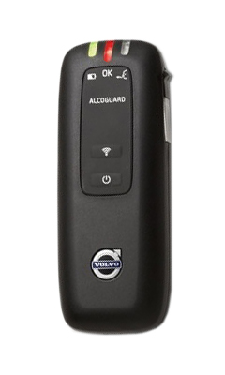

Application of ALCOLOCK V3 – OEM
Automotive OEM
OEM installation into buses & trucks
Installation into lighter vehicles such as taxies
Applicable to all kinds of vehicles in markets
60 International Boulevard, Toronto, Ontario, Canada
+1 416 619 3500

Slide 10
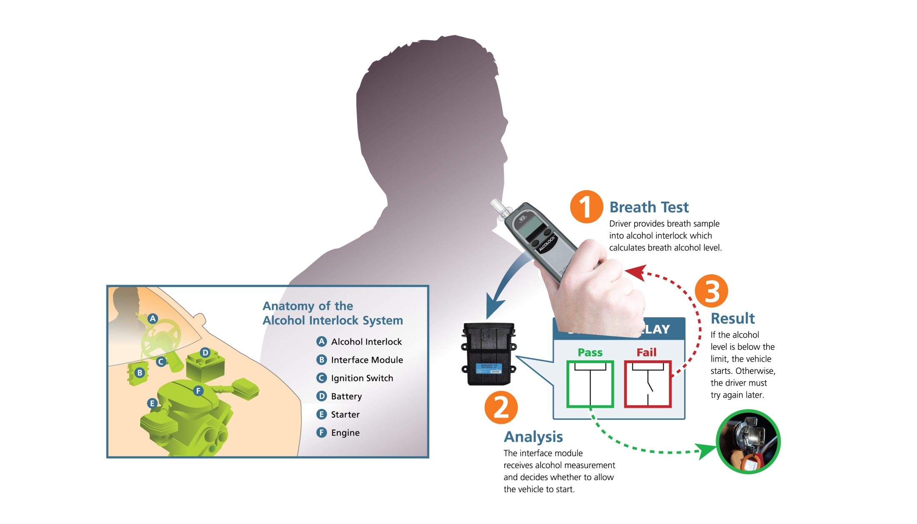
How does Alcohol Interlock work?
1
Breath Test
Driver provides breath sample into alcohol interlock which calculates breath alcohol level.
3
Result
2
Analysis
If the alcohol level is below the limit, the vehicle starts. Otherwise, the driver must try again later.
The interface module receives alcohol measurement and decides whether to allow the vehicle to start.
60 International Boulevard, Toronto, Ontario, Canada
+1 416 619 3500

Slide 11
SAFETY.
IN THE PALM OF
YOUR HAND.
Notice of Proprietary Rights and Copyrights
This presentation contains Confidential Information. It is solely and exclusively the property of Alcohol Countermeasure Systems Corp, and may not be reproduced or otherwise used, in whole or in part, without the express written permission of the company.
ALCOCHECK, ALCOHOL COUNTERMEASURE SYSTEMS, ALCOLAB, ALCOLOCK,ALCOSIM, ALCOSCAN, ALERT, DRIVESAFE, Saf’IR and The Molly Logo are trademarks of Alcohol Countermeasure Systems (International) Inc., and are used under license.
For more information please visit acs-corp.com

