Slide 1

Alcohol interlocks in Belgium
ETSC Safe & Sober – Lisbon 3 April 2023

Slide 2
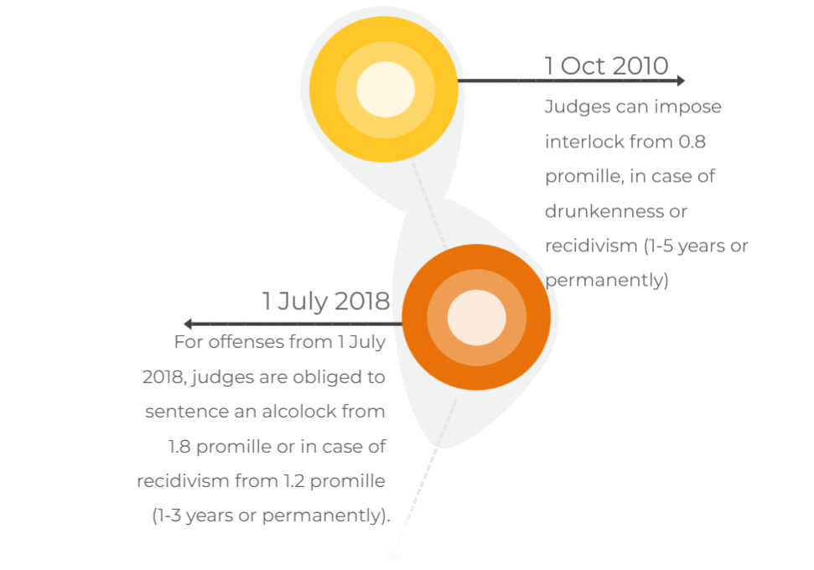
Belgian legislative history

Slide 3
Outside of scope
non-application justifiable for one-off offenses
driving ban due to physical or psychological incapacity
driving ban for life

Slide 4
Targeted offenders
Judges MUST impose interlock in case
of severe intoxication (1,8 pm)
for 1-3 years or for life unless
properly motivated by court
1,2 pm for repeat offenders and no
option with motivation by court
Judges MAY impose interlock for:
- intoxication from 0,8 pm
- drunkenness
- slight recidivism
Interlock for heavy drink-drivers
Interlock may be imposed for certain vehicle categories only, including at least the category of the offense.

Slide 5
Consequences of conviction
1
2
3
4
Driving ban
(+ tests)
Interlock cost
Rehab programme
Fine
1 year: € 2 250
3 years: € 4 100
Training and follow-up
1 year: € 1 200
3 years: €1 700
Theory test
Practical test
Psych eval
Medical test
€1 600 minimum
Repeat offense minimum € 3 200
Fine may be reduced with installation fee(fully or partial), use and/or programme fee

Slide 6
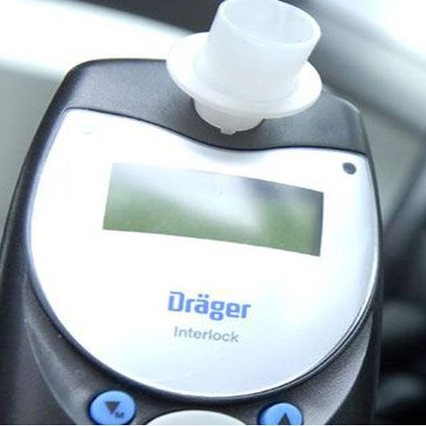
Timing
Actions required after notification:
  Initial interview with support programme centre within 14 days
  driving licence must be in order (code 69) within
  30 days
  interlock must be installed within 30 days

Slide 7

Installation & programme
Number of service centers for installation: 33
Number of programme centers:
3 with 73 branches

Slide 8
Interlock for offenders vs commercial/preventive use
Similarities
Differences
CENELEC-standard
Installers
Immobilization at 0,2 promille
Annual technical inspection (calibration/control cell)
Repeated testing
0,2 pm for offenders vs 0,4/0,22 pm at client’s request (Dräger)
Rehabilitation programme
Data downloads
Breath result on screen
Regulation of alcohol/drug use in the workplace
Company fleets with buses and trucks from AB-InBev, Bpost, Volvo, Renault and IVECO bus & truck (mainly FR: 24000 devices - BE 2500 devices)

Slide 9
Number of installed interlocks for offenders
Provinces | Number | %
Antwerpen | 926 | 35,51%
Brussel | 89 | 3,41%
Henegouwen | 86 | 3,30%
Limburg | 123 | 4,72%
Luik | 114 | 4,37%
Luxemburg | 51 | 1,96%
Oost-Vlaanderen | 283 | 10,85%
Vlaams-Brabant | 434 | 16,64%
Waals-Brabant | 84 | 3,22%
West-Vlaanderen | 390 | 14,95%
Namen | 28 | 1,07%
TOTAL | 2608 | 100,00%
1844 purchased (70.71%)
764 rented (29.29 %)
Numbers for ongoing programmes (2022)

Slide 10
Do’s and don’ts
The penal procedure makes for a big time gap between the offence and the interlock programme
  12 to 18 months
  driving licence withdrawn after offense for 14-30 days
If alcohol dependence is suspected, the procedure may be expedited
  usually results in a driving ban for incapacity due to alcohol dependence => no interlock possible
  sometimes the court ‘abuses’ this procedure to circumvent mandatory interlock

Slide 11
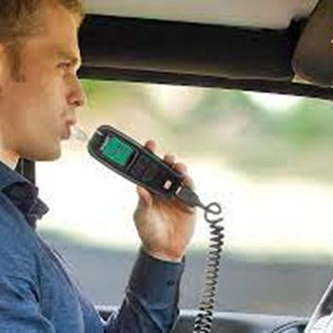
Do’s and don’ts
Imposing an interlock for serious recidivism only became mandatory after realizing judges avoided it, while policy makers were convinced of their usefulness.
Even now for one-off heavy intoxication (from 1,8 pm), judges often use the option of motivation not to impose.

Slide 12
Do’s and don’ts
Frequent retesting to prevent bypassing the interlock:
  to be completed within 15 minutes while driving
  complaints
  roadside parking is not absolutely necessary
  particularly problematic for truck drivers who need to load/unload with the engine running
Some countries reward compliance with less frequent testing. Belgium will stick to random testing for now.

Slide 13
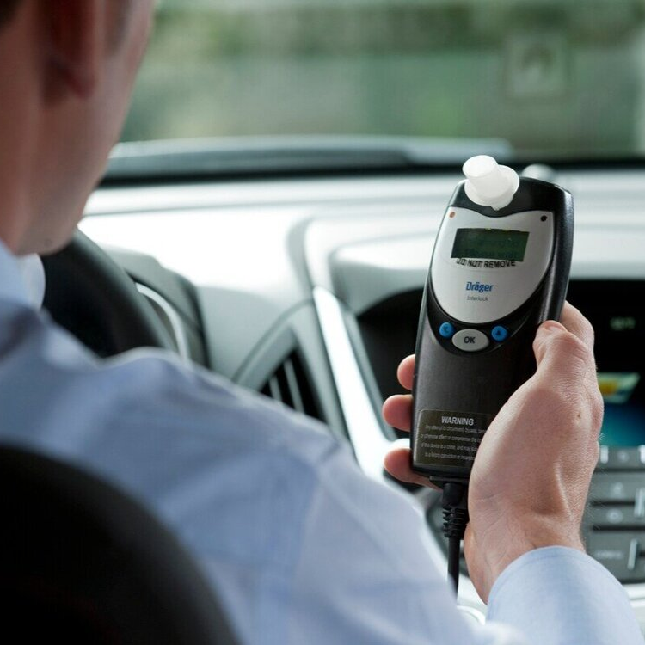
Do’s and don’ts
Using several alcolock manufacturers can provide lower prices, different accents
  (for example, some only allow rental of a device, others also purchase).

Slide 14
Do’s and don’ts
Combining a driving ban (sometimes with tests/evaluation) and an alcolock - in the same court decision or in a subsequent decision - is complicated
  requires proper arrangements with public prosecutor
Options for offender:
  Opting out of interlock means not driving during sentence
  Opting for interlock can only within 30 days after notification:
    Initial interview with support programme within 14 days
    Interlock installed within 30 days
  More flexibility needed

Slide 15
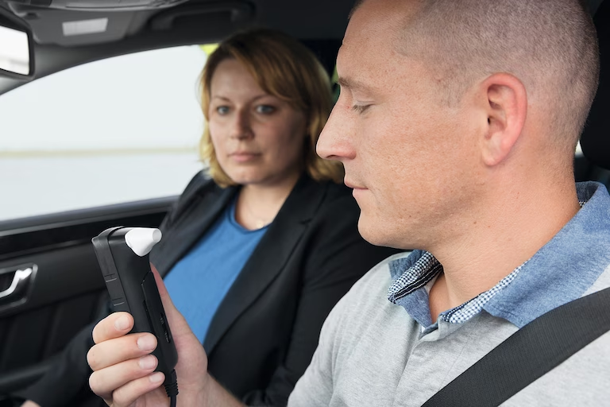
Do’s and don’ts
A programme of 5 years turned out to be too long with a demotivating effect.
1-3 years has proven to be able to cause positive behavorial changes

Slide 16
Do’s and don’ts
The support programme is necessary to acquire behavorial change:
  guidance from a psychologist
  conversations
  individual/group training

Slide 17
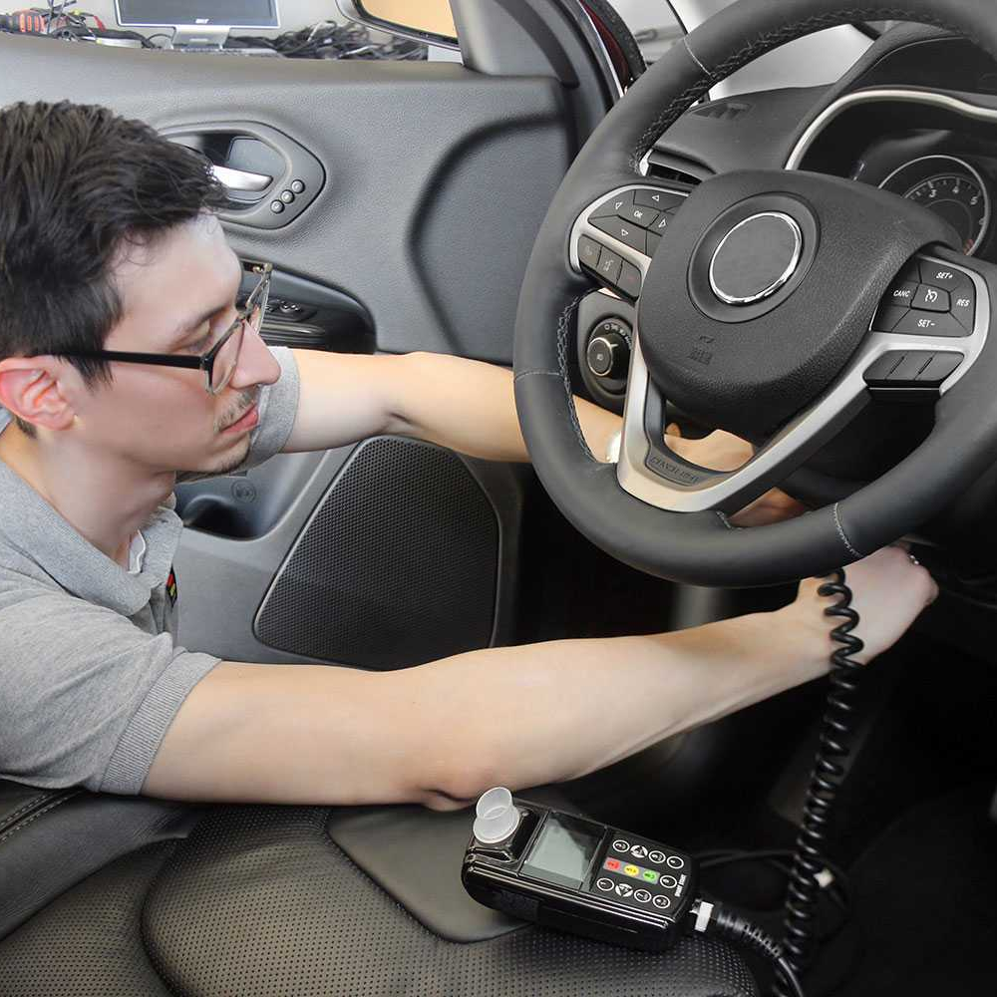
Do’s and don’ts
A device can be rented, leased or purchased.
Allowing the device to remain in the vehicle after the sentence helps keeping up good habits (without a support program).

Slide 18
Do’s and don’ts
Belgian alcohol limit:
  0,5 pm
  0,2 pm for professional drivers
Interlock threshold at 0,2
  Technically zero tolerance
  Important message to offender: no more drink driving

Slide 19

Bruno Jansen – FPS Mobility and Transport bruno.jansen@mobilit.fgov.be

