Slide 1
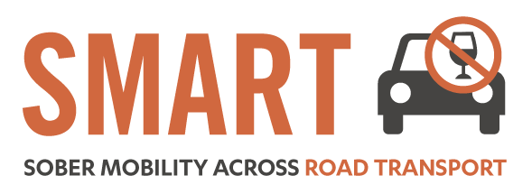
The role of brewers and pub operators in tackling drink driving
14th October 2015
Andy Tighe – Policy Director, BBPA

Slide 2
Who are we
The BBPA is the leading trade association for brewers and pub operators in the UK. Our members produce over 90% of beer sold and own around 20,000 pubs.
Beer and pubs are part of the fabric of British life: chatting over a pint in the pub is the original social network.
Pubs are at the heart of communities -15 million adults visit pubs every week and a major tourist destination with food now also an increasingly important feature.
Brewing is a key part of the UK manufacturing base – a world renowned industry and the third largest exporter in food and drink sector
Beer and pubs generate £22 billion of economic activity and provide £10 billion in tax revenues as well as supporting over 900,000 jobs.
Beer is integral to pubs - seven out of ten alcoholic drinks sold in pubs is beer

Slide 3
Why responsible consumption is better for all
Brewers take their responsibility to promote alcohol responsibility very seriously.
The industry has also taken a strong line in condemning driving over the legal blood alcohol limit.
There has been a real culture change in the UK over the past few decades regarding the unacceptability of drink driving.
The UK has among the safest roads in the EU
(ESTC, 2013 UK ranked 2nd after Malta)
And a sharp decline in in drink-driving accidents and casualties since 1979

Slide 5
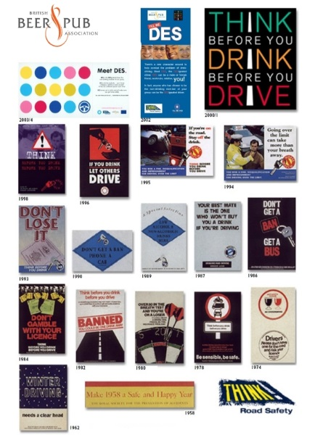
A history of drink driving awareness
The brewing industry has a long history of supporting campaigns to remind people of the danger of driving whilst over the limit
This includes campaigns such as ‘I’ll be Des’ which aimed to remind people of the importance of having a designated driver
Companies have also highlighted anti-drink drive messages in their advertising
Recent campaigns supported by the industry have included the Department for Transport THINK campaign which has effectively helped consumers to confront the consequences of drink driving and helped to change attitudes
Brewers of Europe partnership with ETSC

Slide 6
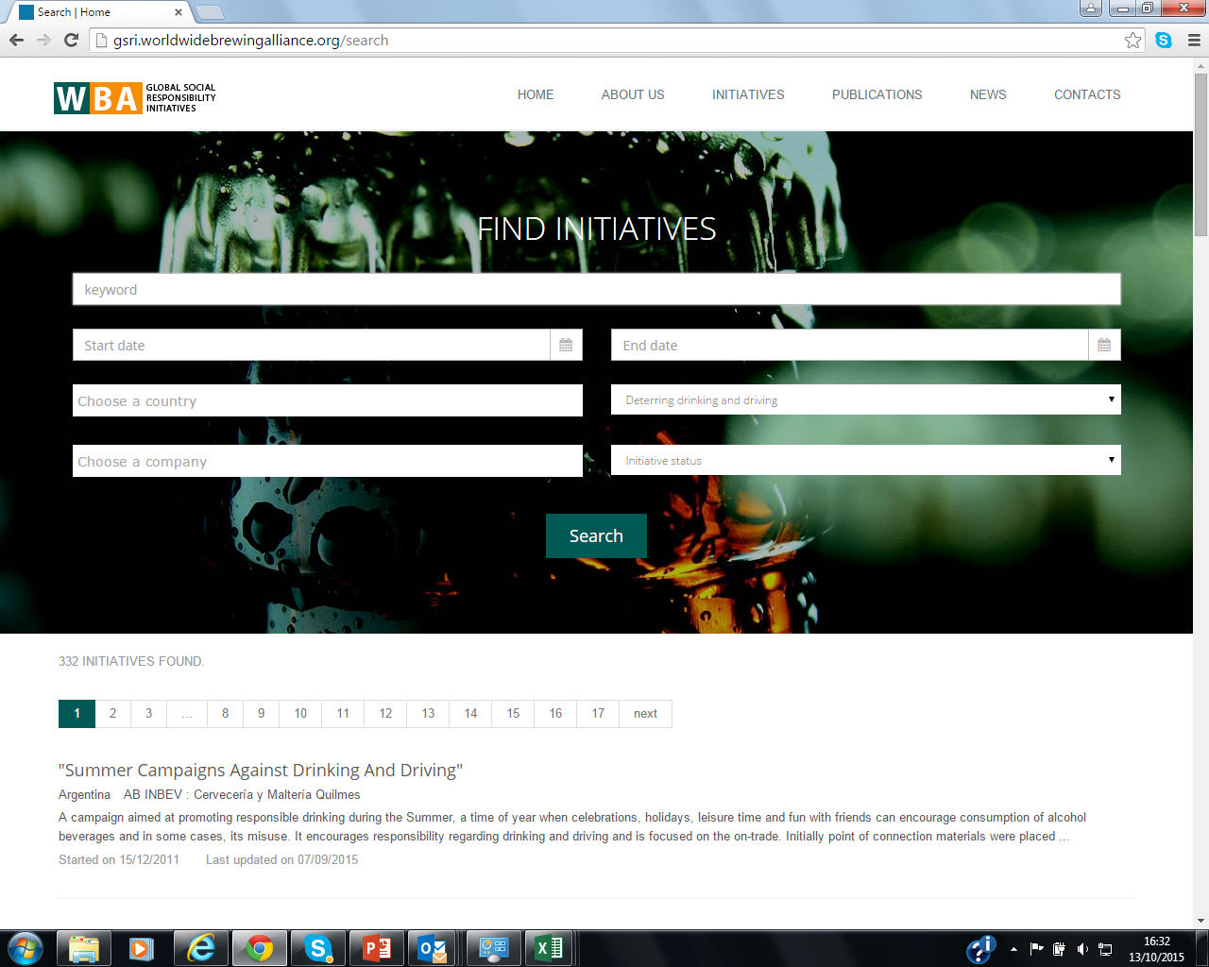
…And sharing good practice globally

Slide 7
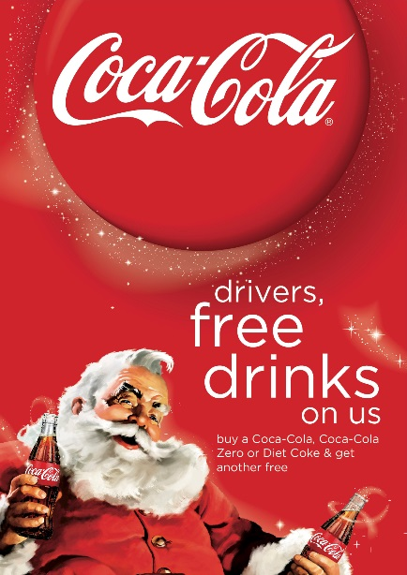
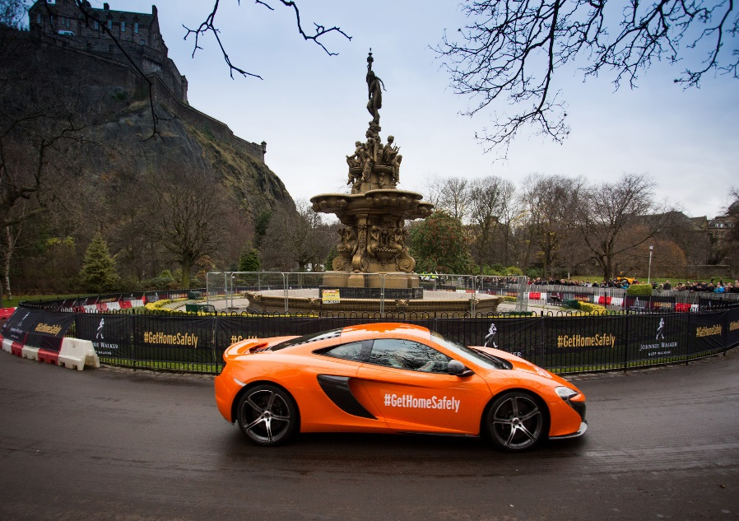
The Coca Cola ‘Designated Driver’ campaign works with participating venues to offer a BOGOF on soft drinks for designated drivers during the festive period.
Over 12,000 pubs took part in the campaign in 2014
For the last nine years, Diageo have run their campaign ‘Join the Pact’ to encourage consumers to commit to never drink and drive
The target is to collect five million pledges from consumers not to drink and drive
In return Diageo will give away five million km of safe rides home, for example in Edinburgh the company partnered with Lothian Buses to provide free bus services home for Hogmanay revellers on New Year’s Eve

