Slide 1

terrific telematics

Slide 2


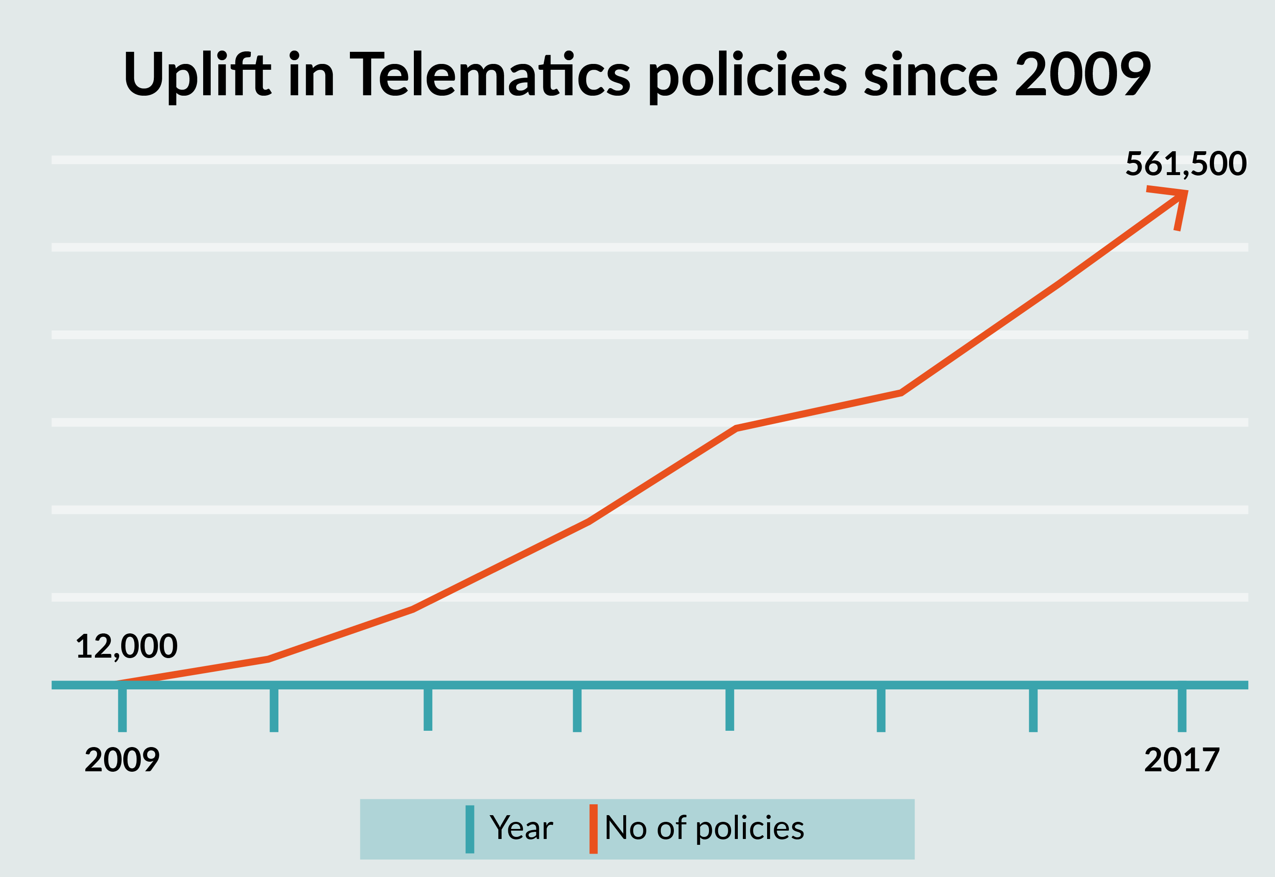


telematics is growing!
We’ve seen our telematics sales increase by 8 times since 2014.
Searches for Black box insurance have increased 4 times.
Based on data collected by BIBA since 2009.
Safer, Fairer, Simpler
Notes:
Uplift in telematics is based on data from BIBA since 2009.
Marmalade New Driver Insurance sales increased nearly 4 times from 2014 to 2015 (based on Jan-Dec) and then doubled again 2015 to 2016 (based on Jan – Dec). This is equivalent to 8 times between 2014 and 2016.
Searches for Black Box Insurance have nearly quadrupled since 2012!

Slide 3
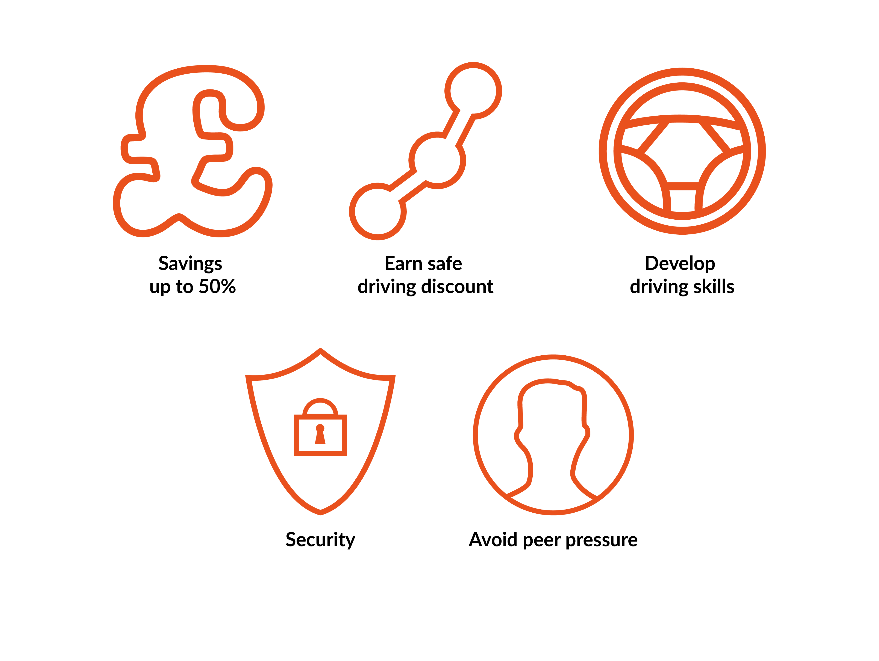
what it means for young drivers…
71% of telematics policies are taken out by motorists under the age of 25 (Gocompare.com March 2016)
Safer, Fairer, Simpler
Notes:
Savings up to 50% - Average Marmalade Premium £1300.
Develop driving skills – the online portal helps them to review and improve their driving (more on this later)
Earn safe driving discount – telematics enables drivers to have premiums based on their own driving rather than young drivers in general. They save on average 36% at renewal with Marmalade and some have saved up to 66%
Security – one of our customers recently had their vehicle recovered by the police after their car keys were stolen during a burglary. The police were able to trace the car using the black box.

Slide 4
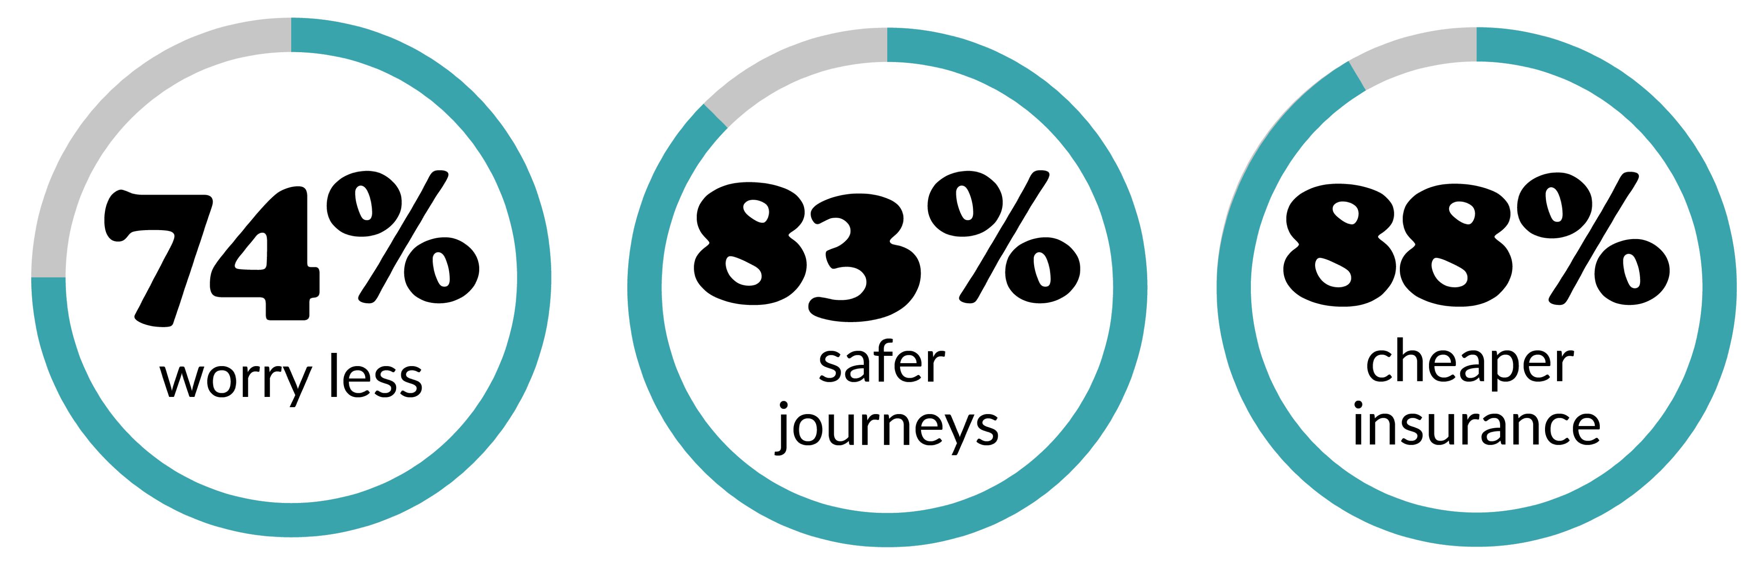
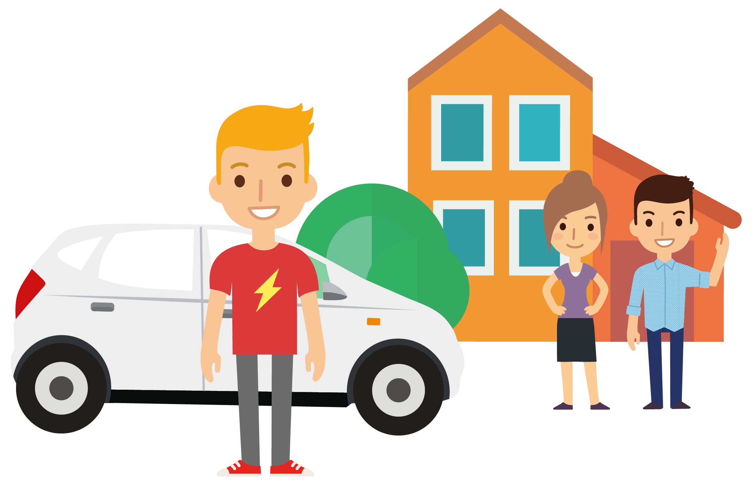
…and their parents!
“ Using black box insurance has helped develop Sarah’s driving massively. The software has flagged a couple of locations where Sarah was having problems so we made a point, the next time we were driving to these locations, to discuss the issues and help her improve her driving response to specific challenges she faces there. ”
john catterson, parent
Safer, Fairer, Simpler
Notes:
Peace of mind!
Our recent survey of parents said:
74% of parents worry less about their children if they drive a car fitted with a black box
83% of those parents said they believe using a black box encourages safer journeys
88% of parents believe black box policies offer cheaper insurance
It’s a team effort – we insist at least one parent/guardian is a named driver so that they are actively involved in supporting the young driver. They also have access to the portal – we often find that it enables the parent to review and improve their own driving too! We have feedback that some parents compete with their children to get the best journey!

Slide 5



making our roads safer
3 times safer
One 2 One
advice
Safer newer cars
Safer, Fairer, Simpler
Notes:
Marmalade’s young drivers are 3 times safer than the national average!
One to one advice over the phone – from their peers, not a stuffy insurance expert.

Slide 6

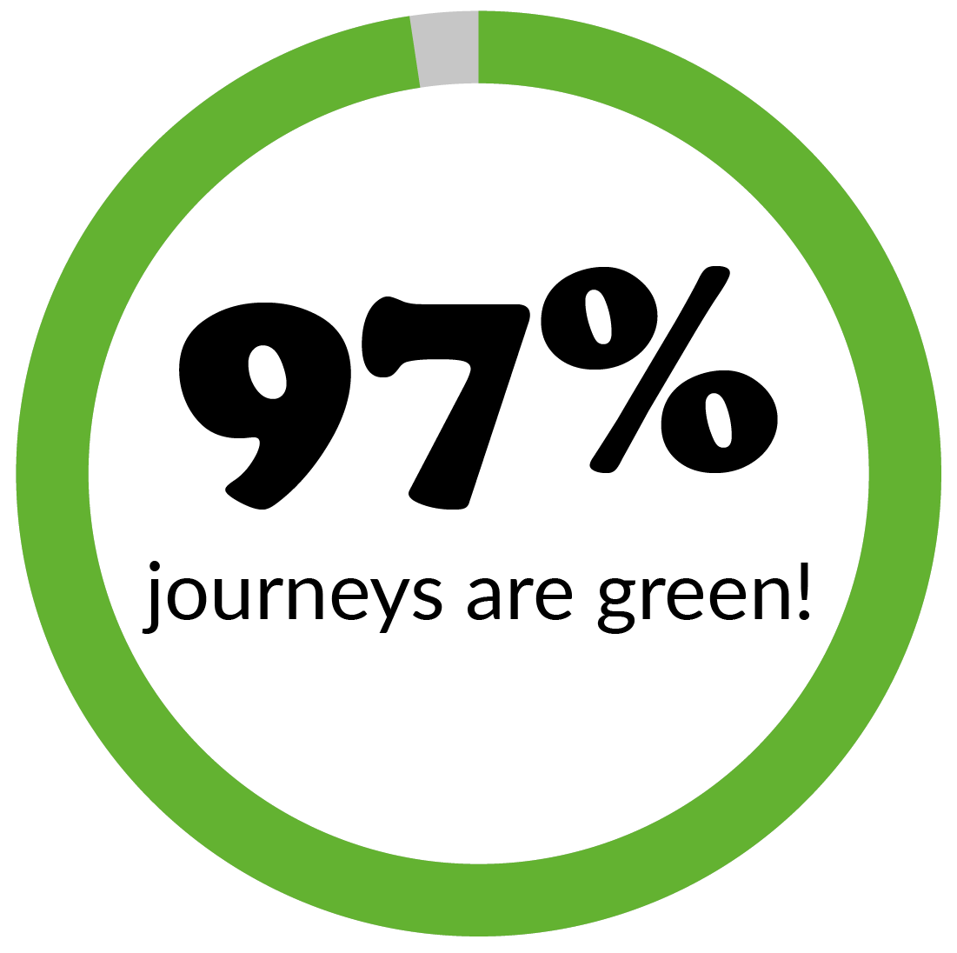
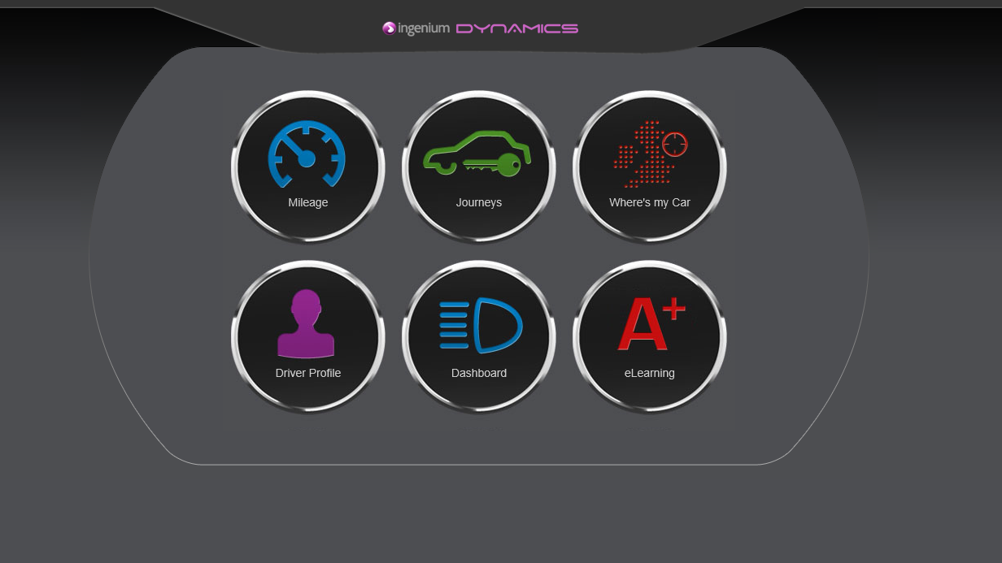

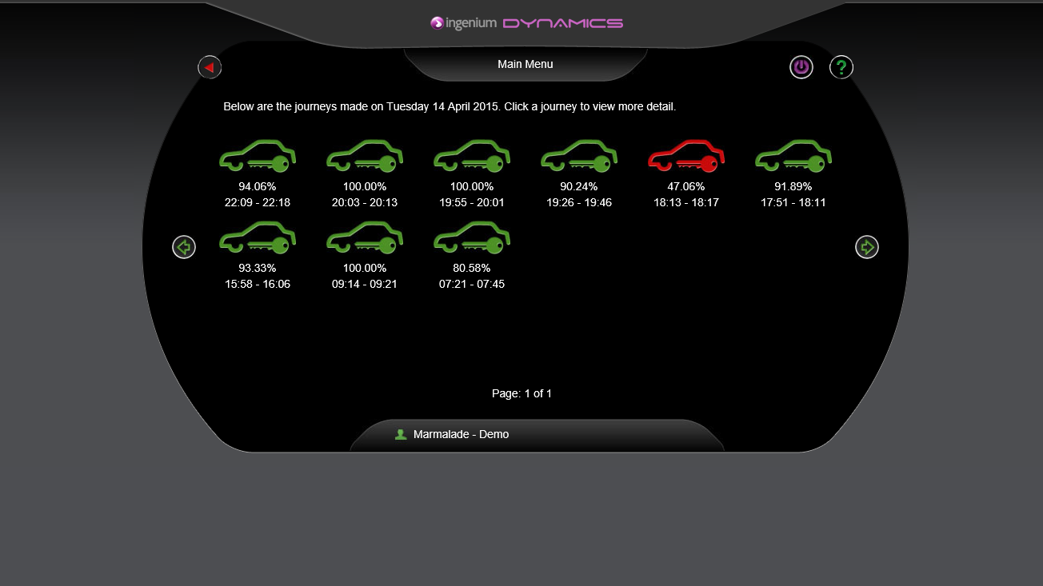
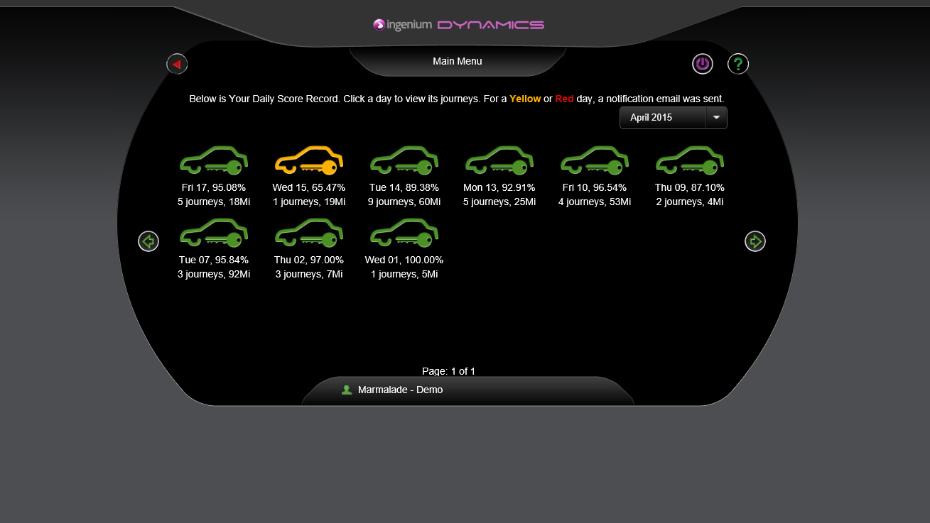
telematics in action
Safer, Fairer, Simpler
Notes:
Our portal enables young drivers, and their named driver, to access a portal to review their journeys – they can check out their average journey score, find our where their car is and review individual journeys in more detail.
Red, Amber & Green flagging system
97% of journeys are green – this is based on a review of over 1.8 million journeys! Less than 1% of the journeys are red – so it is a minority!

Slide 7
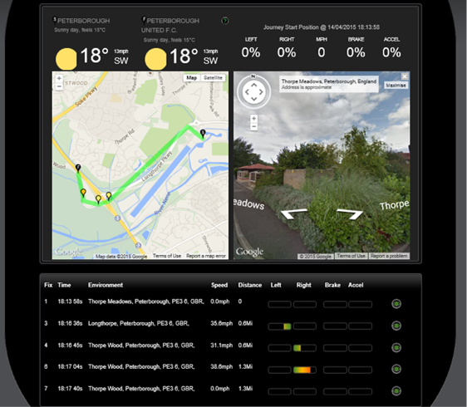
ABC’S of driving
Safer, Fairer, Simpler
Notes:
We measure driving based on Acceleration, Braking Cornering and average Speed. The box uses GPS and measures the G-force while driving to give an accurate picture of driving.
When a young driver incurs a “red” journey – which means a number of points have been flagged – a member of the team can confidently talk the young driver through the journey – where they went wrong – and advise how they can improve.

Slide 8


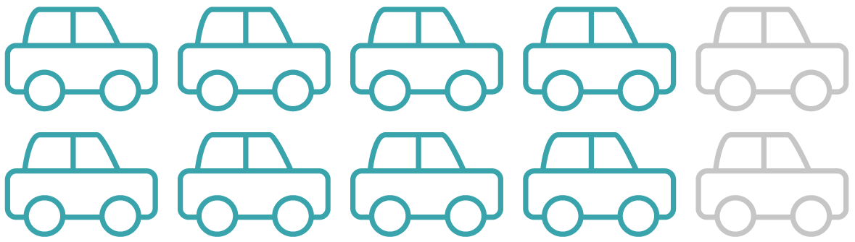
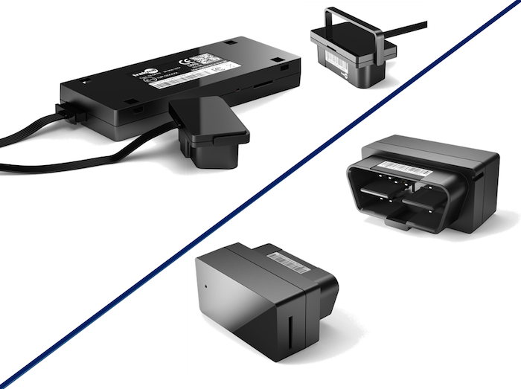
telematics in action
Moving towards plug in devices – fit over 80% of cars!
Safer, Fairer, Simpler
Notes:
For young drivers it’s important that the data is accurate and a mobile device can simply not offer this as it can’t be securely fitted to the car. A fitted or OBD device is firmly attached in the vehicle so both the young driver, and the insurer can be confident with the data.
Data is accurate as it pings off 8 satellites and is accurate within 2 metres – data is available by the second and young drivers can review their journeys immediately.

Slide 9

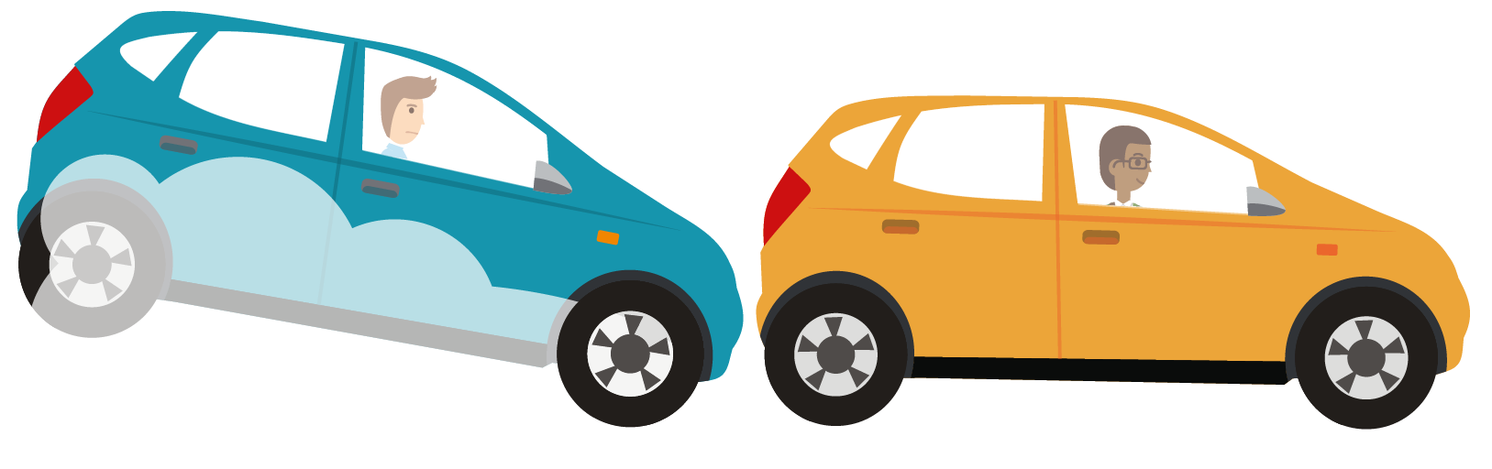

what it means for the industry
Safer, Fairer, Simpler
Notes:
We’ve seen a better claims rate for our insurance than the average.
Moving towards insurance tailored to the individual rather than insurance based on the masses.
Drive iQ expects that one in four car insurance policies will be telematics-based by 2020

Slide 10

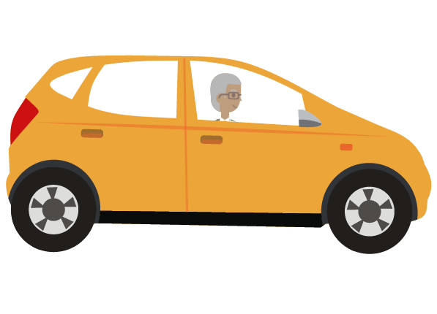


where will telematics take us?
Safer, Fairer, Simpler
Notes:
SAGA GENERATION – opportunity for older drivers to have a second chance rather than having their licence reviewed.
INNOVATION - The technology has allowed us to develop a policy to bridge a gap in the market so young drivers can have their own policy to cover themselves on their parents’ car – the technology lets us ascertain who is driving so we can just provide cover when they are behind the wheel! They can still benefit from the advantages our New Driver Insurance offers and earn their own no claims (without affecting their parents’ no claims)
PAYG Insurance
Every car will be fitted with a black box as standard.

Slide 11


