Slide 1

ETSC and Road Safety Situation in Europe
YEARS Camp
24 October 2016
Dovile Adminaite, Project Officer

Slide 2
Contents
ETSC activities
PIN program and road safety situation in Europe
Young people and road safety
ETSC’s recommendations

Slide 3
ETSC
A science based approach to road safety
Secretariat in Brussels
58 member organisations from across Europe
More than 200 experts contributing to ETSC’s work
The European Commission, Member Organisations, Member States and corporate sponsors are funding our work

Slide 4



























































Slide 5
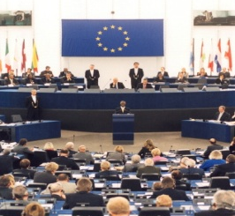






Road Safety Performance Index (PIN)
Ranking EU countries‘ performances
Monitoring EU transport
safety policy
REVIVE
SAFE & SOBER

Slide 6





The PIN Programme
Experts from the 32 participating countries (including all EU Member States)
Steering group
Project team in the ETSC secretariat
Notes:
- Currently includes the 28 EU Member States, as well as Israel, -- Norway, Serbia and Switzerland
- A PIN Panel: experts from each of the 32 countries
A PIN Steering Group, with members from research organisations, the EC, the PIN sponsors and the ETSC leadership

Slide 7

Targets and performance
The EU set a target of cutting road deaths by 50% between 2001 and 2010
The 50% reduction target renewed for 2010- 2020
Countries have similar national targets

Slide 8
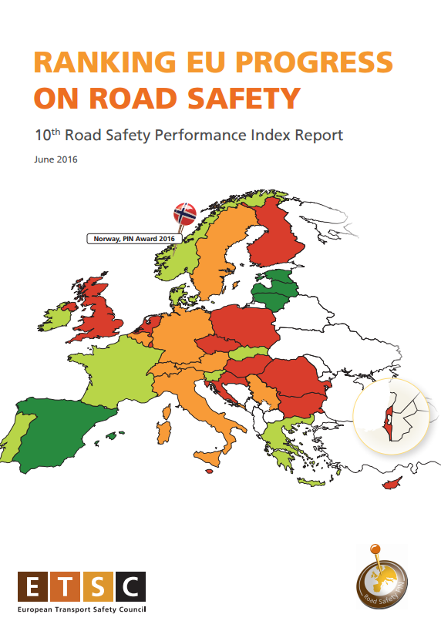

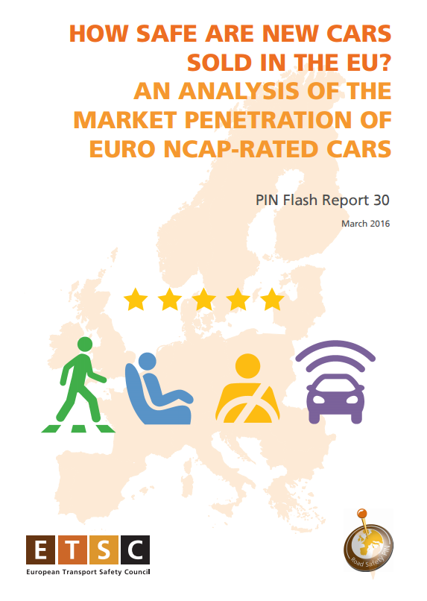
Annual and thematic PIN reports

Slide 9
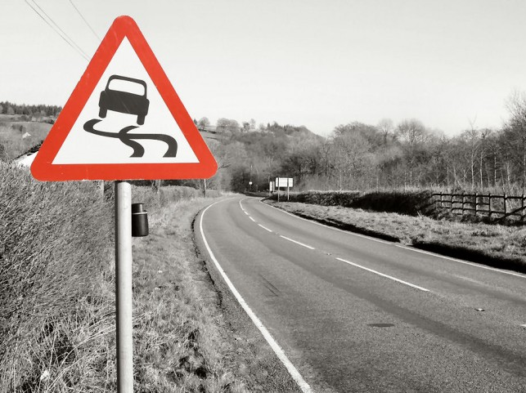
2014-2015
bad years for road safety
Notes:
The PIN annual report for this year, published today reveals a worrying picture.
2014 was a bad year for road safety in the EU

Slide 10
How many people were killed in 2015 in the EU28?

Slide 11

26,276
people died in road traffic in the EU in 2015
Notes:
76 people die each day on EU roads

Slide 12
How many were seriously injured in 2015 in the EU28?

Slide 13
135,000
*
seriously injured in road traffic in the EU in 2014 according to MAIS3+ definition
*European Commission estimate
Notes:
For every death, there are roughly five times as many people seriously injured in road traffic collisions.

Slide 14
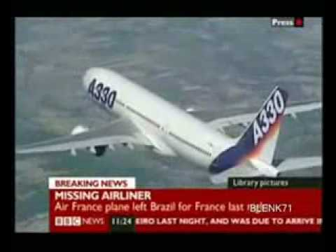
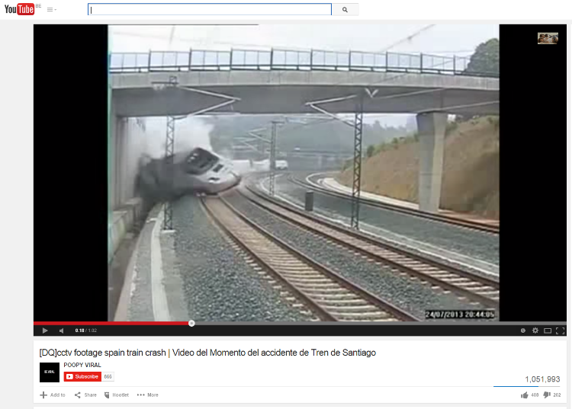
11 deaths – Commercial Air Traffic
202 deaths – General Aviation
EASA (2013)
123 passengers and staff deaths
279 level crossing deaths
643 ‘trespasser’ deaths
UIC (2013)

Slide 15

+1%
First increase in road deaths since 2001
Notes:
In 2015 first increase since 2001

Slide 16
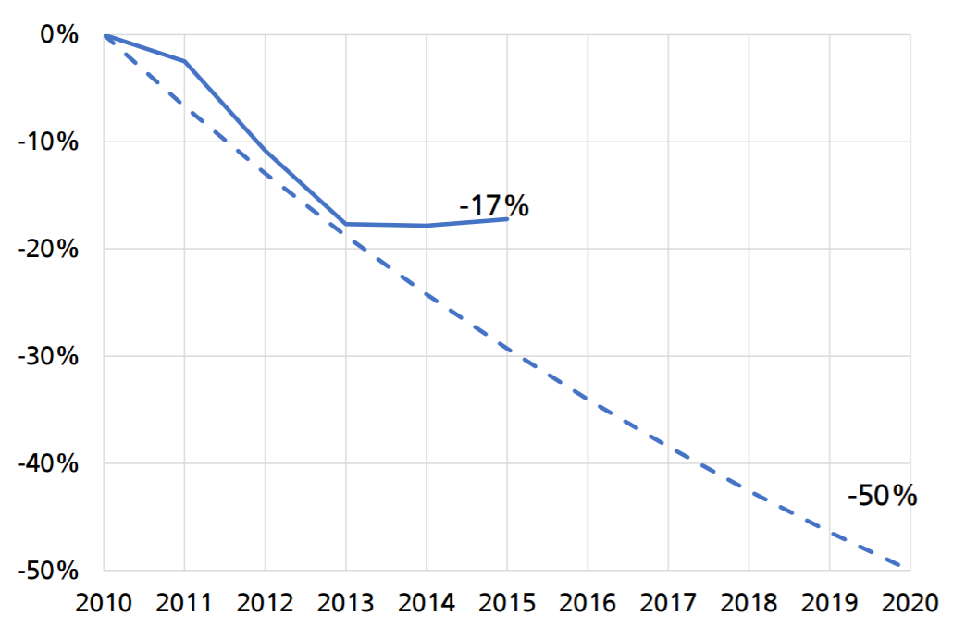
EU target at stake

Slide 17
Reduction in the number of road deaths 2010-2015

Slide 18
Road deaths per mln. inhabitants 2015 and 2010

Slide 19
Road deaths per mln. inhabitants 2015 and 2010

Slide 20
Young people mortality (2007-2009)
EU average 103

Slide 21
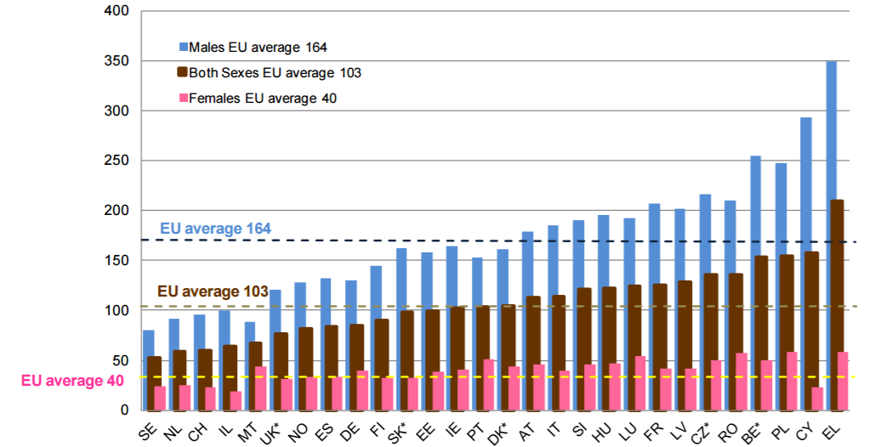
Young people: a male problem
Road deaths per million inhabitants in 2007-2009 (ETSC PIN Flash 25)

Slide 22
25% of all young people deaths occur on the roads
Share of young people’s road deaths out of the total number of youth deaths (suicides, illnesses,…)
Average for 2011–2013. Source: PRAISE (May 2015) Managing young drivers at work

Slide 23
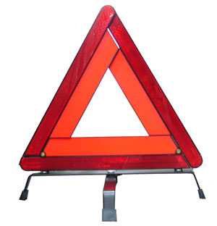
The main killers on the roads
Speeding
More than 1,300 road deaths could be prevented each year if average speeds dropped by ‘only’ 1km/h on all roads across the EU.
Drink driving
At least 5,600 deaths could have been prevented if all drivers involved in accidents and reported to be driving over the limit had been sober.
Non use of seat belts
Around 8,600 car occupants survived serious crashes in 2012 because they wore a seat belt.
Notes:
23
General safety regulation can address three main killers on the roads

Slide 24
ETSC recommendations to Member States
Accompanied driving, prior to licensing for solo driving
Improve training and licensing systems
Introduce 0 BAC tolerance for novice drivers
Introduce special demerit point systems which make novice drivers subject to stricter penalties or rehabilitative measures
Achieve high levels of traffic law enforcement

Slide 25
ETSC recommendations to EU institutions
Seat Belt Use
  Seat belt reminders for all passenger seats
Speed
  Intelligent Speed Assistance (ISA)
Drink Driving
  Alcohol interlocks on professional vehicles and a standard interface for all vehicles

Slide 26
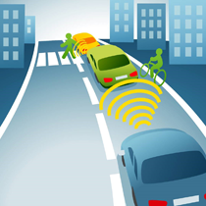
Vehicle safety: General Safety Regulation

Slide 27

Seat Belt Reminders
The seat belt remains the single most effective safety feature in vehicles
Seat belt use is mandatory on all seats
BUT reminder alerts only on driver seat
Wearing rates vary greatly across Europe
Notes:
The seat belt remains the single most effective safety feature in vehicles. Moreover, other important safety features such as airbags work as designed only if occupants are restrained by their seat belts.
Yet, despite the legal obligation to wear a seat belt, wearing rates still vary greatly across Europe.
Adopt legislation to ensure that every new car has as standard equipment an enhanced seat belt reminder system for front and rear seat occupants with audible and visual warnings.

Slide 28
Seat belt wearing rates 2015

Slide 29
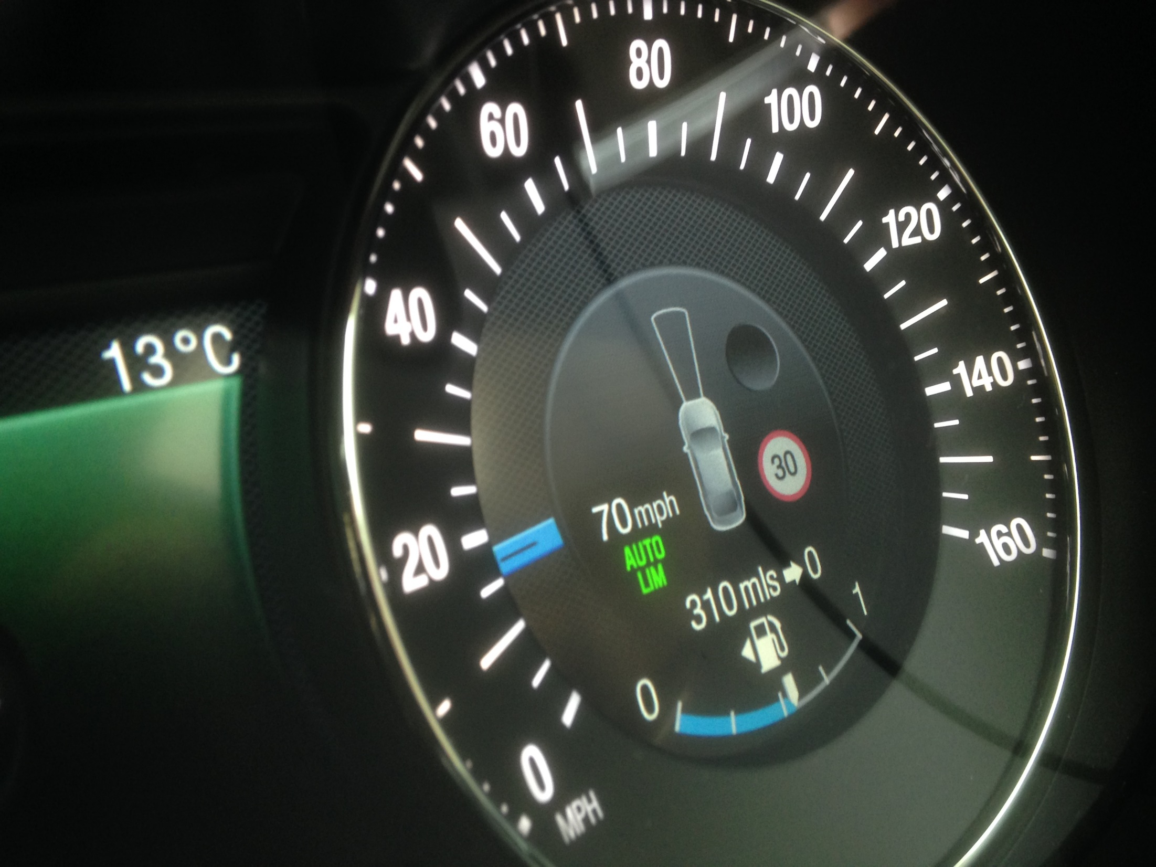

Slide 30
The problem of speed
Drivers have slowed down since 2001
Best progress has been made on motorways: around 30% of drivers exceed the speed limit on motorways
But speed violations are still up to 70% on rural roads (in Demark and Poland) and as many as 80% on urban roads (Poland)
Notes:
- Drivers who say they are sufficiently skilled to speed safely should keep in mind that they are not able to override or repeal the laws of physics.

Slide 31
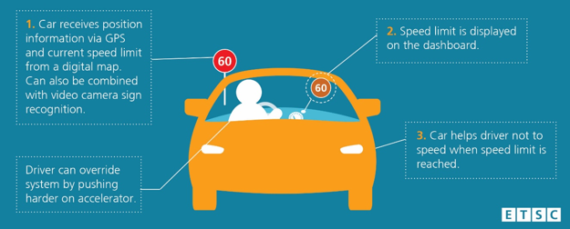
Intelligent Speed Assistance

Slide 32
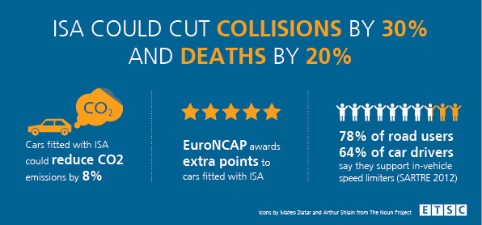
Why ISA?

Slide 33
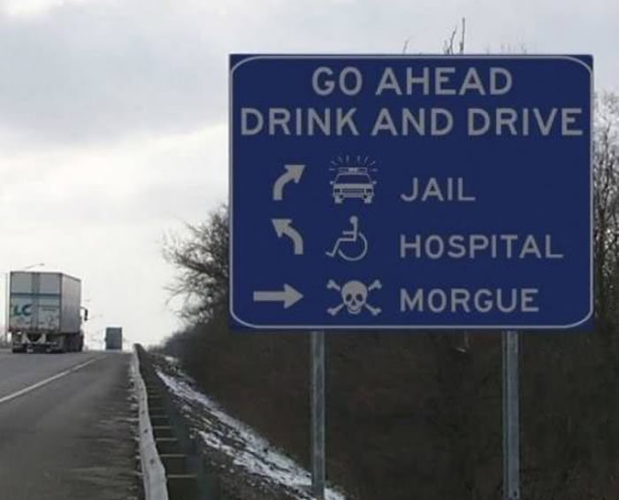
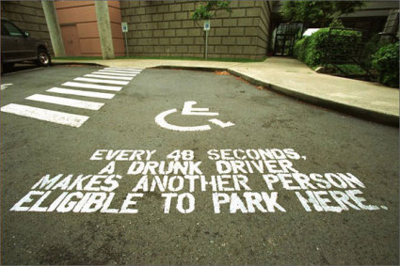
SAFE & SOBER
Up to 1.5 - 2% of Km driven in the EU are driven with an illegal Blood Alcohol Concentration
Of the 26,025 deaths in 2013, less than 15% were attributed by MS to drink driving. But according to EC, between 19% - 28% of all road deaths across the EU are alcohol-related (over 30% of driver deaths)
Alcohol related crashes are the leading cause of death in the age group 16-25
Notes:
While the dangers linked to drink driving are fairly well understood, the phenomenon is still widespread in the EU:

Slide 34
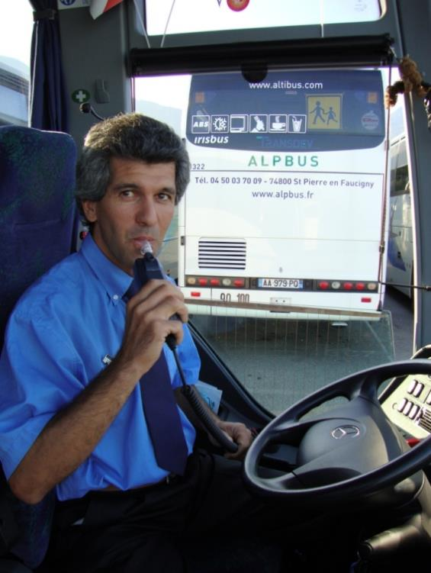
ALCOHOL INTERLOCKS
Increasingly used across Europe for professional drivers and in rehabilitation programmes for drink driving offenders.
Reoffending rates in Finland reduced from 30% to 6% with use of interlocks.
Already compulsory on school buses in France and Finland. 100,000 in use in Sweden.
Should be mandatory for professional vehicles and all cars should have a standard interface to enable use when needed.

Slide 35
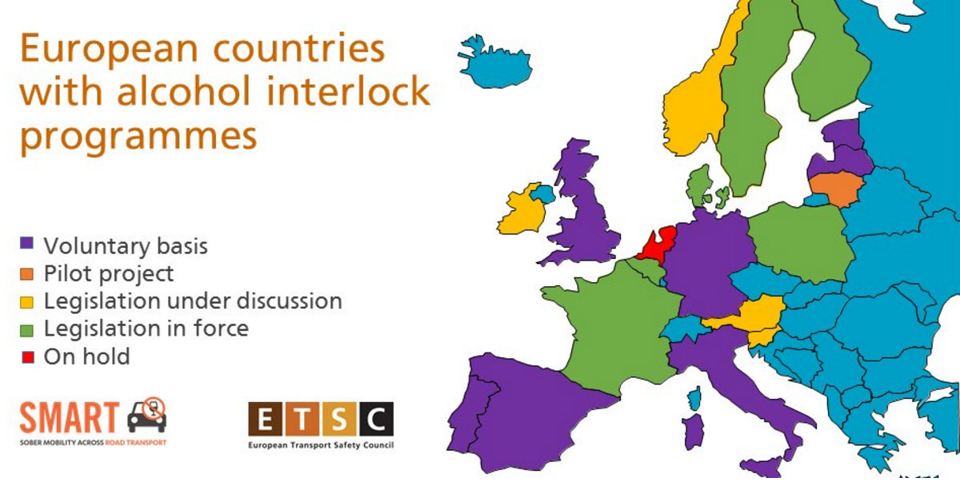

Slide 36
Thank you!
www.etsc.eu
@etsc_eu
dovile.adminaite@etsc.eu
Notes:
36

