Slide 1
Government Measures to tackle Drink Driving in Great Britain
What is the current drink drive position?
Taking forward Enforcement
Continued Educational Interventions
Questions
Notes:
Introduction
Going to talk about the current drink drive position, the legislation and the statistics.
Then going to go on and talk about some of the work we’re doing to tackle the issue.

Slide 2
Drink drive deaths as a proportion of total road deaths have fallen since 1979….
1979
2013
6,352
total deaths
1,713
total deaths
1,640
drink drive deaths
240
drink drive deaths

Slide 3
Statistical Picture of Drinking and Driving
The total number of casualties of all severities in drink drive accidents for 2013 was 8,270, down 17% on the 2012 figure and the lowest total on record.
In 2013 we estimate that between 220 and 260 people were killed in accidents in Great Britain where at least one driver was over the drink drive limit, with a central estimate of 240 deaths.
Around 14%of all deaths in reported road traffic accidents in 2013 involved at least one driver over the drink drive limit.
The number of seriously injured casualties in drink drive accidents decreased by 8% from 1,200 in 2012 to 1,100 in 2013.

Slide 4
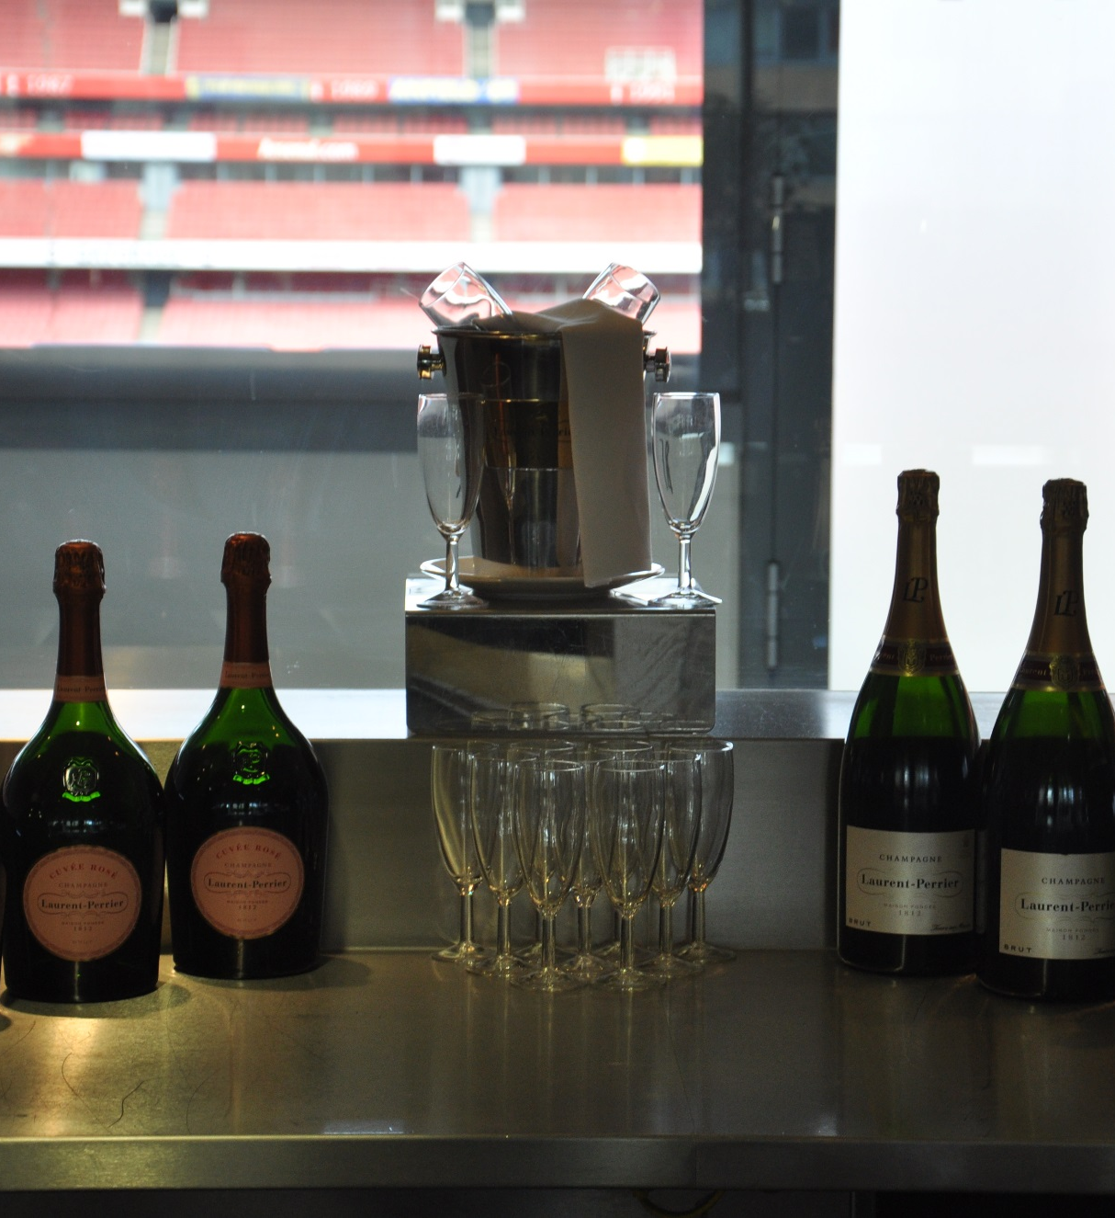
Current Drink Drive Limits
In England, Wales and Northern Ireland, the legal alcohol limit for drivers is:
35 microgrammes of alcohol per 100 millilitres of breath
80 milligrammes of alcohol in 100 millilitres of blood
107 milligrammes of alcohol per 100 millilitres of urine
In Scotland (from 5 December 2014) the legal alcohol limit for drivers is lower at:
22 microgrammes of alcohol per 100 millilitres of breath
50 milligrammes of alcohol in 100 millilitres of blood
67 milligrammes of alcohol per 100 millilitres of urine.
Limits for rail, maritime and aviation differ.

Slide 5

Current Position - Offences
Under the 1988 Road Traffic Act
If a person—
(a)drives or attempts to drive a motor vehicle on a road or other public place, or
(b)is in charge of a motor vehicle on a road or other public place,
after consuming so much alcohol that the proportion of it in his breath, blood or urine exceeds the prescribed limit he is guilty of an offence.
The penalty for this may include
6 months’ imprisonment
an unlimited fine
a driving ban for at least 1 year (3 years if convicted twice in 10 years)
Other linked offences include:
being drunk in charge of a vehicle and failing to provide when asked for a specimen of blood, breath or urine.
Specific additional measures are applicable to individuals classed as High Risk Offenders
Notes:
Offences
Being in charge of a vehicle while above the legal limit or unfit through drink
You may get:
3 months’ imprisonment
up to £2,500 fine
a possible driving ban
Driving or attempting to drive while above the legal limit or unfit through drink
You may get:
6 months’ imprisonment
an unlimited fine
a driving ban for at least 1 year (3 years if convicted twice in 10 years)
Refusing to provide a specimen of breath, blood or urine for analysis
You may get:
6 months’ imprisonment
an unlimited fine
a ban from driving for at least 1 year
Causing death by careless driving when under the influence of drink
You may get:
14 years’ imprisonment
an unlimited fine
a ban from driving for at least 2 years
an extended driving test before your licence is returned

Slide 6
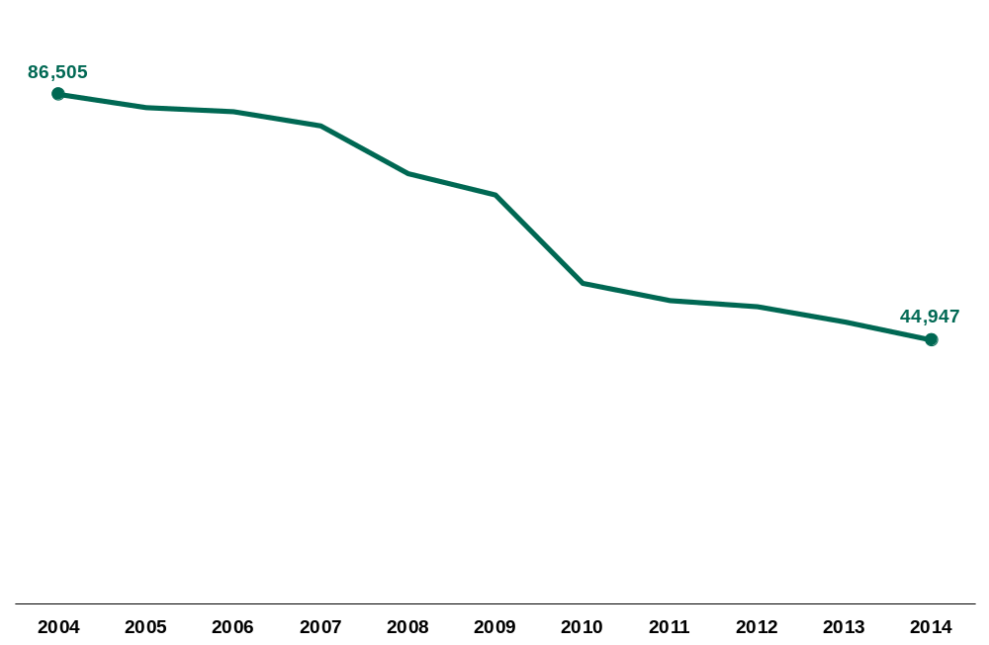
Findings of guilt for offences relating to drink driving: England and Wales, 2004-2014
Source: MoJ "Criminal justice system statistics quarterly: December 2014" and associated "Motoring data tool"

Slide 7
High Risk Offenders – DVLA Medical Examination Regime
High Risk Offenders are drivers who are:
convicted of 2 drink driving offences within 10 years;
convicted of driving with an alcohol reading of at least 87.5 microgrammes of alcohol per 100 millilitres of breath, 200 milligrammes of alcohol per 100 millilitres of blood, or 267.5 milligrammes of alcohol per 100 millilitres of urine
convicted for refusing to give the police a sample of breath, blood or urine to test for alcohol.
Refused to allow a sample of blood to be tested for alcohol (e.g. if blood taken while unconscious).
High Risk Offenders need to undergo a medical examination by a DVLA appointed doctor before they can reapply for their licence. This includes
filling in a medical questionnaire about alcohol consumption
a physical examination
a urine test, and
blood tests.
Licences are not returned if the examination finds evidence of
persistent alcohol misuse within the past six months or dependence within the past 12 months, or
current misuse or dependence.

Slide 8


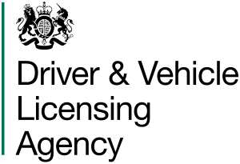




Education and Enforcement - Sharing Best Practice
Effectively tackling drink driving is a joined up matter and involves a lot of different participants all with a shared aspiration.
Department for Transport – Policy development and legislation
  Driver and Vehicle Licensing Agency –Managing High Risk Offenders
  Driving and Vehicle Standards Agency – Leading on rehabilitation of offenders with those companies who deliver training.
Home Office – Development and Type Approval of new technology
THINK – 50 years of excellent campaigns
Police and Courts – Enforcement and Education
Local Authorities – Taking forward local campaigns and activities

Slide 9
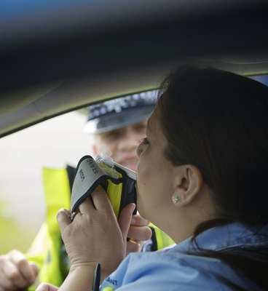
Enforcement – Making it Easier
Legislative Changes
The 2015 De-Regulation Act contained provisions to make it easier to enforce drink driving. http://www.legislation.gov.uk/ukpga/2015/20/schedule/11/enacted
This removed the so called “Statutory Option” which entitled:
  ‘a suspected drink driver to have their breath specimen replaced by a specimen of either blood or urine, provided that the lower of the two breath specimens contains no more than 50 micrograms of alcohol per 100 millilitres of blood’
Previously delays could occur in obtaining an evidential specimen when the suspected drink driver exercised this entitlement, allowing them to ‘sober up’ and evade conviction.
The Act also expanded the role and remit of registered healthcare professionals allowing them to take blood in a wider range of circumstances.
Technology
The Home Office Centre for Applied Science and Technology (CAST) is in the process of Type Approving new Mobile Evidential Breath Testing Instruments which will allow evidential breath specimens to be taken at the roadside.

Slide 10
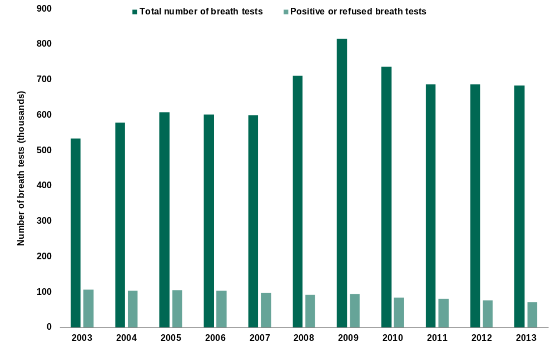
Number of breath tests and number positive or refused, carried out by
police in England and Wales, 2003 to 2013
Source: Home Office "Police powers and procedures England and Wales year ending 31 March 2014"

Slide 11

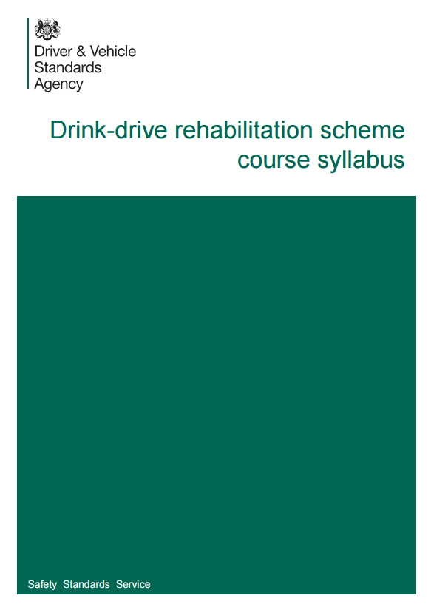
Education - Drink Drive Rehabilitation Courses
Individuals convicted of drink driving may be offered a drink drive rehabilitation course.
Currently there are 17 course providers who have been approved by DVSA to deliver an approved drink- drive rehabilitation course in England and Scotland. The Welsh Government operate their own drink drive rehabilitation scheme and currently have 3 course providers approved to deliver the course in Wales.
The drink-drive rehabilitation course can be offered to people convicted of driving or being in charge of a motor vehicle with excess alcohol in their breath, blood or urine or of failing to provide a specimen.
A magistrate can decide to offer a chance to take a drink-drive rehabilitation course if an offender is:
  Found guilty of a drink-drive offence
  Given a ban of 12 months or more
This includes the following offences:
  Driving or being in charge of a motor vehicle with excess alcohol in your breath, blood or urine
  Failing to provide a specimen
https://www.gov.uk/government/publications/drink-drive-rehabilitation-syllabus
Notes:
A magistrate can decide to offer a chance to take a drink-drive rehabilitation course if an offender is:
Found guilty of a drink-drive offence
Given a ban of 12 months or more
This includes the following offences:
Driving or being in charge of a motor vehicle with excess alcohol in your breath, blood or urine
Failing to provide a specimen
Benefits
An offender can find a course that they wish to attend (Information on GOV.UK ‘Find your nearest drink-drive rehabilitation scheme course’), prior to their appearance in Court or on the day of the hearing. The course can cost up to a maximum of £250.
If an offender satisfactorily completes a drink drive course, they can expect;
A reduction of up-to 25% off the length of their ban
Education in understanding the impact of alcohol use in relation to driving to help an offender to change their behavior so ultimately they don’t reoffend.
What to expect?
The course is;
face-to-face
takes place over 16 hours (usually run on 3 sessions spread over 3 weeks)
will have other drink-drive offenders

Slide 12

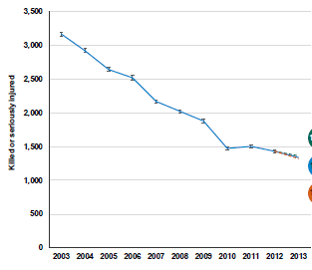
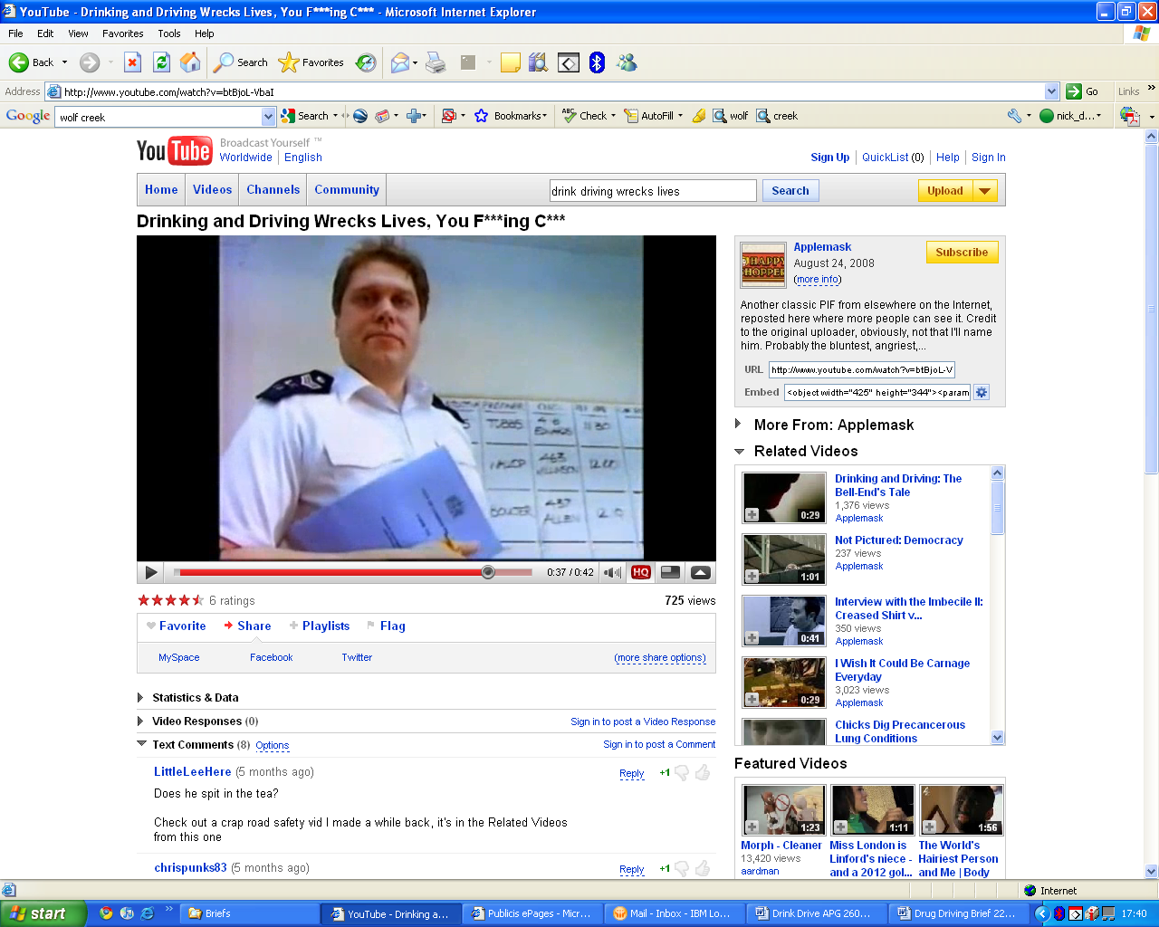
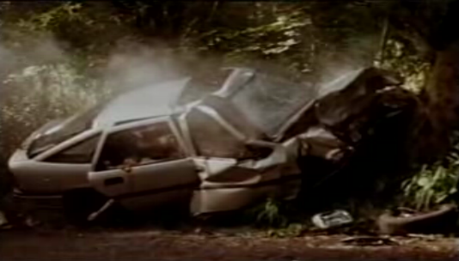
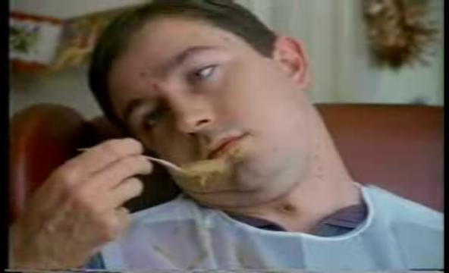
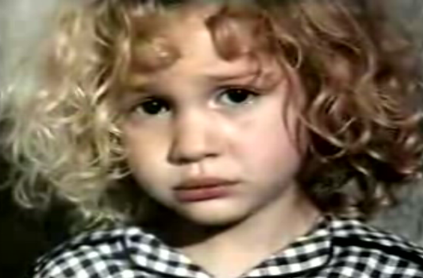
Education – THINK campaigns
The DfT’s THINK campaign has played a key role in changing attitudes and making drink driving increasingly become a taboo behaviour
In 30 years, the campaign is estimated to have saved 2,000 lives and prevented 10,000 serious injuries
Killed or seriously injured casualties in reported drink drive accidents: GB 2003 to 2013
Notes:
Years of ads showing the deadly consequences of drink driving successfully set new norms, making it socially unacceptable to drink drive and helped to reduce the prevalence of drink driving
In 30 years, the campaign is estimated to have saved 2,000 lives and prevented 10,000 serious injuries, creating a value of £3bn to society. We have been able to identify this through econometric analysis.
If asked:
Econometric paper is on: Gov.uk https://www.gov.uk/government/publications/drink-drive-30-years-of-communication
Stats from: Reported road casualties in Great Britain: Estimates for accidents involving illegal alcohol levels: 2013
THINK! Road Safety Biennial Survey 2015
I think this sums up the main approaches the UK has taken to tackling drinking and driving. It’s 50 years since we first ran a drink drive campaign, so I’d like to leave you with our latest. Thank you

