Slide 1
Drinking and driving in Switzerland
SMART, 21st of March 2016, Warsaw
Uwe P. Ewert, PhD MPH, Researcher
u.ewert@bfu.ch – www.bfu.ch

Slide 2
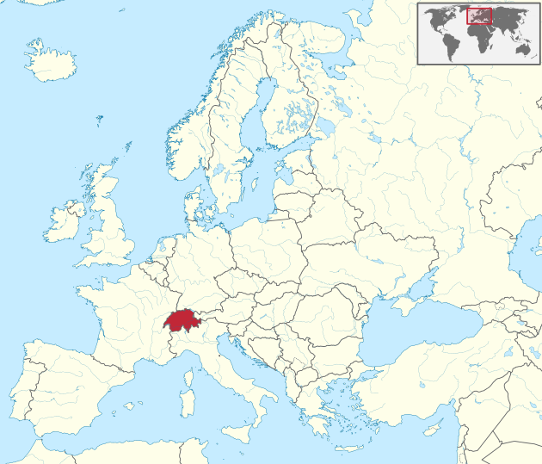
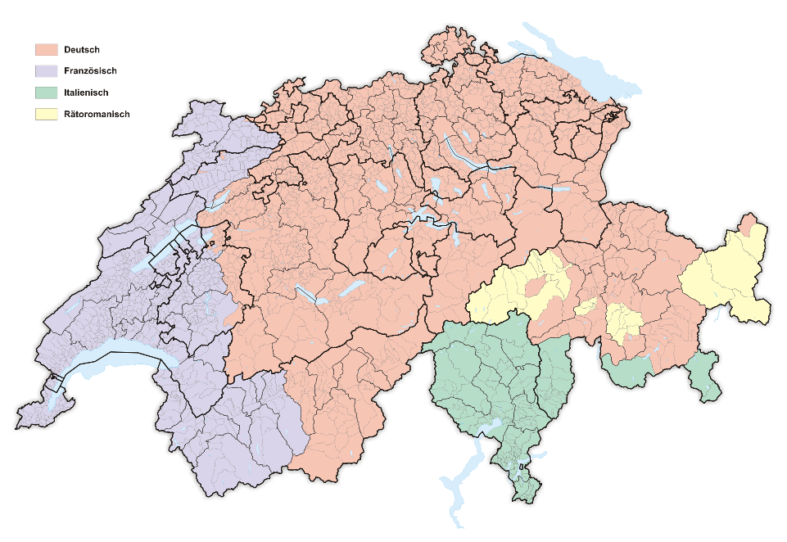
Switzerland
Small country in the middle of Europe
8.3 million inhabitants
4 different languages/cultures
German-speaking 64%
French-speaking 20%
Italian-speaking 6%
Romansh-speaking 0.5%

Slide 3
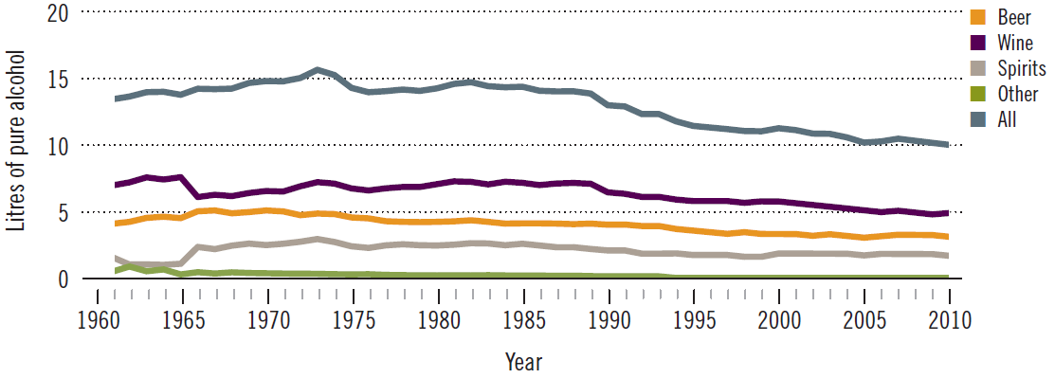
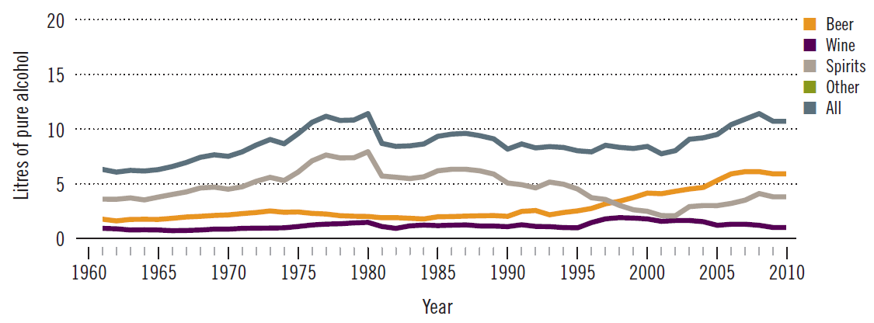
Drinking in Switzerland
Drinking is decreasing: 15 liters of pure alcohol in the 1970’s;
9.5 liters in 2014 (per inhabitant age 15 and older)

Slide 4
Different drinking patterns in the language regions

Slide 5
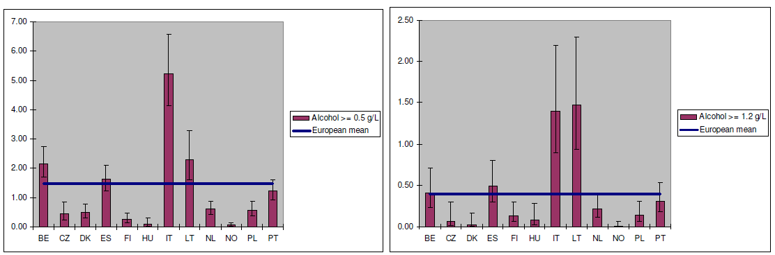
Frequency of drinking and driving
As of today - no national roadside survey was conducted
In french-speaking Switzerland: 4.7% of drivers checked had some alcohol
Of these
- 1.3% at 0.8‰ or higher
- 3.4% below 0.5‰
DRUID

Slide 6
Drinking and driving: police enforcement
Percentage of drivers controlled for alcohol within the last year

Slide 7
Drinking and Driving: judicial enforcement
Number of drivers prosecuted because of drunk driving
(0.8 ‰ and more) over time
punishment:
fine or up to
3 years in
prison

Slide 8
Drinking and Driving: judicial enforcement
Number of drivers prosecuted because of drunk driving
(0.8 ‰ and more) over time
punishment:
fine or up to
3 years in
prison

Slide 9
Drinking and driving: administrative enforcement
Number of license withdrawals:

Slide 10
Drinking and driving: administrative enforcement
Percentage of license withdrawals:

Slide 11
Drinking and driving: administrative enforcement
Percentage of license withdrawals because of alcohol by region:

Slide 12
Number of persons injured in alcohol crashes

Slide 13
Number of persons injured in alcohol crashes

Slide 14
Number of persons injured in alcohol crashes

Slide 15
Percent of persons injured in alcohol crashes

Slide 16
Decrease of alcohol-related fatalities from 21% to 10% since
1992
Decrease of alcohol-related severe injuries from 13% to 11%
Two remarkable decreases in the fatalities beyond trend
2004 to 2006
2012 to 2014
What has happened?

Slide 17
Percent of persons injured in alcohol crashes

Slide 18
What has happenend from 2004 to 2006?
1st of January 2005: lowering of the maximum BAC
from 0.8 to 0.5 ‰
1st of January 2005: random breath testing allowed
(previously only on suspicion)
1st of January 2005: Cascade system for license withdrawal
in case of repeated violations
- depending on severity and frequency of violations

Slide 19
Cascade system for license withdrawal
Number of violation | Severity of previous violations | Minumum length of licence withdrawal
 |  | minor | medium | severe
First | - | warning | 1 month | 3 months
Second | 1 medium | 1 month | 4 months | 6 months
Third | 2 medium | 1 month | 9 months | 9 months
 | 2 severe | 1 month | 15 months | Undefined (at least 2 years)
Fourth | 3 medium | 1 month | Undefined (at least 2 years) | Forever (at least 10 years)

Slide 20
Percent of persons injured in alcohol crashes

Slide 21

What has happenend from 2013 to 2014?
1st of January 2014: 0.1 ‰ BAC for learner license owners

Slide 22
Summary
Police enforcement of alcohol has increased by a factor of 3 since the year 2000
Legislation on alcohol has changed (0.5‰, random breath testing allowed, cascade system of license withdrawal,
0.1 ‰ for young drivers)
Decreases in punishment, license withdrawals and road fatalities

Slide 23
Criticism
Cascade system of license withdrawal is probably too difficult for all drivers to understand.
Maybe change to a penalty point system?
Differentiation between punishment and administrative measures is not understood well.
License withdrawal is often regarded as the severest punishment.

Slide 24
