Slide 1

10 steps to designing an intervention to change road user behavious
Dr Fiona Fylan
Health Psychologist
Brainbox Research

Slide 2


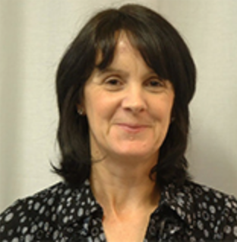

Rarely an individual effort
Dr Fiona Fylan
Dr Cris Burgess
Dr Helen Scott
Professor Steve Stradling

Slide 3


Slide 4
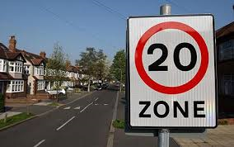
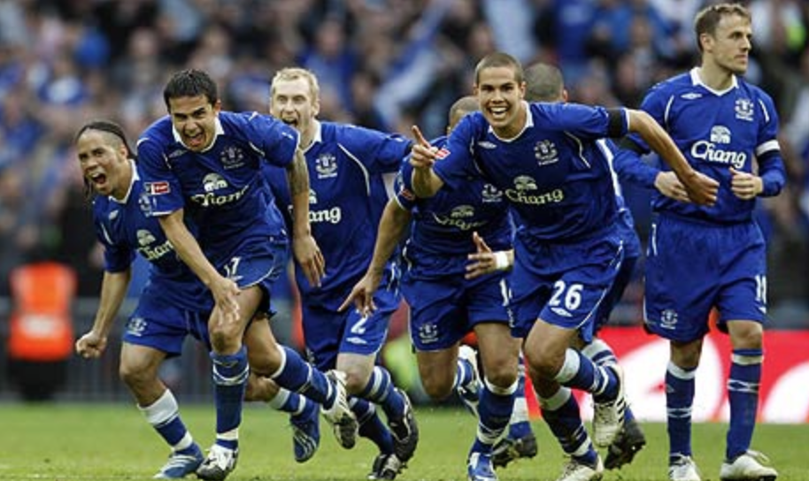
Step 1
Identify the target behaviours
Notes:
Reduce the number of people speeding through 20mph zones. Or score more goals. Not the aim, which might be to reduce road casualties. What is the exact behaviour you want people to do differently.

Slide 5

Step 2
Review the literature
Notes:
Academic literature, sector reports.

Slide 6
Generic and specific predictors
Notes:
We can look at behavioural factors in more detail. When we try to unpick how a person is behaving in the roads we need to consider four different elements: what they perceive; what they think; how they feel; and any barriers to them behaving in the way they intend to.

Slide 7
Perceptions
There are limits to what the human sensory system can perceive.
Sensation vs perception.
The effects of state, e.g. fatigue, drugs.
Often called human factors.

Slide 8
Perception: age or experience?
Increased crash risk in young novice drivers thought to be partly due to less ability to perceive hazards.
Is the effect youth or inexperience?
Novice drivers don’t anticipate or notice hazards as well as experienced drivers.
Experienced drivers use more of the visual field.
Older adults have different problems with perception.
Notes:
When it comes to hazard perception then it’s probably experience.
Novice drivers not as good as fixating hazards, e.g. Crundall et al. (2009), Pradhan et al (2005). Novice drivers are particularly poor at fixating pre-cursors to hazards, e.g. a pedestrian stood at the side of the road before they step out.
Experienced drivers use more of the visual field. Some interesting differences in age – older drivers also use less.

Slide 9
Cognitions
Beliefs (plus assessment of good/bad) form attitudes.
Behavioural interventions often focus on beliefs about risks and consequences.
Beliefs aren’t always accurate:
  Two ways of thinking.
  Cognitive biases.
Notes:
Cognitions are simply thoughts. Thoughts underpin beliefs. Beliefs, plus an evaluation as good/bad etc form attitudes.

Slide 10

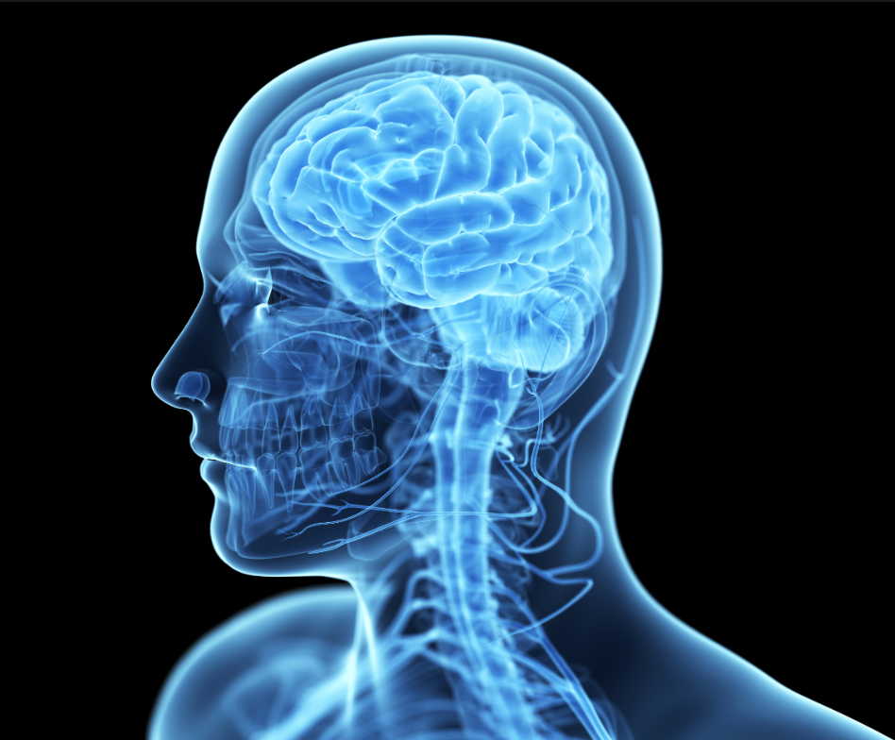
Two paths to behaviour
Slow: reflective, logical
Fast: intuitive, emotional

Slide 11

17 x 24 =
2 x 2 =
Notes:
We find it automatic to know what this expression is.
We don’t automatically know what 17 x 24 is (408)
We do automatically know what 2x2 is – we don’t calculate it, we just know it. We can’t stop ourselves from knowing it.

Slide 12
The fast intuitive system
Automatic
No effort required
Good at simple tasks, e.g.
  Make a “disgusted” face.
  Answer “what is the capital of England?”
  Drive a car down an empty road (experienced drivers).
  Detect that one object in a picture is further away than another.

Slide 13
The slow reflective system
Needs attention
Effortful
You apply this system for complex tasks, e.g.
  Look for a man with a blue tie in a crowd.
  Compare the specifications of two laptops.
  Search your memory for a specific event.
  Park your car in a very tight parking space.

Slide 14
Problem
The slow system is very very lazy.
The fast system steps in first.
The fast system often delivers an answer for complicated tasks that are wrong.
You don’t realise it’s wrong.

Slide 15

Example
Bed and breakfast costs €110
The bed costs €100 more than the breakfast
How much does the breakfast cost?
Notes:
What does your intuition tell you?
You really want to say the breakfast costs £10 – but this would mean that the room costs £110, and the whole thing costs £120. The right answer is £5 (£5+ £105 = £110)
But we really really want to say the “easy” system 1 answer.
We have to over-ride it and think hard about the question. A lot of the time we can’t be bothered.

Slide 16
You don’t realise it’s wrong
You often SUBSTITUTE a difficult question for an easier one that the fast system can answer.
  Should the EU limit immigration?
  How likely are you to get a job?
  How happy are you with your life?
  What mood are you in right now?
  How should people convicted of animal cruelty be sentenced?
  How angry do you feel when you think of animal cruelty?

Slide 17
Why driving?
The fast system takes over.
Questions such as “How safe is this situation?” are answered by:
  Did I get away with it last time?
  How much do I want to get through the lights?
  How important is this call?
  How embarrassed would I feel in front of my colleagues if I slow down?
  How much am I enjoying this right now?

Slide 18
Biases in how people think

Slide 19
Self-enhancement bias
“I’d never do something as stupid as that!”
Notes:
This is a type of bias in the way that we think. It’s a tendency to think that we are better than other people. So it’s like the opposite of an inferiority complex.
How does this happen?
When we compare ourselves with other people we pay more attention to things that show us in a positive light and disregard things that we are perhaps less good at.
We are also very good at forgetting about things that didn’t go so well and we’re much better at remembering things that we did very well.
This is the case for our everyday lives and also for our driving. We tend to forgive and forget the things that we do wrong – pulling away in the wrong gear and stalling, getting in the wrong lane at a roundabout, sneaking through a traffic light that is more red than orange, not noticing we’ve slowed down and so speeding up when another driver overtakes us. But we notice when other people do these things and we don’t normally say good things about these other drivers.
The result? Because we concentrate on things that we do well, when we see other people doing something daft or dangerous we think that we’re much better than them – that we’d never do something as stupid as that. We become big headed and we feel immune to bad things happening to us – artificially safe.

Slide 20
Optimistic bias
“I can take chances and I’ll be ok.”
Notes:
We never really believe that something bad will happen to us.
We dismiss the facts and think that we will be ok.
Car crashes only happen to other people.
We can take chances and we’ll be ok.
And if we think that everybody else is an idiot and we’re good then we can take a few more chances than other people, or break a few more rules because we’re not as bad as other people.

Slide 21
What’s Worked bias
Notes:
What’s Worked (also called Heuristics) is all about the rules that we use to make decisions.
In our day-to-day lives we make lots of decisions – which shop to go to, which route to take, what brand to buy. We often don’t spend time weighing up the advantages and disadvantages of every option. We tend to go by what has worked well for us in the past.
We call these “rules of thumb” or “common sense.”
You can do some stupid things on the road and get away unscathed if other drivers are able to guess what you’re going to do and take action to avoid crashing.
If you get away with it you think you’re safe.
This is also the case when we’re driving. We go by what’s worked for us in the past. Sometimes this is about what rules we can break – whether we can overtake on solid white lines, or nip through a red traffic light or deliberately choose a lane that is moving faster than the one we are supposed to be in.
If we got away with it – we got past that slow car, or we got through the traffic light without causing a crash – then we remember this as something as worked for us and we’re more likely to do it again
The trouble is we sometimes get away with it because other drivers are able to compensate for us. They guess what we’re going to do, perhaps slow down, or just keep out of the way.
And this makes us think it’s safe, and it starts to become normal behaviour.

Slide 22
In-group, out-group bias
When you identify with a group you think you and your group are different from other groups.
People in my group are better than those in other groups.
People in other groups are all the same.
You are more pro-social to people in your group.
Notes:
Examples are sports fans.
People in my group are better
People in other groups are all the same – homogeneity effect.

Slide 23
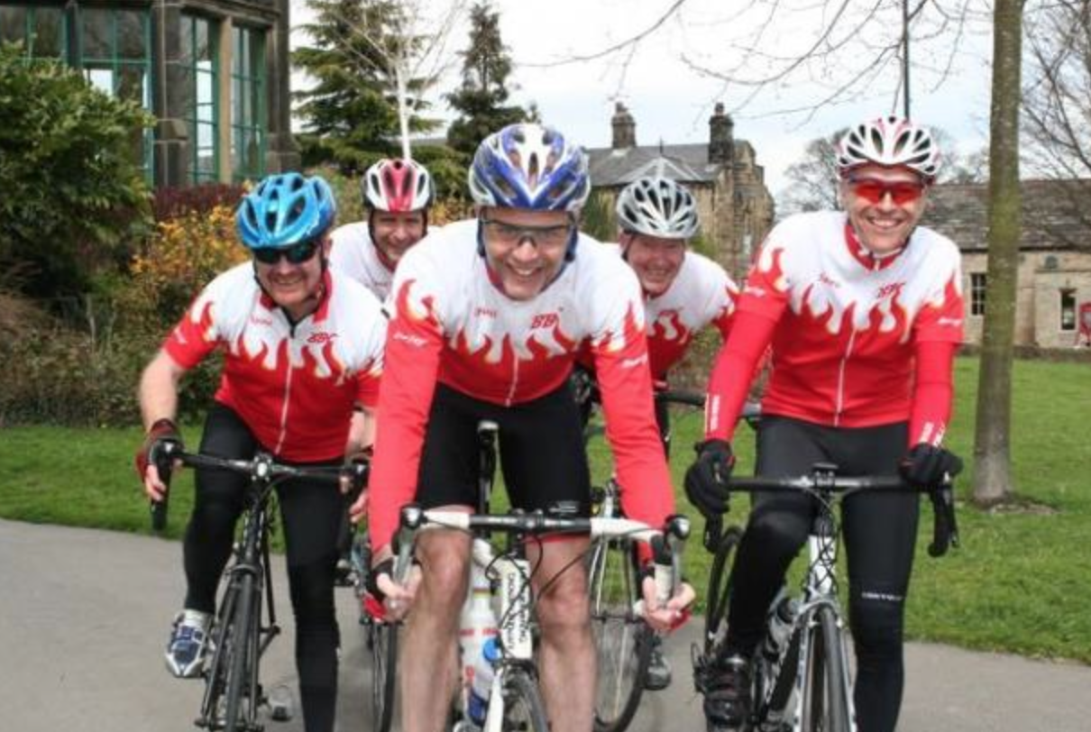
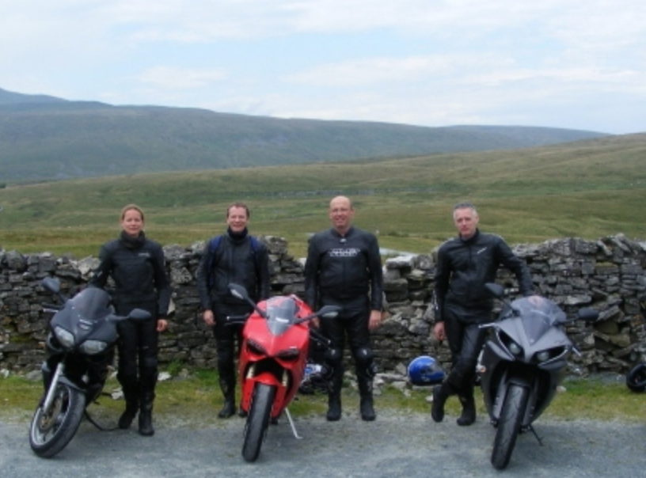
Self-identity
Notes:
Simply putting on lycra or leathers can change your self-identity as a member of a group, which means that the in-group, out-group bias is activated.

Slide 24
Emotions
Increasing evidence that how you feel influences your behaviour directly – not just through intentions.
Feeling “giddy”, angry and pressured are all dangerous emotions for road users.

Slide 25
Personality and emotions
People high in sensation seeking and extroversion take more risks and are more crash-involved.
There is new research that highlights the effect of impulsivity on risk taking and crash involvement.

Slide 26
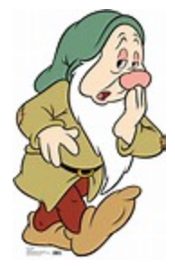
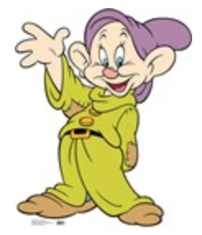
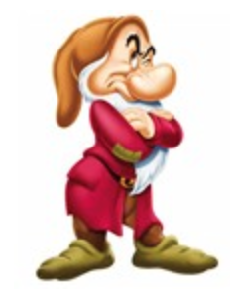
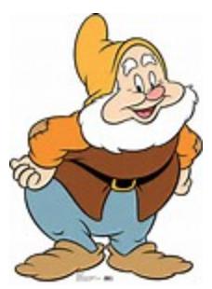
Step 3
Identify any population sub-groups
Notes:
Are all people the same? Are there any barriers or motivations that are different? Will they need different skills, e.g. strikers vs midfielders?

Slide 27
Step 4
Define the theoretical model: dual process/prototype willingness
Driver responsibility
Norms
Barriers
Risks
Attitudes
Intention
Behaviour
Consequences
Skills
Self-identity
Emotions

Slide 28
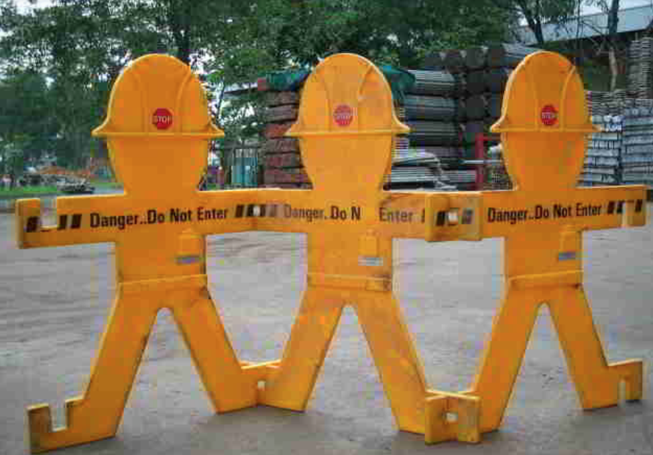
Step 5
Understand any barriers to change
Notes:
Understand barriers to change – what are they and how can they be overcome?

Slide 29
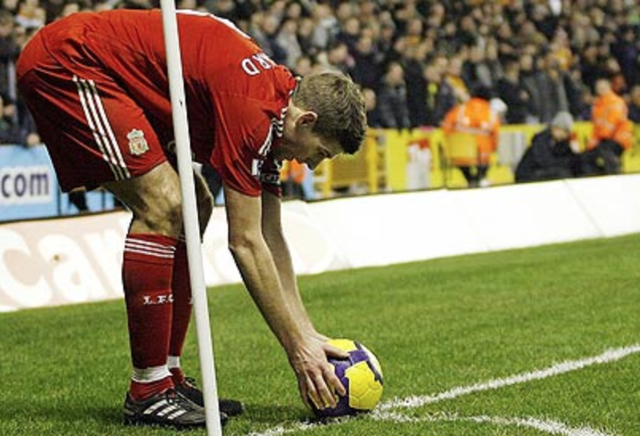
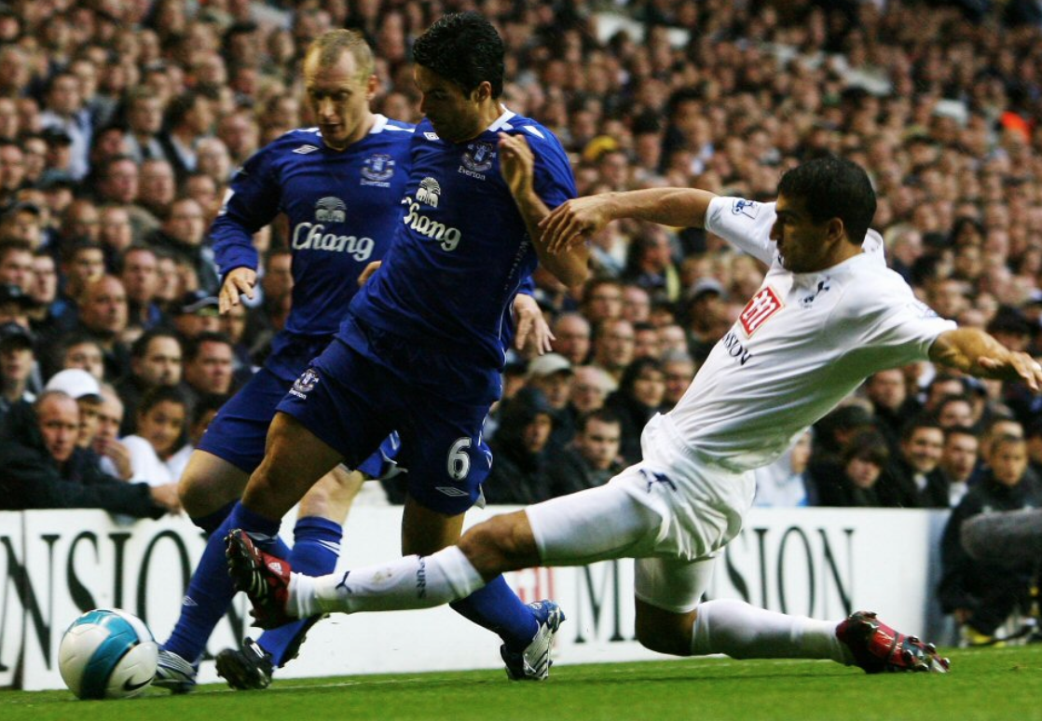
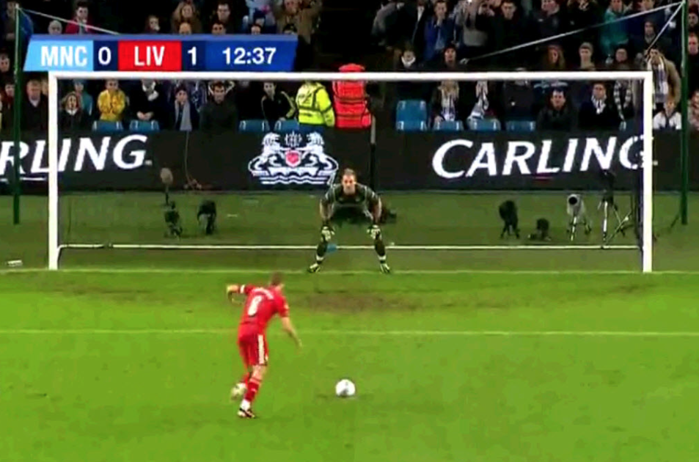
Step 6
Develop the intervention objectives
Notes:
Not enough just to say we’re going to score more goals. How exactly. Improve set pieces? Get better at tackling? Improve penalty taking skills?
In NDORS courses this might be to increase skills in identifying the speed limit, increase negative beliefs about speeding.

Slide 30
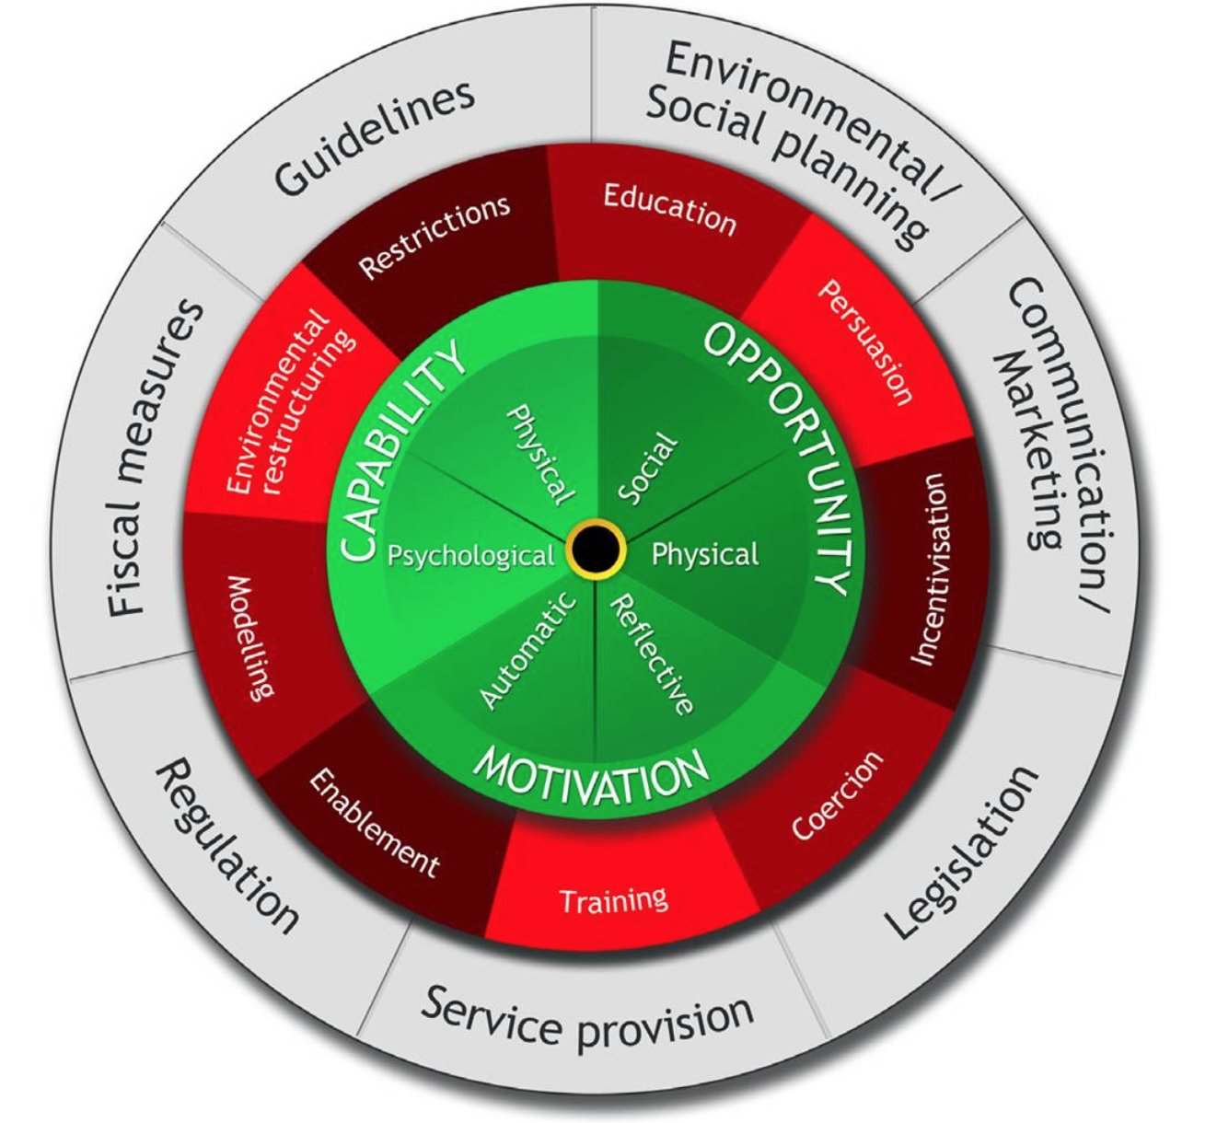
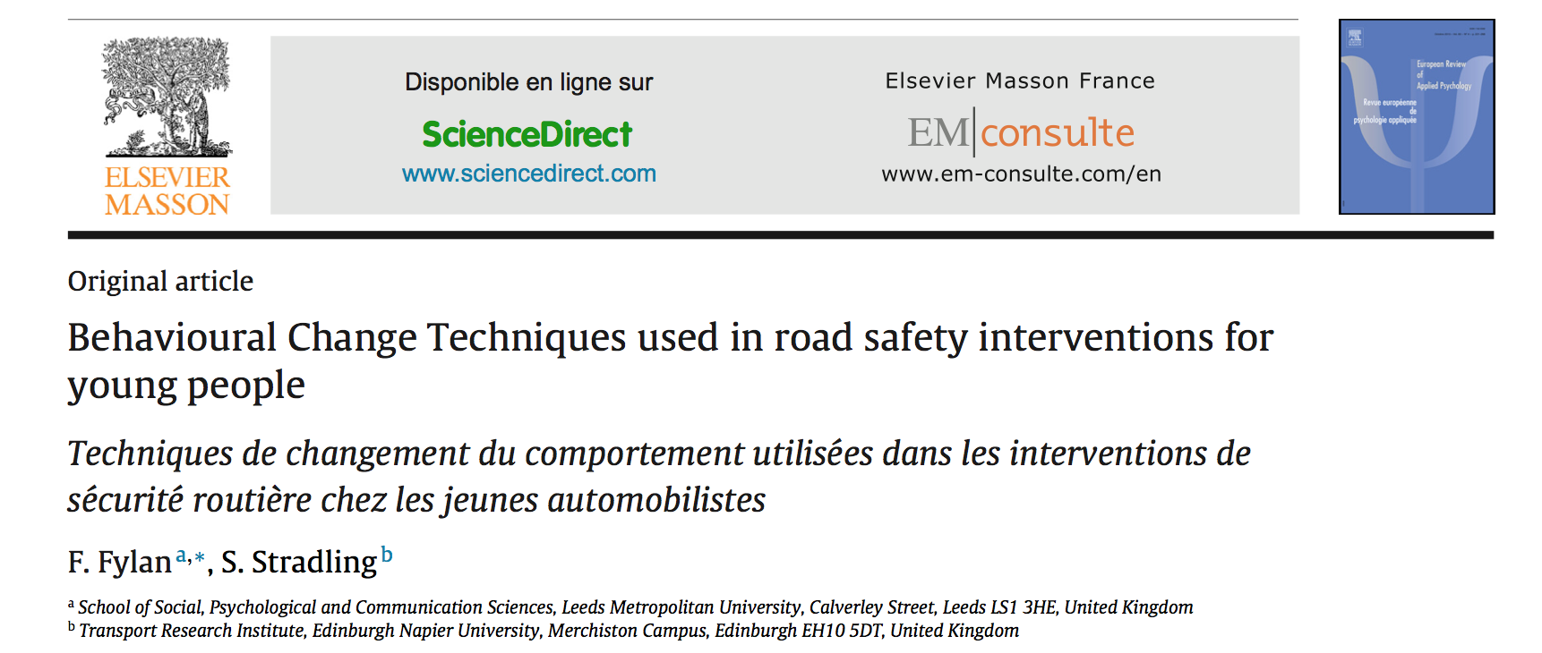
Step 7
Select the BCTs

Slide 31
27 Driver BCTs (Fylan and Stradling)

Slide 32
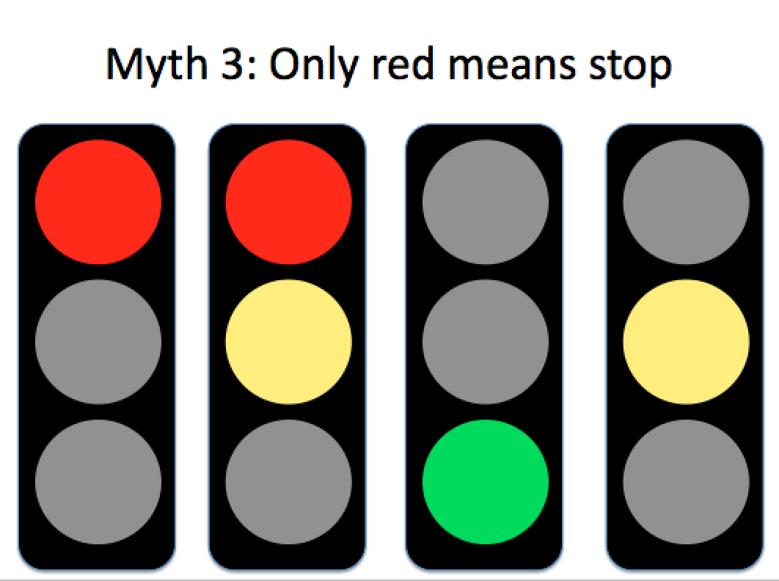
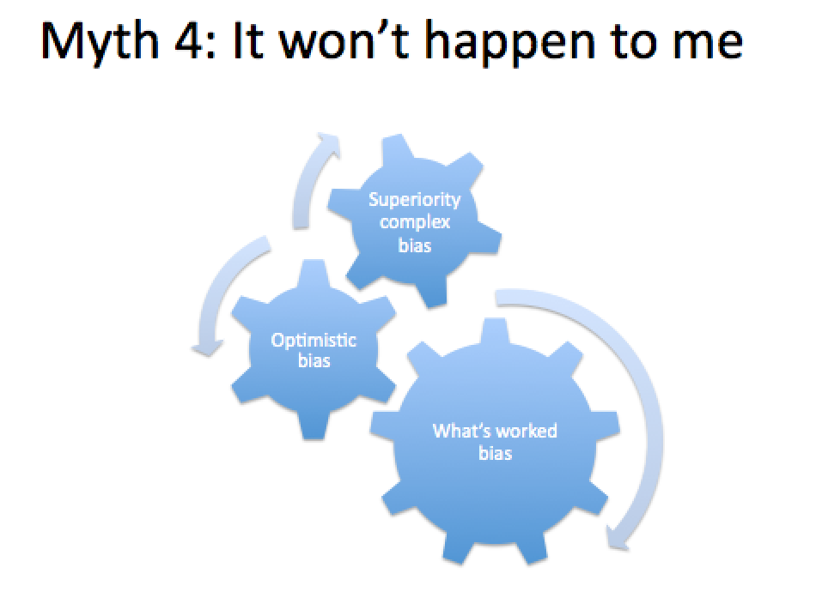
Step 8
Develop the intervention content

Slide 33
Step 9
Map the intervention

Slide 34

Step 10
Pilot and evaluate

Slide 35
10 Steps
Identify the target behaviours
Review the literature
Identify any population sub-groups
Define the theoretical model
Understand any barriers to change
Develop the intervention objectives
Select the BCTs
Develop the intervention content
Map the intervention
Pilot and evaluate
Notes:
Steps in the same colour are iterative.

Slide 36
Four key design principles
Notes:
Easy – Make it default, reduce the hassle factor, simplify messages, try to make it automatic (e.g. smaller plates mean smaller portions).
Attractive - Attract attention by making beliefs seem more relevant to us personally – more salient. Build in rewards and punishments.
Social - Most people do this – social norms and ideally find a peer champion. Get people to make a commitment to others.
Timely – people most likely to change at times of transition. Have immediate costs and benefits, people are especially sensitive to short-term losses. Get people to make an implementation intention and identify and overcome barriers.

Slide 37
Example: NSAC20
Step 1
Short-life NDORS course to reduce speeding in 20mph areas.

Slide 38
Recent research
Step 2
Drivers overestimate how often others violate road rules (Warner and Aberg, 2014).
Interaction between mood and passengers where happy mood plus passengers means faster speeds (Rhodes et al., 2015).
People who are angered while driving speed up (Roidl et al., 2014).
After stopping at traffic lights in low-speed areas drivers can resume at a higher speed unless they are reminded of the limit (Gregory et al., 2014).
Implementation intentions reduce speeding in unintentional speeders (Elliott et al., 2014).

Slide 39
Subgroups
Step 3
Four types of speeding drivers.
Three types of 20mph drivers: champions; pragmatists; and opponents. Media campaigns could promote champions’ norms. (Toy et al., 2014).
Intentional and unintentional speeders need different messages.
Pragmatists and opponents need different messages.

Slide 40
Theoretical model
Step 4
No evidence that the dual process model is inappropriate.
Where intentions to comply are high, a prototype willingness model is useful.

Slide 41
Barriers
Step 5
Intentional and unintentional speeders have different barriers.
Difficulties identifying the speed limit.
Difficulties in controlling the vehicle’s speed.
Positive beliefs about speeding.
Moral norms that don’t preclude speeding.

Slide 42
Objectives
Step 6
More negative, less positive beliefs about speeding.
Increase skills in identifying speed limits.
Recognise personal responsibility for speed choice and its impact on others.

Slide 43
Select the BCTs
Step 7
27 BCTs in 9 different groups.
E.g. information about risk, demonstrating, forming specific intentions, identifying and overcoming barriers.
Select the most appropriate for the course objectives and the delivery method.

Slide 44
Intervention content
Step 8
Provide skills in scanning the environment to help identify the speed limit and detect hazards.
Challenge descriptive norms (perceptions of what other drivers do).
Use risk perception and moral norms (it’s wrong to speed).
Explore situations in which people might be willing to break road rules.
Target emotions.
Target self-efficacy.
Include implementation intentions.

Slide 45
Map the intervention
Step 9
Review each component/slide against the BCT it’s using:
  Is the BCT appropriate?
  Is there a sufficient range of BCTs?
Review each component/slide against the objectives
  Does the content address each of the objectives?
  Is there a good balance of material?
Do the objectives address the target behaviours?
  Are all behaviours addressed?
  Is the balance of objectives appropriate?

Slide 46
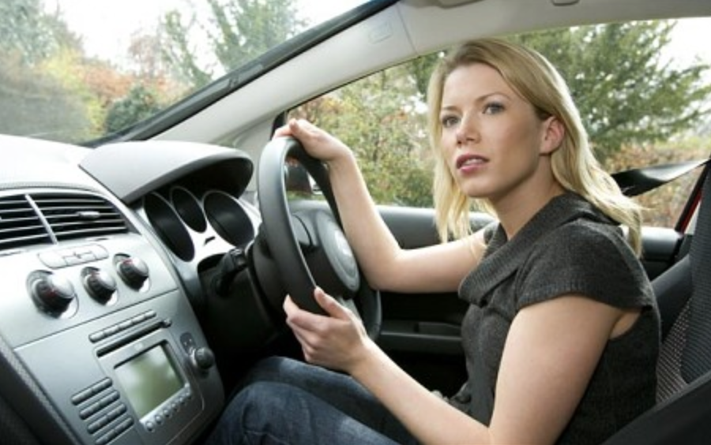
The NSAC20 evaluation
Step 10
Does the course meet its objectives?
Is the course more or less effective for any population sub-groups?
Should the course continue or should it be subsumed into NSAC?

Slide 47
What do we know?
NSAC20 successfully:
  Increases negative beliefs and decreases positive beliefs about speeding;
  Increases skills in identifying speed limits and confidence in being able to drive within the limit;
  Strengthens moral norms about speeding, although it does not affect descriptive norms.
Leads to a decrease in self-reported speeding in 20mph areas, particularly for males.

Slide 48
And finally
Review the intervention:
  What isn’t working as expected?
  What is working?
  Why? – qualitative research.
Revise the intervention:
  Should it continue?
  Based on the research, do the objectives need to change?
  Does the content need to change?
  Strengthen any weak areas.
  Ensure fidelity of delivery
Notes:
Qual research should involve trainers.

Slide 49
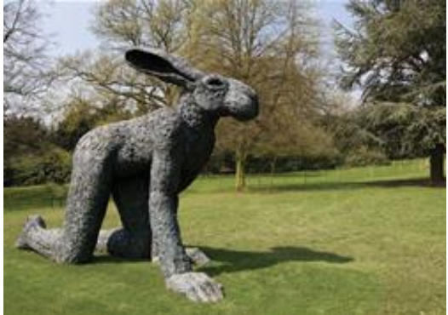
Thank you
0113 238 0157
hello@brainboxresearch.com
www.brainboxresearch.com

