Slide 1






Young Europeans Acting for Road Safety
24- 28 October 2016
Brussels

Slide 2
Young Europeans Acting for Road Safety
24 October 2016, Brussels
Francesca Podda, Project Manager

Slide 3
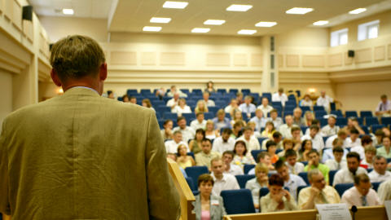
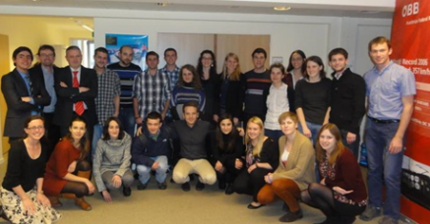
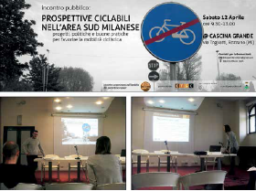
Steps of the YEARS project
Students apply in pair to take part
Camp: students with the best project ideas attend a 1 week training in an EU capital to improve their ideas with experts
Challenge: students carry a safety activity with the support of ETSC and its partners
Award Ceremony in Brussels
Notes:
But let’s remind ourselves of the fatality figures.

Slide 4
















YEARS Lectures
A Lecture tour across universities: 20 lectures in selected universities across Europe to motivate students (engineering but not only) to take action and come up with ideas for local road safety projects targeting young road users.

Slide 5
YEARS students selection
Site already identified with solution proposal
Strong motivation
Strategy in place
IMPORTANT:
By attending the YEARS Camp you get a compromise on trying to implement your project.
Notes:
I will track your progress along the year.

Slide 6

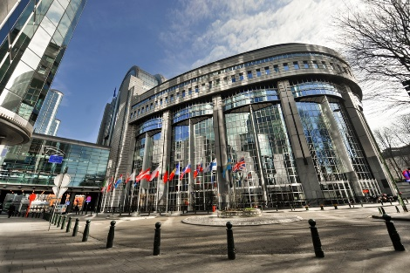
YEARS CAMP:amp Agenda
Lectures:
Road Safety Engineering
Road Safety Campaigning
Group exercises
Other activities:
EU Institutions: Parliament visit
Guided cycling tour

Slide 7
YEARS CAMP objectives:amp
Conclusions
Improve technical knowledge on road safety infrastructure
Learn how to run a communication campaign, involving media and public authorities
Have a more structured idea on the project you’re going to manage
Go back to your country even more motivated to start your campaign

Slide 8

Few rules…
Be punctual
Listen carefully to the lecturers presentations
Interaction
After the Camp...
Report every single progress you make during your campaing

Slide 9

YEARS Project Schedule:
By 31 March 2017 :progress report
By 31 June 2017 : second progress report
Between September and October 2017 ETSC will organize mid-term visits to your high risk site to monitor the progress of your campaign
By end of 2017: final report including what you have done and what you plan to do in the short future if the site is not totally treated.
Notes:
9

Slide 10

The YEARS Jury
The Jury is composed of experts, including the Camp lecturers and ETSC (staff and members).
The Jury will evaluate the final reports of 11 groups of finalists and they will decide the winners.
Notes:
10

Slide 11
Towards the final assessment...
Presentation guidelines:
Introduction and context:
Description of your high risk site
Main safety issues
2. Solution proposal A
3. Solution proposal B
4. Campaign to implement your site:
    Timeline expected
    Strategy adopted
    Evaluation of the results
5. Possible Difficulties
Notes:
11

Slide 12
Good luck and…
...enjoy Brussels!

Slide 13
YEARS CAMP: Group exercise
24 October 2016, Brussels

Slide 14
Towards the final assessment...
Draft 3 emails introducing yourselves to:
the local authorities
the university
potential partners (check who can they be and list them)
in order to explain who you are, what your project is about , in which way they can contribute and what you expect from them.
Deadline: Wednesday 26th. Feedback on Thursday 27th.
Notes:
14

