Slide 1
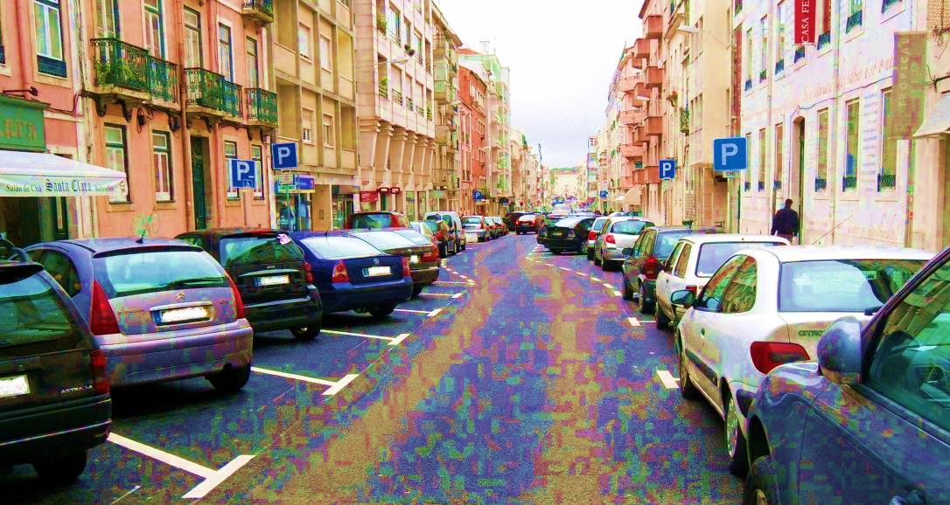


ADYSE Adapt Your Speed to the urban Environment
SHARING MY EXPERIENCE
Joana Nogueira – ISPA
Frederico Henriques - IST
Brussels
October 28TH 2016

Slide 2
contents
The ADYSE project
Steps to design and develop a project
III. Motivational advices

Slide 3
I. The Adyse project
To reduce speed in one particular street in Lisbon
Increase awareness to the issue of road safety in Portugal.
Change road users perception
Reduce speed
Increase road safety (real and perceived)
Notes:
1) Reduction of the speed in one particular street, Rua Coelho da Rocha, in Lisbon
Through the implementation of infrastructure measures, chicanes, created through parking modes reconversion, this project aims at contributing to reduce the actual speed in the street, which in turns will contribute to increasing road users real and perceived safety, in particular, vulnerable road users (pedestrians). The chicane scheme aims at changing drivers’ road perception and lead them to adapt their speed to the urban environment as it avoid excessive speed (Figure 5).
2) Increase awareness to road safety issue in Portugal.
Through the implementation of this local action (one chicane scheme at Coelho da Rocha Street, Lisbon) in the extremely adverse current economic, political and social Portuguese context and with very limited outset resources, ADYSE project aims at that road safety measures can still be successful implemented. This will contribute to slowly change Portuguese institutional culture towards road safety projects and hopefully be a source of inspiration and optimism. Above all, ADYSE project aims at increasing awareness to the importance of road safety actions by reaching out to the greater public through the web, media, distribution of leaflets, presentations and publications and least but not last its value recognition by an European organisation like ETSC.

Slide 4
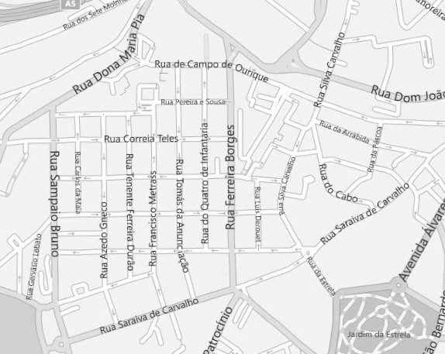
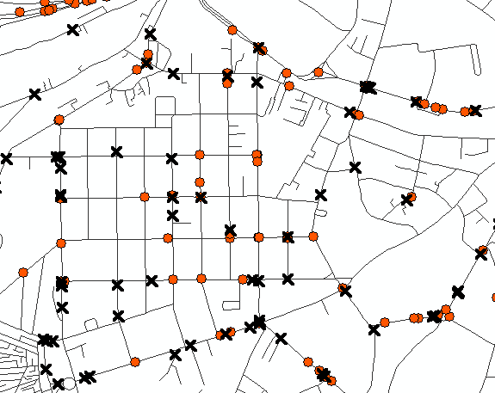
Intervention Site
Accidentology
Urban Characteristics
Collisions (2004-2007)
  Involving vehicles
  Involving pedestrians
Mixed residential and business neighbourhood
Speed limit: 50km/h
One way street belonging to a orthogonal network
There were no pedestrian crosses (except on traffic light)
High travel demand for all the transport modes
High parking pressure
Collision type:
  running over - 3 casualties; 3 slight injuries
Data collected from SACRA research project carried out at IST
Notes:
Below are described some of the main characteristics of the selected street section prior to the ADYSE project:
is one of the entries in Campo de Ourique neighbourhood;
belongs to a mixed residential and commerce street and has one small but important Lisbon museum (Casa Fernando Pessoa) increasing the high parking pressure, There are schools and parks nearby;
is a one way street belonging to a orthogonal network which is prone to favouring confidence and speeding (Figure 7 and Figure 8). The selected section is about 180 meters long;
the buildings are between 4 and 5 floors high (Figure 8). They were built in the beginning of the 20th century and as a default do not have garages;
the speed limit is 50 km/h;
there were car parking spaces in both sides of the street: angled parking on the South side and longitudinal parking on the North side (Figure 8 and Figure 9, respectively);
there were no pedestrian crossings along the street section (Figure 9) therefore, pedestrians often cross the street out without any protection (Figure 11);
there was no pedestrian crossing at the beginning of the street creating an unsafe situation for these vulnerable road users (Figure 9 and Figure 10);
there was no parking space for motorcycles and these frequently parked on the pedestrian paths (Figure 12).

Slide 5
measure
Traffic Calming Measure: Chicanes
Current parking scheme
Chicane implementation & Proposed parking scheme
angled parking
parallel parking
buildings
parallel parking
buildings
Bike parking
angled parking
parallel parking
angled parking
sidewalk
sidewalk

Slide 6
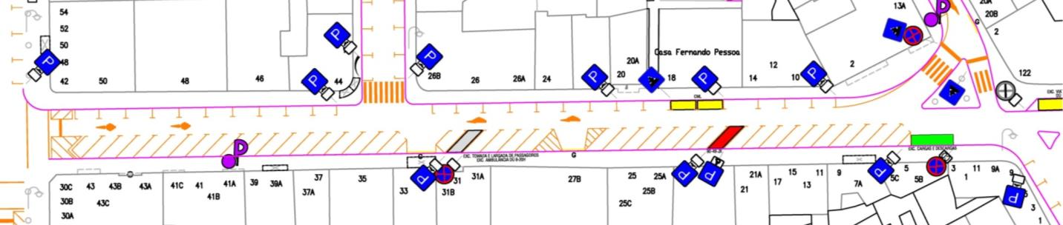
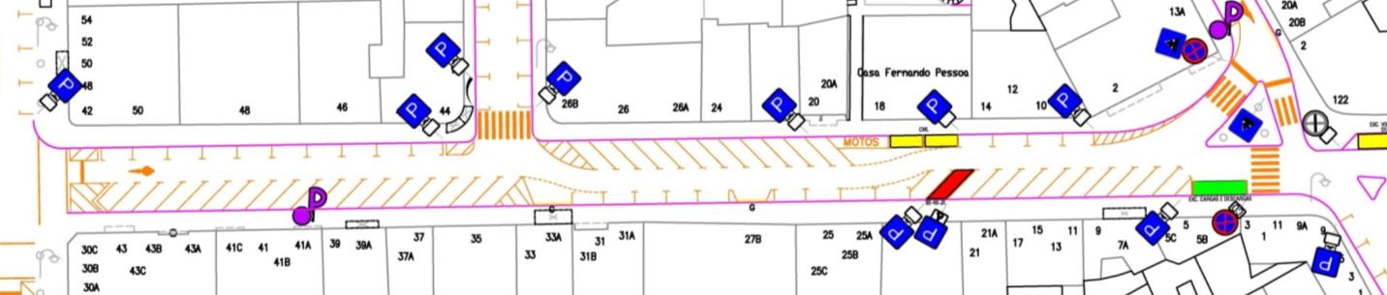
Implementation of the measure
Chicanes
Motorcycles
parking space
Pedestrian
cross
Notes:
Vertical barriers
Vertical traffic signs
Paint for parking lines
Paint for pedestrians crosses
Lugares de estacionamento

Slide 7
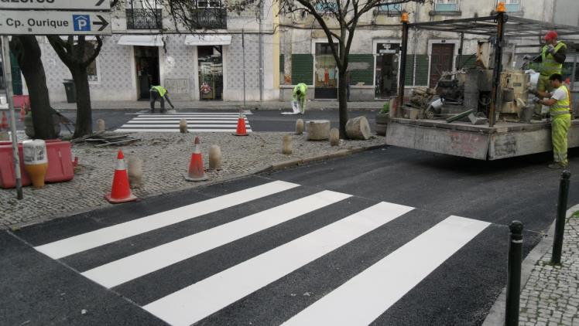
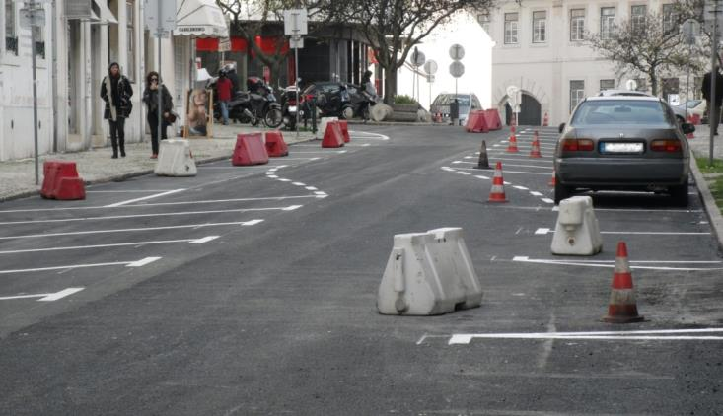
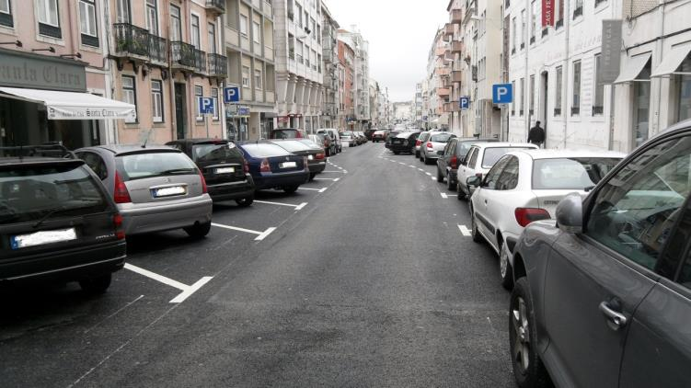
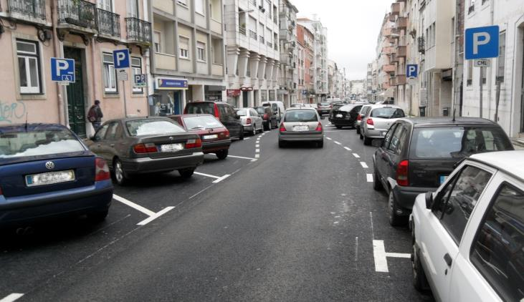
Work in progress
Pictures of the road works (being carried out and finished)

Slide 8
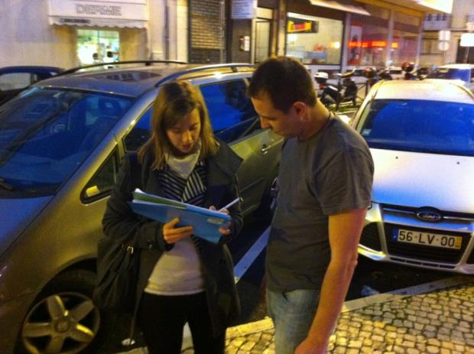
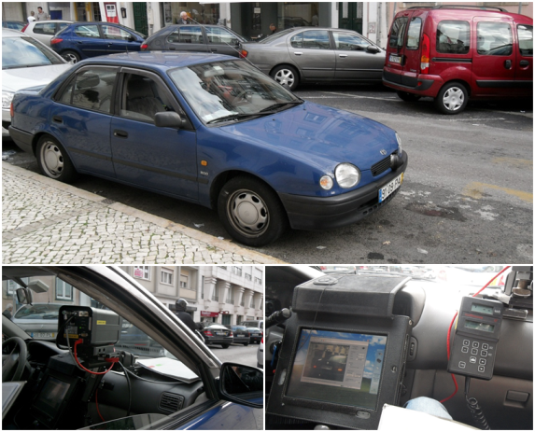
Assessment
Proposed
Indicators
Traffic
Speed
Traffic demand
Pedestrian crossings
Perceptions
Pedestrian questionnaire
Drivers questionnaire
Traders questionnaire
Perceptions
Noise level
Gas emissions
Actual
Indicators
Traffic
Speed
Traffic demand
Pedestrian crossings
Perceptions
Pedestrian questionnaire
Drivers questionnaire
Traders questionnaire
Questionnaire
Speed radar
Notes:
However, resources needed to carry out all these evaluations were impossible to gather within the time available for the project, for a couple of reasons:
pedestrian crossings - lack of human resources to count pedestrian crossings along the whole street; and
noise level and a gas emissions - equipment was not made available although non‑successful attempts of partnerships were carried out .

Slide 9
Partners
European Transport Safety Council
Sílvia Shrubsall (supervision, Researcher at Lisbon Technical University)
Portuguese Association of Road Signs and Safety - AFESP
TRAFIURBE
Lisbon City Council (CML)
Santo Condestável Civil Parish (JFSC)
Lisbon Public Security Police (PSP) – speed radars

Slide 10
Main Difficulties
  Get political approval for the intervention
  Lack of resources to assess the proposed indicators;
  Match schedules between partners;
  Weather conditions – delayed the road works;
  Meet deadlines due to bureaucracies and administrative delays.
Notes:
To meet the timeline due to political and bureaucratic issues and due to unfavourable weather conditions
To get a speed radar
We were unable to get equipment to measure noise and emissions in order to run the assessment methodology initially proposed
To get a significant questionnaires sample size
Difficulties:
Resources limitations;
Political issues due to proximity of local elections;
LIMITATIONS - Mainly related to time schedules problems and resources;
- Lack of control site, speed measurements of limited time and reduced questionnaires’ sample size.

Slide 11
Conclusions
  Speed decreased from 32 to 28 km/h and the overall number of drivers driving above 30km/h decreased about 10%;
  Risk perceptions’ assessment demonstrated that the performed intervention had a direct and positive effect on road users’ perception of safety;
  People in general considered this street safer after the implementation of the chicanes;
  No collision has been recorded so far;
  ADYSE clearly succeeded in demonstrating, that few resources combined with serious commitment, will secure the success of well designed projects.

Slide 12
II. Designing and Developing a Project
WHAT – Background research (current situation, accidentology, statistical data)
WHY – Project relevance (valid points, sustainability and viability)
HOW – Main goals and target
Timeline (not unrealistic or unachievable)
Methodology (measures and effectiveness assessment)
Partners (contact network)
Team work and motivation to overcome hardships

Slide 13
Motivational advices
  Perseverance and resilience are the main keys to success. If we don’t believe in our project no one will. If we don’t fight for it, no one will;
  Open-mindness to change and adapt the project to the conditions of sponsors and local authorities, as long as our main purpose remains covered;
  Above all, we need make sure that we keep a positive outlook when facing adversities and hardships and always stand up to achieve our goals and accomplish our mission.
  This project can be the beginning of something bigger, regarding the impact of road safety measurements in your City - think about it!

Slide 14
Thank You For
Your Attention
Joana Nogueira
jsampaio.nogueira@gmail.com
Frederico Henriques
fredericophenriques@gmail.com

