Slide 1

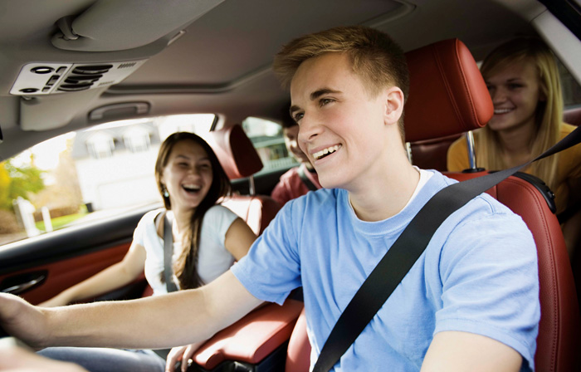
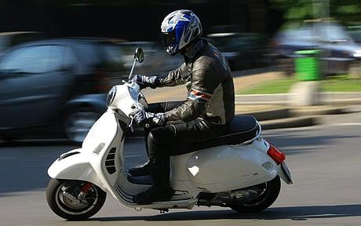
YOUTH and Road Safety in Europe
Laurence Atchison
Senior Researcher, PACTS

Slide 2
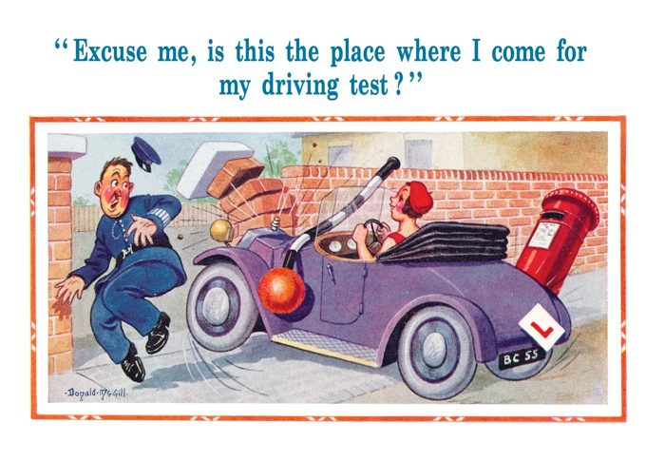
outline
PACTS, ETSC and the YEARS Project
Young people and road risk
What causes this increased risk?
How can we manage it?

Slide 3
1. PACTS, ETSC and The YEARS POLICY Report

Slide 4

PACTS and ETSC
PACTS
ETSC
A Parliamentary Group and a charity
Members from road, rail, air, insurance, research and local, regional and national government bodies
Provide independent advice for Parliamentarians on transport safety
Responds to Government, Parliamentary and public proposals for safety improvements
Non-governmental organisation promoting independent science-based approach to road safety
Supported by 58 member organisations across Europe.
Funded by members, the European Commission and corporate sponsors
Bringing together practitioners, researchers, policy-makers and parliamentarians from across the EU
4
PACTS: Parliamentary Advisory Council for Transport SAFETY

Slide 5
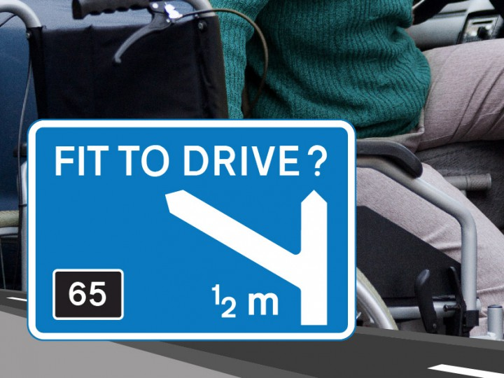

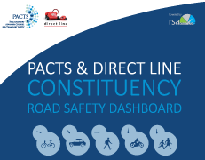





Slide 6
THE YEARS POLICY REPORT
Aims
Questions to Answer
A summary of the current situation in Europe for young drivers/riders
A better understanding of what is happening and why
Using evidence-based, up-to-date literature and research
Recommendations based on good examples
Who is at risk?
Where and when is risk highest?
What causes higher risk?
What can be done to reduce this risk?

Slide 7
2. Young people and road risk

Slide 8
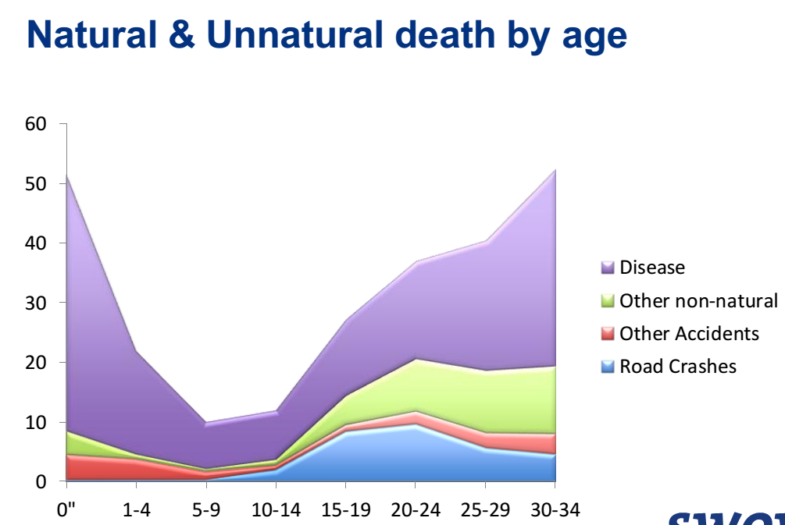
Headline Figures
In 2013, over 3,800 young people were killed in road traffic collisions
Young people aged 15-25 are more likely to be killed than older drivers
A road collision is one of the leading causes of death for young people
This also affects other road users and passengers
Collisions involving young drivers/riders account for:
37% of total road traffic deaths
For each young driver/rider killed, an average:
1.12 passengers/other road users killed
Young people make up:
11% of drivers
but
17% of deaths on the road

Slide 9
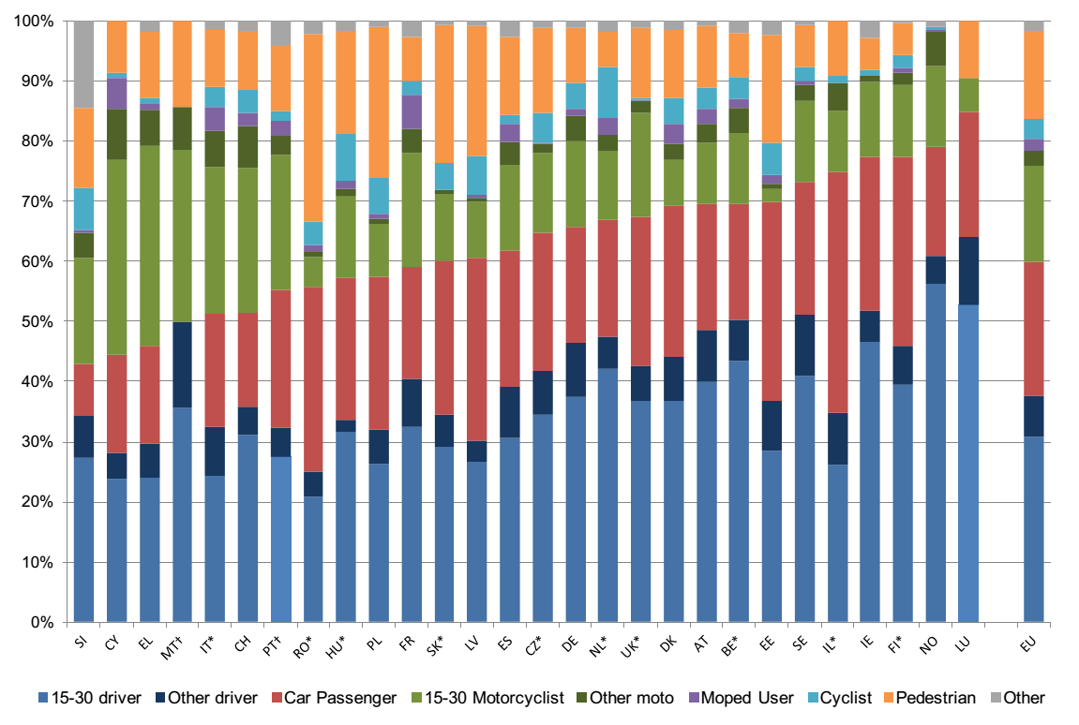
Road deaths following collisions involving at least one car or motorcycle driven by a young person ranked by the share of car users (drivers or passengers) killed in those collisions. *Latest 3 years available 2007, 2008, 2009. † Latest data available 2007, 2008

Slide 10
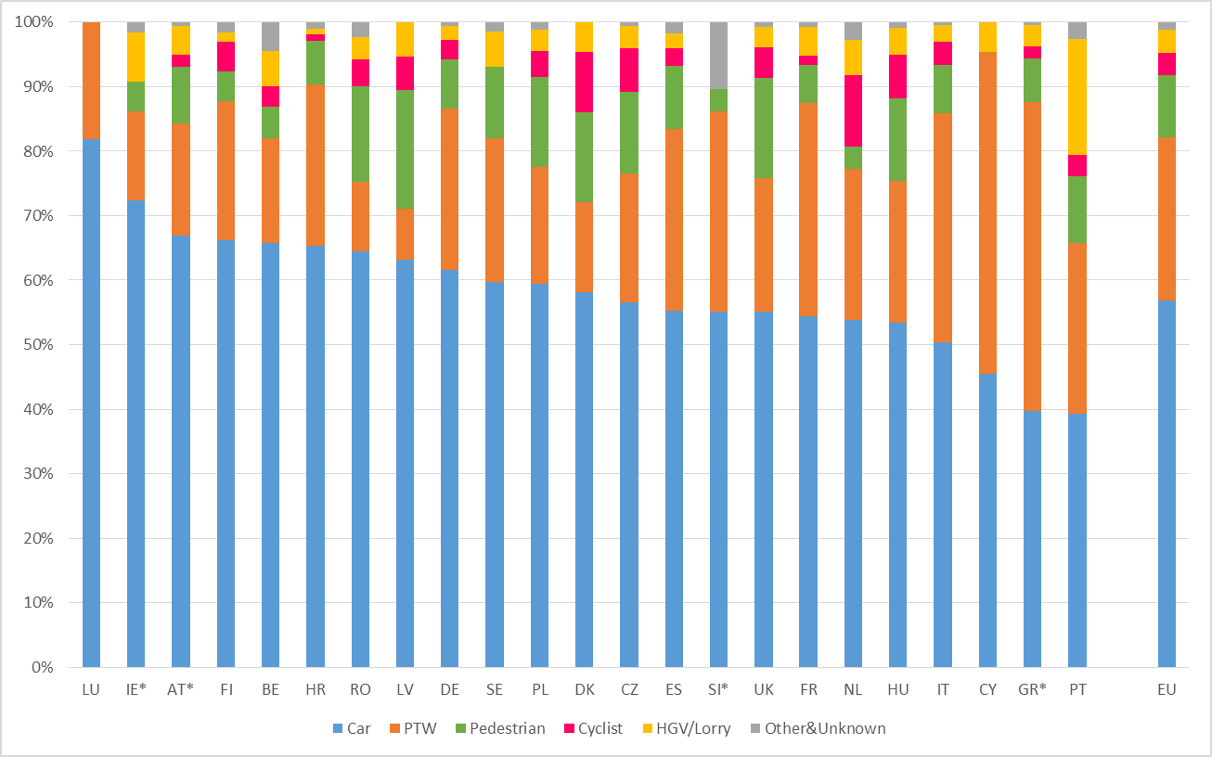
The majority are drivers and riders…
Road deaths by road user type among the 15-30 age group in 2013, with countries ranked by percentage of car users. *2012 data used

Slide 11
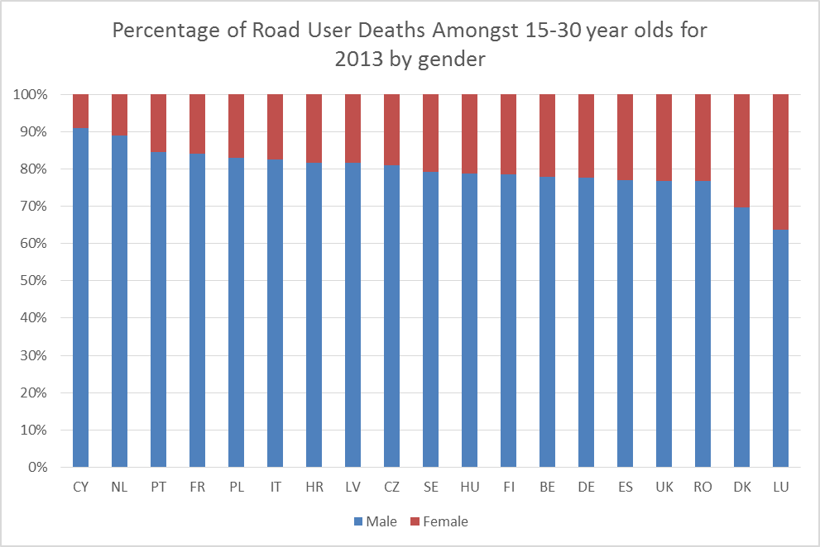
Males are much more at risk than females…
Percentage of road user deaths amongst 15-30 year olds for 2013 by gender

Slide 12
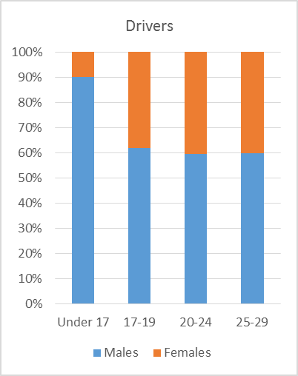
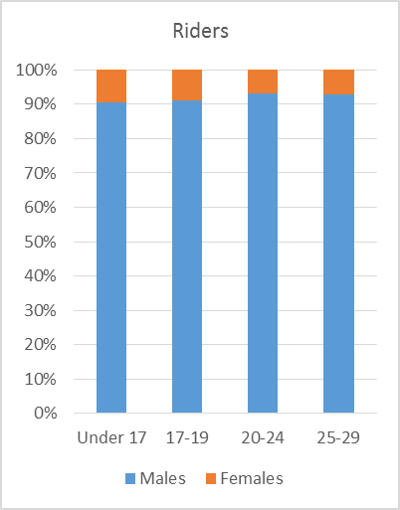
Especially when it comes to riders:
Driver and rider casualties in reported accidents between ages of under 17 and 29, by gender

Slide 13
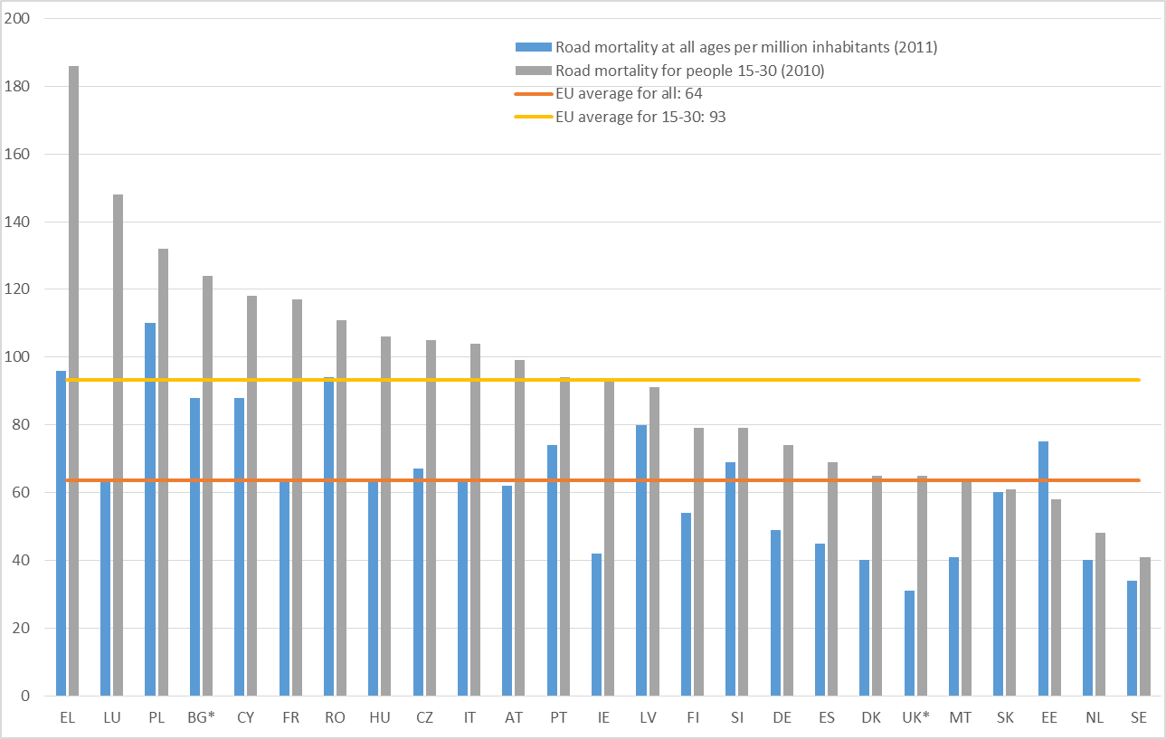
Where the issue is particularly bad…
Young people road deaths per million young inhabitants (with road deaths per million inhabitants at all ages for comparison

Slide 14
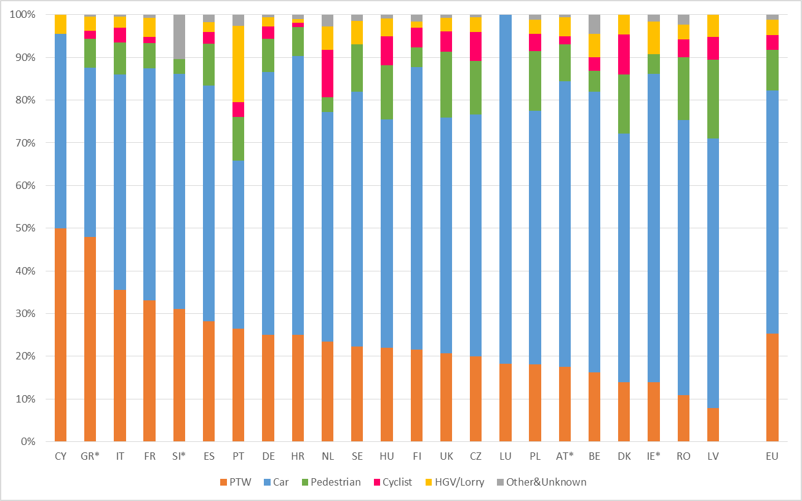
Which types of collision are happening where…
Road deaths by road user type for the 15-30 age group in 2013,
with countries ranked by percentage of PTW users. *2012 data used

Slide 15
3. What causes this increased road risk?

Slide 16
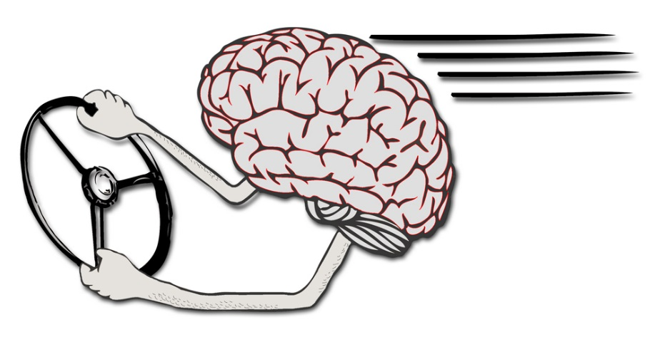
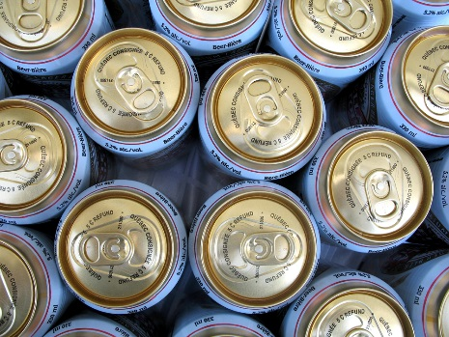
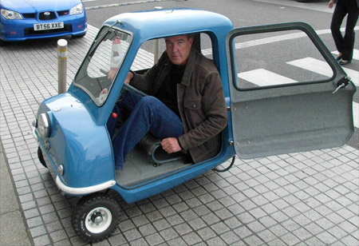
Four Main Factors
Age, gender and biology
A lack of driving and riding experience
Impairments and distractions
Vehicle choice and the consideration of safety

Slide 17
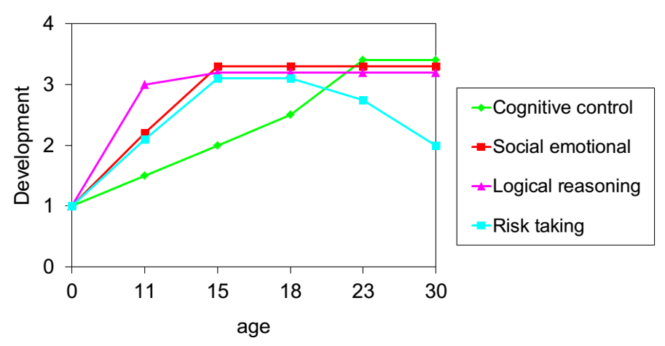
Age, Gender and biology
Cognitive abilities are developing between ages of 15-25
Hormonal changes change attitudes to risk
Social changes occur at the same time
  Need to move around
  Drink and drugs
  Friends and peer pressures

Slide 18
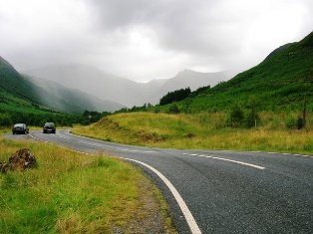
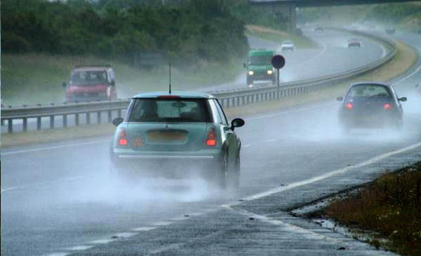
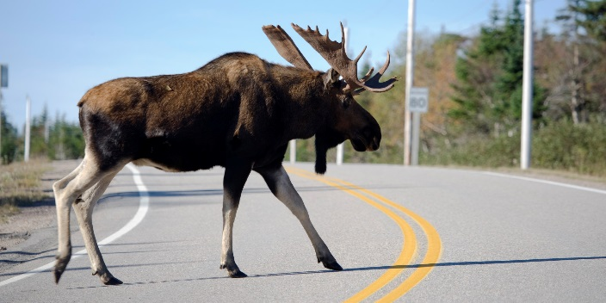
A lack of Experience
Young drivers/riders have:
A basic knowledge of vehicle control
But less experience of actual driving
  Types of roads
  Weather conditions
  Hazard perception
Takes time for these skills to develop

Slide 19
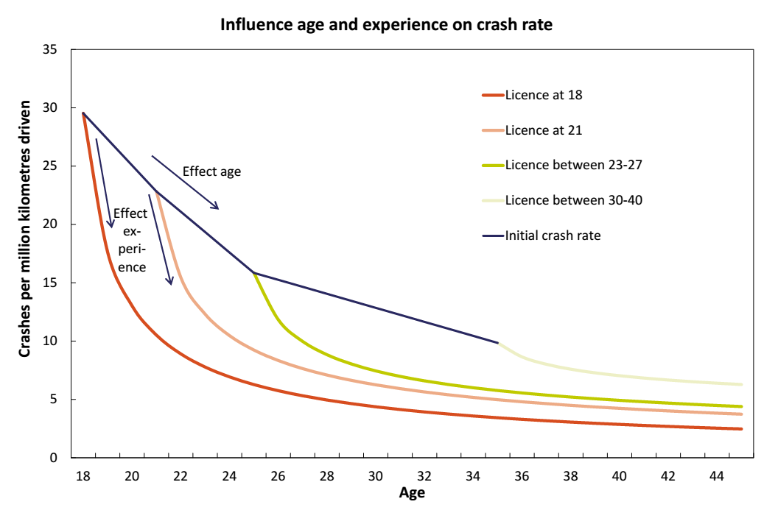
Decrease in the crash rates of novice drivers starting their driving career early
and novice drivers starting their driving career later or late

Slide 20
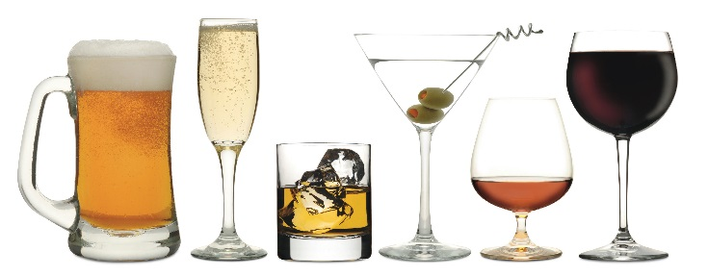
Impairments and Distractions
These can affect all road users at all ages and are common problems
But they affect young people in particular:
  Greater exposure to them
  Lower tolerance
  Less experience of them
Impairments
  Alcohol ✓
  Drugs ✓
  Fatigue ✓
Distractions
  Mobiles/tablets/SatNavs ✓
  Friends/Passengers ✓

Slide 21
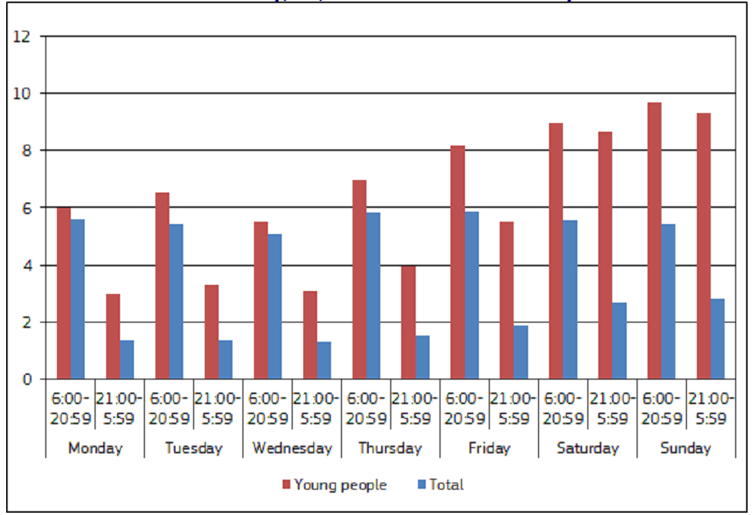
Young people and total death rates per million population by day of the week
and time of the day, EU, 2013, or latest available year

Slide 22
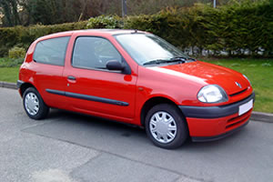
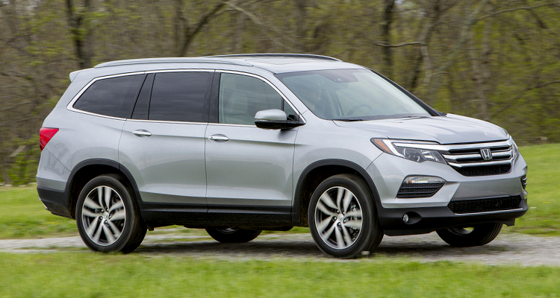
Vehicle Choice and Safety
Types of vehicles being used
Safety features and technologies
Costs of learning to drive/ride
Choosing to drive safely, or not

Slide 23
4. How can we manage the risk?

Slide 24
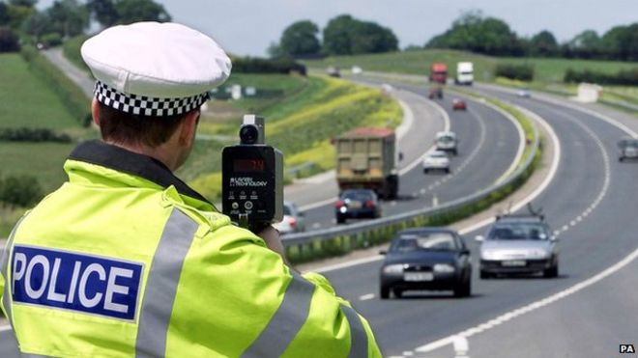
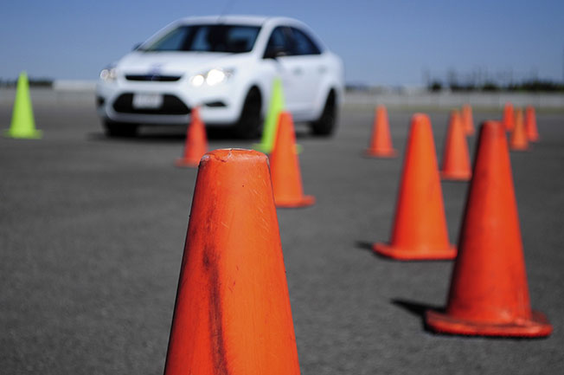

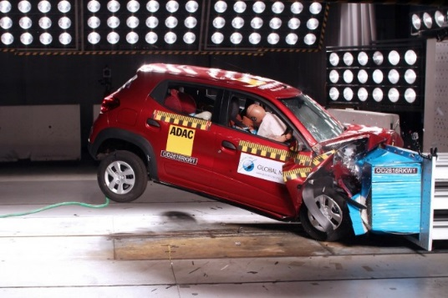
Countermeasures
General safety measures
Training and education
Licensing and testing
Safer vehicles and telematics

Slide 25


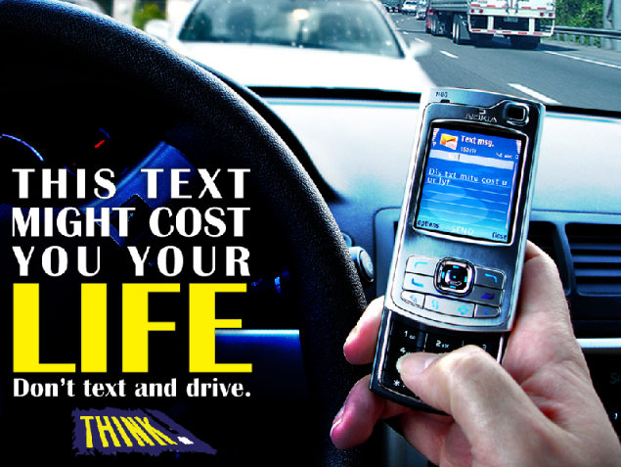
General safety measures
Benefit everyone, but especially young people
  Examples include alcohol limits, speed limits, seatbelt laws
For young people:
  Strict demerit point systems
  Lower alcohol limits
  Alternative modes of transport
  Good information campaigns targeting young people

Slide 26
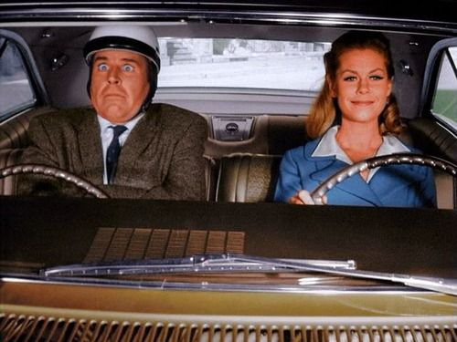
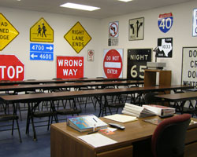
Training and education
General road safety and learning to drive
  Education
  Training – formal and informal
  Post-licence training
For young people:
  Encourage road safety in schools
  Make sure that formal training has more than just basic skills, especially for riders
  Encourage more informal training
  Consider post-licence training in some form

Slide 27
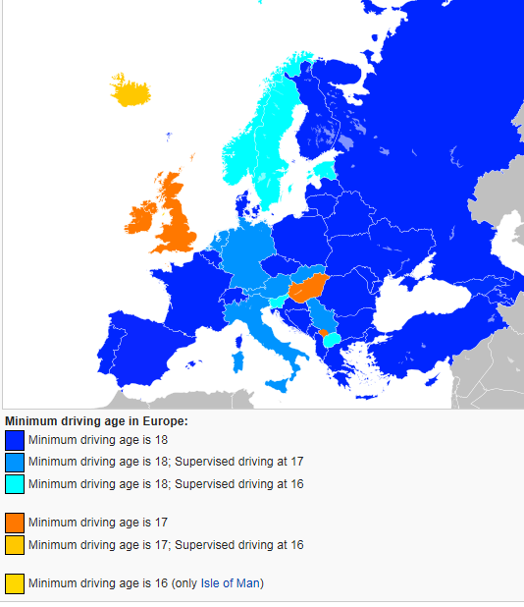
Licensing and testing
What are the key skills a candidate needs? Do they have them?
  Theory tests
  Practical tests
For young people:
  What age to licence at?
  Graduated Driver Licensing
  Hazard Perception Testing
  Test content, length and location
    Independent Driving

Slide 28

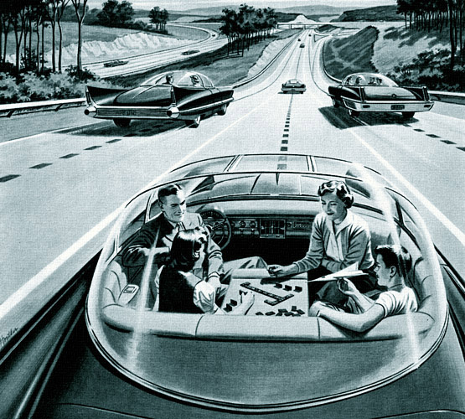
Safer vehicles and telematics
Vehicle choice, safety technologies and the cost of being a driver/rider
For young people:
  Encourage safer vehicles
  Encourage safety technologies
  Telematics insurance
  Cars of the future?
    Is this all a waste of time?!

Slide 29
PACTS: Parliamentary Advisory council for transport safety
Laurence.Atchison@pacts.org.uk
Thanks for listening

