Slide 1
Good practice exchange on drink driving policies: Finland
SMART policies to tackling drink driving
14 October 2015, London
Marita Löytty

Slide 2
Content
Finland: Facts & number of DUI cases
Measures undertaken to tackle drink driving:
      Alcohol interlock program for DUI offenders
      Campaigns

Slide 3
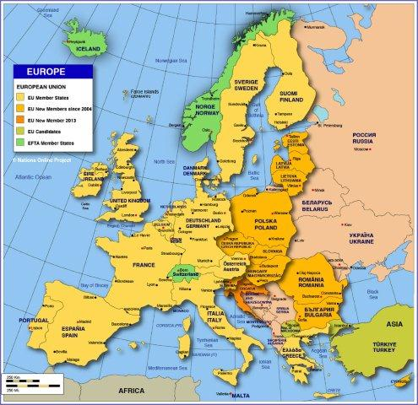
Finland: facts
  Area 338 432 m2 (10 % lakes)
  5,5 million inhabitants
  3,7 million driving licences
  5,0 million vehicles
  BAC-limit: 0,5 ‰
  Random checks by the police:
  ~ 2 million/year
  Road traffic accidents:
  ~ 20 % of deaths and
  ~ 10 % of injuries related to DUI

Slide 4
Finland: number of DUI cases (caught by the police)

Slide 5
Alcohol interlock programme for DUI offenders instead of a driving ban
DUI offender is caught by the police
  The police informs the offender about the interlock possibility
  The offender
  Gets the alcohol interlock installed and the vehicle inspected
  Visits a doctor or an another health care professional
  Submits the driving licence application to the police
  Receives a driving licence with national code 111 (interlock)
  Keeps the interlock 1–3 years (court decides the duration)
  Takes the interlock to log-data read-out every 60 days
  Pays all the costs (total on average less than 5 € per day)
  After the mandatory period, may get the interlock removed, or may leave it in the vehicle (with voluntary use settings applied, e.g. data read-out)

Slide 6
Alcohol interlock programme for DUI offenders
An evaluation study published in February 2013
The study included
A survey (questionnaire) to all the drivers in the interlock program since July 2008 (N=1569; response rate 45 %)
An analysis of the drink-driving offences before, during and after the interlock period
An analysis of the interlock log data
Interviews with the relevant authorities within the process
The average age of the participants was 51 years. The youngest was 20 years old, the oldest 82.
84 % of the participants were male.

Slide 7
Alcohol interlock programme for DUI offenders
Evaluation study: Recidivism
More than half of the drivers had been convicted of DUI several times before applying for the alcohol interlock driving licence.
3.3 % of the drivers were caught for DUI during their period of alcohol interlock controlled driving licence (most likely with another vehicle, not fitted with an interlock).
After the end of the alcohol interlock supervision period, 2.5 % of the drivers were caught for a DUI offence.
The recidivism rate of alcohol interlock users seems to be significantly smaller than that of all DUI offenders, as generally the recidivism rate in Finland is at least 30 %.

Slide 8
Alcohol interlock programme for DUI offenders
Evaluation study: Results
Effect on use of alcohol
25 % reduced drinking, 17 % no longer drank before driving, 11 % stopped drinking for good
After the mandatory period
At least one third of the drivers leave voluntarily the alcohol interlock device fitted in their vehicle after the mandatory period of 1−3 years!
Please read more at http://www.trafi.fi/palvelut/julkaisut/2013_julkaisut/effectiveness_and_impact_of_alcohol_interlock-controlled_driving_rights
Trafi Publications 6/2013 (in English): “Effectiveness and impact of alcohol interlock-controlled driving rights”

Slide 9
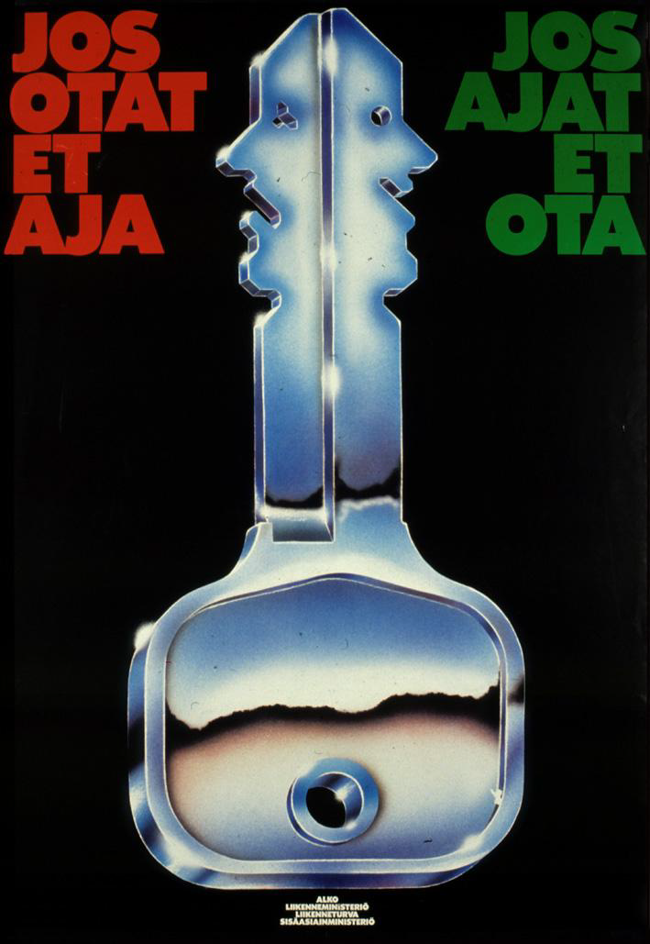
CAMPAIGNS
Situational control
1980’s:
”If you take – do not drive
If you drive – do not drink”

Slide 10
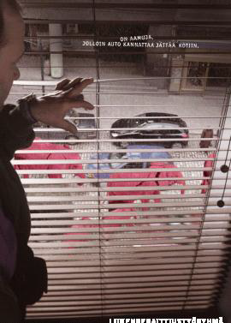
CAMPAIGNS:
Self control
2000’s:
”There are mornings when it is wise to leave the car home”

Slide 11

CAMPAIGNS (2012):
Youngsters came up with this idea themselves (Slogan competition)
”It is OK to be stupid – but it’s NOT OK to be drunk driver”

Slide 12
Thank you!
Questions?
marita.loytty@trafi.fi

