Slide 1
ETSC Drink Driving Conference
Progress in tackling drink driving in the EU
Matthew Baldwin
European Coordinator / Road Safety and Sustainable Mobility
Brussels, 11 December 2019

Slide 2
Why this matters
25.000 deaths in EU
135.000 serious injuries
1.300.000 global deaths

Slide 3
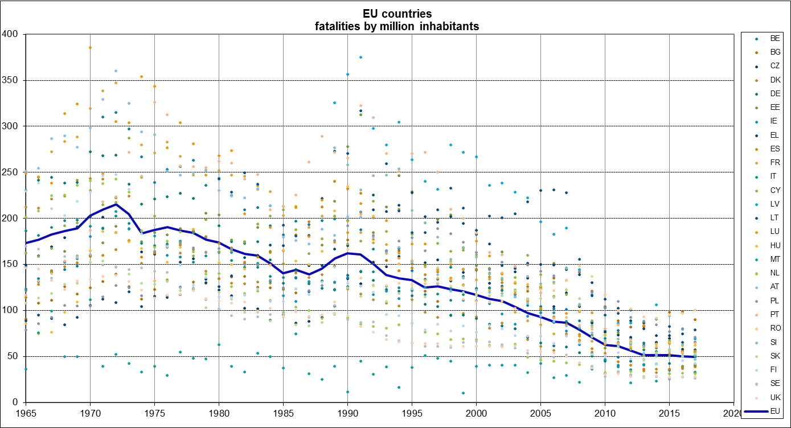
EU deaths per million from 1965 – present
Down from more than 200/m to 50/m

Slide 4
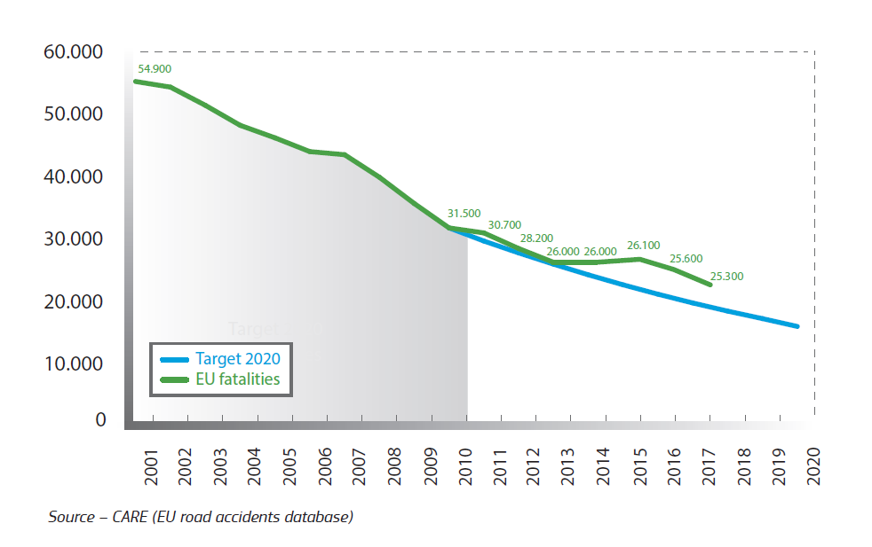
Road fatalities in the EU and current target

Slide 5
EU instruments for road safety
  Road accident data collection and analysis
  Targets
  Legislation (where necessary) e.g. on infrastructure, vehicle safety, enforcement, roadworthiness
  Recommendations / resolutions
  Funding/financing support for investment e.g. in safe infrastructure, research, studies
  European Road Safety Charter - Best practice guidelines etc

Slide 6
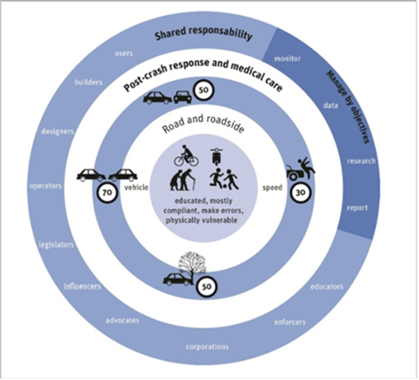
Road safety policy framework 2021-2030
  Principles:
    "Safe System" approach
    Confirmation of "Vision Zero" (2050)
    New interim targets (50% reduction in fatalities and serious injuries)
    Monitoring based on key performance indicators
    Reinforced coordination between levels and sectors
    Appointment of EU Road Safety Coordinator
    Funding support
    Global dimension

Slide 7
What’s the EU been doing on drink driving, and where could we go further?
Data – KPI
Recommendation on BAC – lower? wider? tougher?
Installation and use of alco-locks

Slide 8
KPIs agreed with Member States in 2019
Speed
Safety belts / child restraints
Protective equipment
Alcohol / drugs
Distraction
Vehicle fleet
Infrastructure
Post crash care

Slide 9
Data
Key performance indicator
  “Percentage of drivers within the legal limit for blood alcohol content”

Slide 10
Strengthen the recommendation
Try to reduce the differences ?
  Go to 0.2…or to zero ?
  Tighten the suggested max for certain categories of driver (currently 0.2 mg/ml)

Slide 11
… or legislate ?
Worth recalling that Commission did propose a Directive on harmonised BAC levels … in 1988
Opposed by Council on grounds of subsidiarity
Clearly remains very very difficult.

Slide 12
Enforcement
  Best practice guidelines on enforcement ?

Slide 13
Use of alco-locks
General Safety Regulation - standardised interface
Guidance on requiring their use for repeat offenders and professional drivers ?

Slide 14
Comments and conclusions
Culture
Knowledge – how much alcohol affects our driving
Laws
Perceptions – will I get caught ?
Attitudes – it’s just wrong
Roles of data, industry and technology

Slide 15
Thank you!

