Slide 1
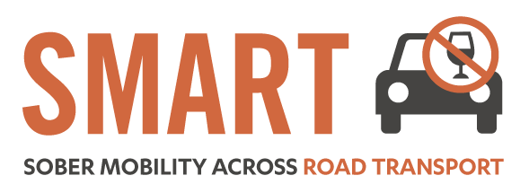


Drink-Driving in the European Union
SMART United Kingdom
European Commission Representation, London
Wednesday 14th of October 2015
January 2015, Brussels
Antonio Avenoso
ETSC Executive Director
Notes:
Welcome participants, speakers…
Thank 10 colleagues
Theme of conference
Depending on how successful we are with this and other activities we might “decapitalise” the E and become the electronic transport safety council…

Slide 2


















































ETSC MEMBERS

Slide 3
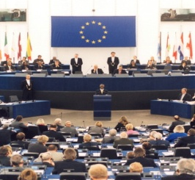

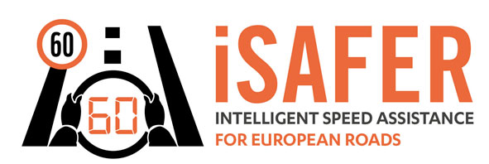

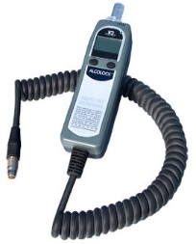

Road Safety Performance Index (PIN)
Ranking EU countries‘ performances
Monitoring EU transport
safety policy
YEARS
SAFE & SOBER

Slide 4
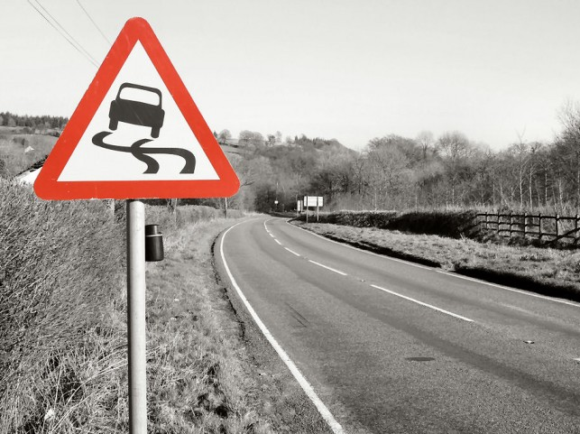
2014
A bad year for road safety

Slide 5
25,964
people died in road traffic in the EU in 2014

Slide 6
% change in road deaths 2013-2014
CROATIA -16%
SLOVENIA -13%
27. UK 5%

Slide 7
% change in road deaths 2010-2014
30. ESTONIA -1%
31. SWEDEN 1%
32. LUXEMBOURG 9%
29. UK -5%

Slide 8
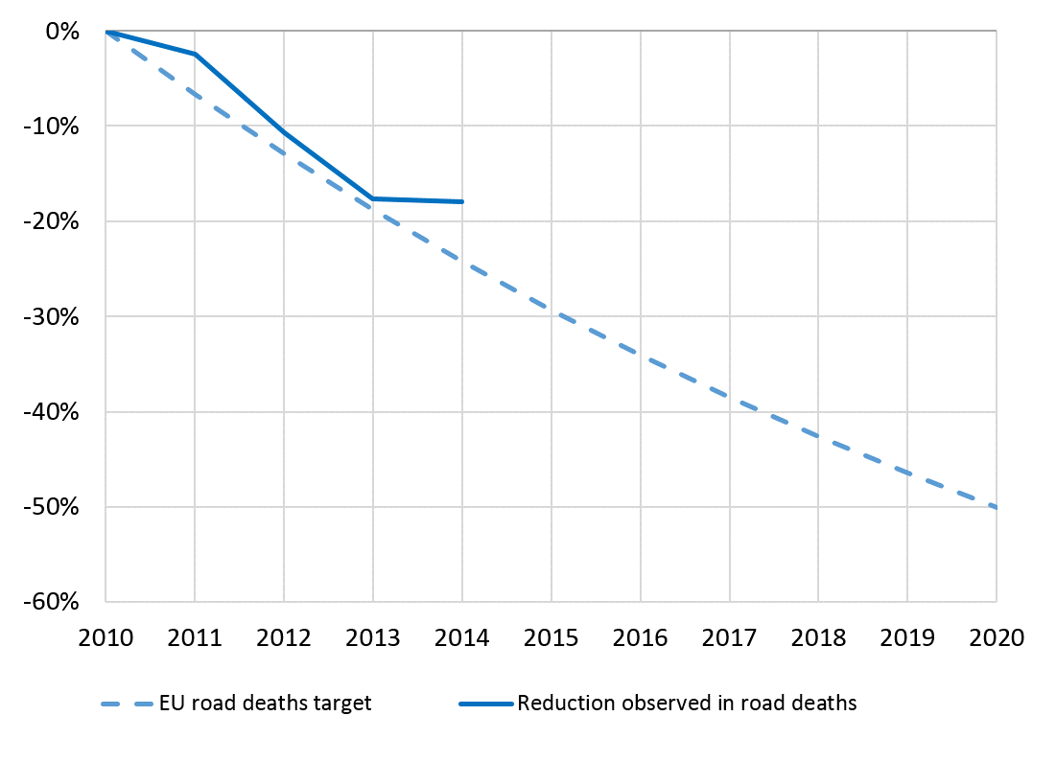

Slide 9

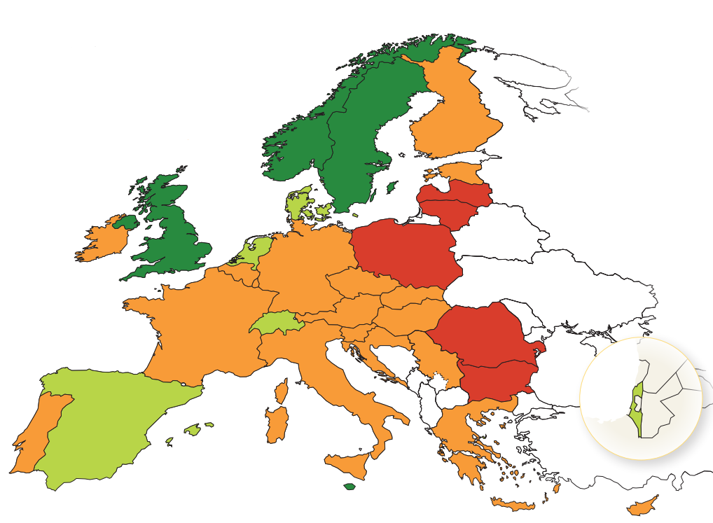

Road deaths per million inhabitants in 2014
< 30
30-36
37-80
>80

Slide 10
Road deaths per mln. inhabitants

Slide 11
203,500
*
seriously injured in road traffic in the EU in 2014
*Data from police records in 23 EU countries

Slide 12

Average annual reduction in deaths
In EU28
6.2%
Average annual reduction in recorded
serious injuries in EU28
2.6%

Slide 13
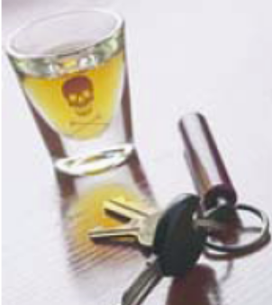
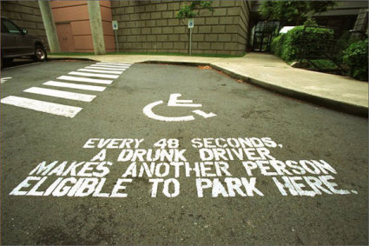
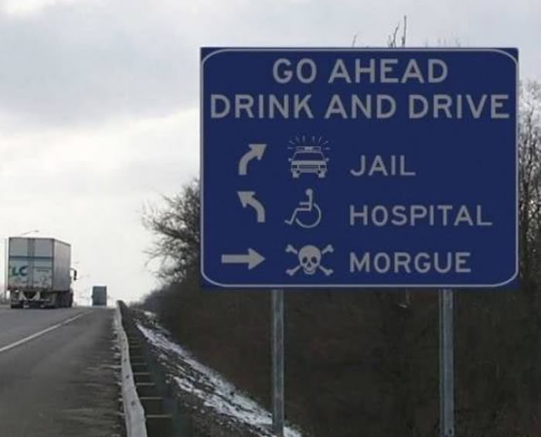
Drink-driving in the EU
While the dangers linked to drink driving are fairly well understood, the phenomenon is still widespread in the EU:
Up to 1.5 - 2% of Km driven in the EU are driven with an illegal Blood Alcohol Concentration
Of the 26,025 deaths in 2013, less than 15% were attributed by MS to drink driving. But according to EC, between 19% - 28% of all road deaths across the EU are alcohol-related (over 30% of driver deaths)
Alcohol related crashes are the leading cause of death in the age group 16-25

Slide 14
Attributing deaths to drink driving
Each Member State has its own way of attributing a road death to drink driving
In 2010, 7 countries attributed fewer than 6% while 5 countries attributed more than 30%
So it is meaningless to compare numbers attributed to drink driving in different countries
But we can look at how the numbers of deaths attributed to drink driving have changed over recent years

Slide 15
Progress in tackling drink driving 2001-2014
Difference between the average annual percentage change in deaths attributed to drink driving and corresponding change in other road deaths
Notes:
Data for UK are n/a

Slide 16
BAC limits across the EU
 | Standard BAC | BAC Commercial drivers | BAC Novice Drivers
Austria | 0.5 | 0.1 | 0.1
Belgium | 0.5 | 0.2 | 0.5
Bulgaria | 0.5 | 0.5 | 0.5
Cyprus | 0.22 | 0.22 | 0.22
Czech | 0.0 | 0.0 | 0.0
Denmark | 0.5 | 0.5 | 0.5
Estonia | 0.2 | 0.2 | 0.2
Finland | 0.22 | 0.22 | 0.22
France | 0.5 | 0.5 (0.2 bus drivers) | 0.5
Germany | 0.5 | 0.0 | 0.0
Greece | 0.5 | 0.2 | 0.2
Hungary | 0.0 | 0.0 | 0.0
Ireland | 0.5 | 0.5 | 0.2
Italy | 0.5 | 0.0 | 0.0
Latvia | 0.5 | 0.5 | 0.2
Lithuania | 0.4 | 0.2 | 0.2
Luxembourg | 0.5 | 0.2 | 0.2
Malta | 0.8 | 0.8 | 0.8
Netherlands | 0.5 | 0.5 | 0.2
Poland | 0.2 | 0.2 | 0.2
Portugal | 0.5 | 0.5 | 0.5
Romania | 0.0 | 0.0 | 0.0
Slovakia | 0.0 | 0.0 | 0.0
Slovenia | 0.5 | 0.0 | 0.0
Spain | 0.5 | 0.3 | 0.3
Sweden | 0.2 | 0.2 | 0.2
UK (except Scotland) | 0.8 | 0.8 | 0.8
An increasing number of countries are lowering their BAC limits to be in line with EU recommendation 2001 on maximum BAC legal limit
18 EU countries apply lower BAC for novice drivers (0.0 – 0.2)
18 EU countries apply lower BAC for professional drivers (0.0 to 0.2 BAC)

Slide 17
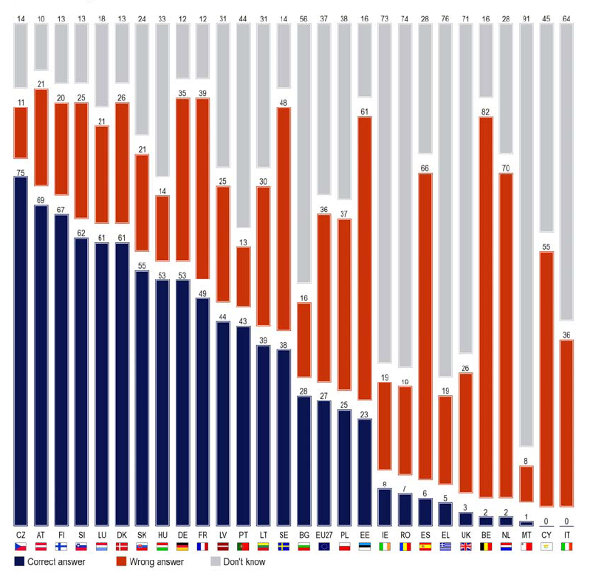
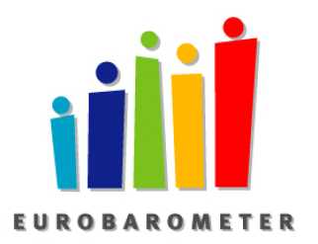
Awareness needs to be reinforced
On average only 27% of respondents knew the legal BAC limit
36% gave a wrong answer
37% did not know
Eurobarometer, Oct. 2010

Slide 18
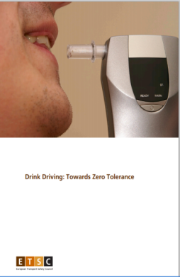
Recommendations to:
Member States :
Zero tolerance
Minimum targets for alcohol checks
Systematic breath-testing in all Police checks
Rehabilitation programmes for DUI offenders and higher penalties to address recidivism
Campaigns raising awareness of drink-driving risk
Alcohol interlocks to
repeat offenders and
professional drivers
EU:
Zero tolerance for commercial and novice drivers
Adoption of standardised definitions of alcohol-related collisions
Uniform standards for alcohol interlocks in Europe
Legislate for a consistently high level of reliability of alcohol interlock devices
Legislate their use by professional drivers
ETSC (2013) Drink-Driving, Towards Zero Tolerance

Slide 19
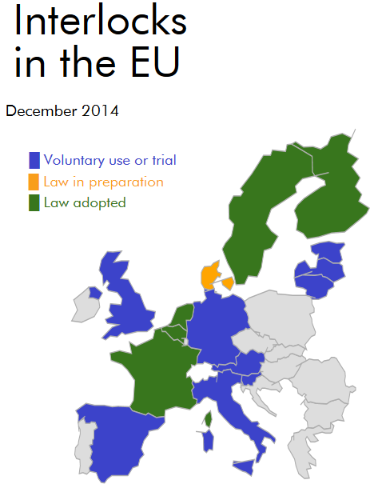
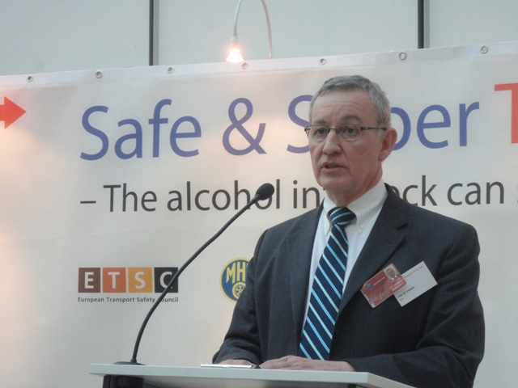
ETSC Alcohol interlock barometer
Pilots
Legislation
Legislation implemented
Good practices
Over 15 EU countries
http://etsc.eu/alcohol-interlock-barometer

Slide 20
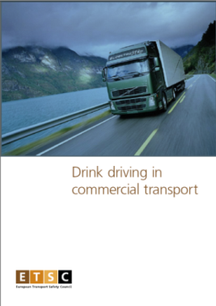
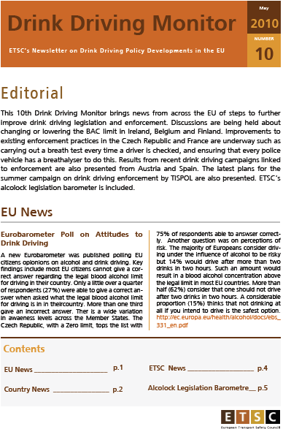

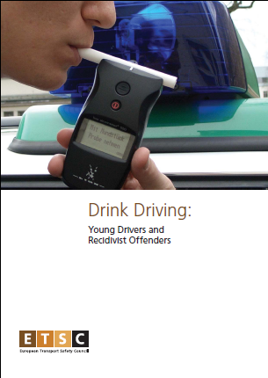
FIND OUT MORE www.etsc.eu
@etsc_eu
Notes:
Welcome participants, speakers…
Thank 10 colleagues
Theme of conference
Depending on how successful we are with this and other activities we might “decapitalise” the E and become the electronic transport safety council…

