Slide 1


Drink-Driving in the European Union
SMART Czech Republic
Ministry of Transport, Prague
Thursday 7th May 2015
January 2015, Brussels
Antonio Avenoso
ETSC Executive Director
Notes:
Welcome participants, speakers…
Thank 10 colleagues
Theme of conference
Depending on how successful we are with this and other activities we might “decapitalise” the E and become the electronic transport safety council…

Slide 2



















































ETSC MEMBERS

Slide 3
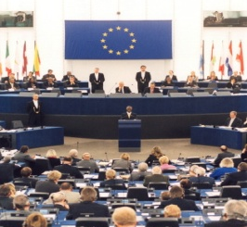






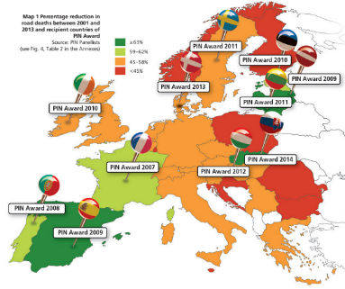
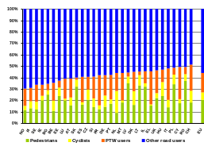

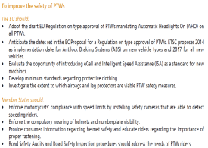
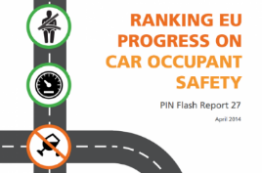

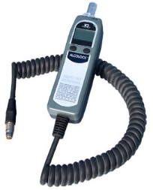

Monitoring EU transport
safety policy
Benchmarking and analysing over 32 European countries’ road safety performance
Developing European Road Safety projects and research networks
SAFE & SOBER
Notes:
Monitoring EU transport safety policy
Road Safety Performance Index (PIN) - Ranking EU countries‘ performances
Bike Pal - Cycle Safety
Road Safety ‘At’ Work and ‘To’ Work
Sober Mobility Across Road Transport
Safe & Sober Campaign

Slide 4
25,700
Recorded killed as a consequence of road collisions in 2014 in the EU28
Notes:
Road
Actual figures higher as not all deaths recorded attributed to road collisions.
Road deaths fell by a negligible 1% in the EU last year according to new data released today by the European Commission. The drastic slowdown in progress puts at risk the region’s target of halving road deaths by 2020.

Slide 5
500
deaths every week
Notes:
It’s as if an Airbus A380 fell out of the sky every week.
Limited research funding should be prioritised based on the potential for deaths / injuries avoided.
For this reason, this presentation focusses mainly on avoiding road deaths.

Slide 6
Percentage change in road deaths 2010/2013
1. Slovakia: – 37% 2. Spain: – 32%
3. Greece: - 31%
10. Hungary: – 20%
12. Czech Republic: – 19 %
25. Germany: - 9%
EU 28 average: -18%
ETSC (2014) 8th PIN Annual Report
Notes:
Slovakia - 37%
Spain - 32%
Greece - 31%
Portugal - 31%
France - 19% Italy - 17%
Germany - 9%
The UK - 6%
Estonia + 2.5% Sweden - 2%
Finland - 5%
Malta and LU: small numbers subject to high fluctuations.
81 people killed in 2013 (79 in 2010, 101 in 2011, 87 in 2012).

Slide 7
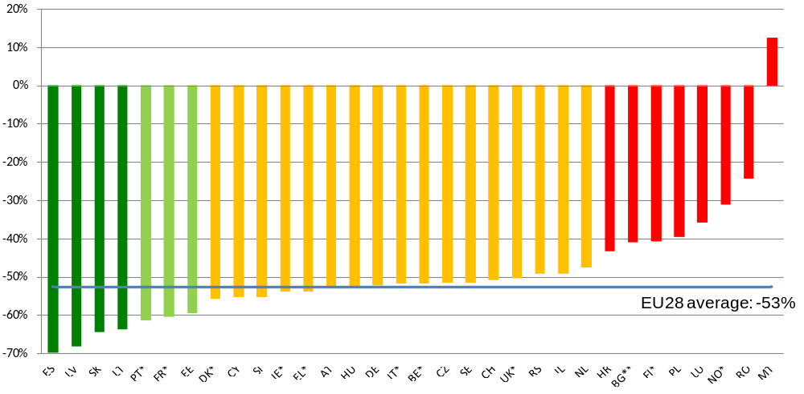
Progress in reducing road deaths since 2001
Spain - 70%
Latvia - 68%
Slovakia - 64%
France – 60%
Austria - 53%
Czech Rep. - 51%
Poland - 39%
Romania - 24%
EU 28: - 53%
ETSC (2014), 8th Road Safety PIN Report
Notes:
Serbia, reduction of 24%, 5534 road deaths in 2001.

Slide 8
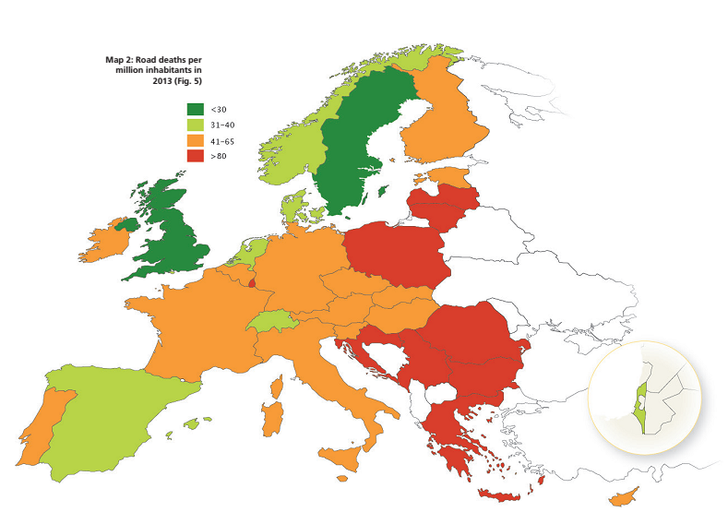
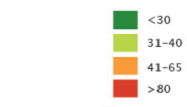
ROAD DEATHS PER M INHABITANTS (2013)
Notes:
- ETSC set up the PIN Programme in 2006 as a response to the first target set by the European Union
- Its purpose is to provide a means for comparing the road safety performance of Member States
- It allows best practice to be identified and promoted and through this brings about the political awareness and leadership needed to create a safer transport system.
- No matter how well a Member State performs there is always room for improvement

Slide 9
Road mortality (per mln inhabitants) in 2013
ETSC (2014) 8th PIN Annual Report

Slide 10
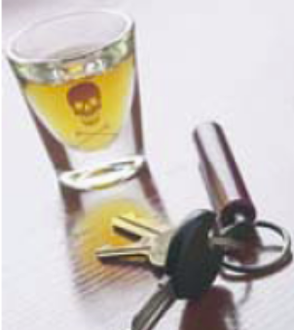
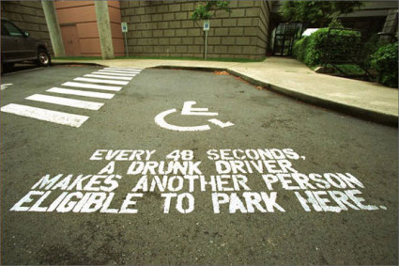
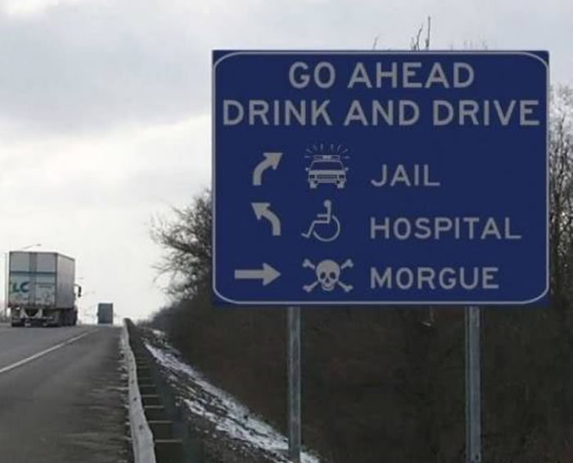
Drink-driving in the EU
While the dangers linked to drink driving are fairly well understood, the phenomenon is still widespread in the EU:
Up to 1.5 - 2% of Km driven in the EU are driven with an illegal Blood Alcohol Concentration
Of the 26,025 deaths in 2013, less than 15% were attributed by MS to drink driving. But according to EC, between 19% - 28% of all road deaths across the EU are alcohol-related (over 30% of driver deaths)
Alcohol related crashes are the leading cause of death in the age group 16-25

Slide 11
Attributing deaths to drink driving
Each Member State has its own way of attributing a road death to drink driving
In 2010, 7 countries attributed fewer than 6% while 5 countries attributed more than 30%
So it is meaningless to compare numbers attributed to drink driving in different countries
But we can look at how the numbers of deaths attributed to drink driving have changed over recent years

Slide 12
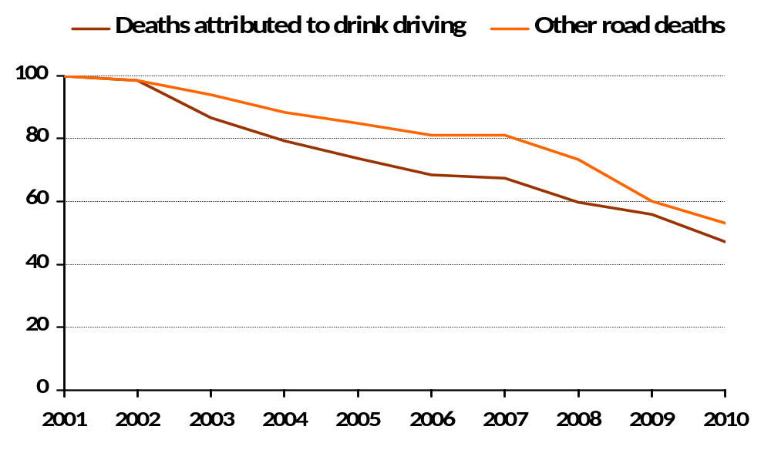
Drink driving deaths in 22 countries
Reduction in road deaths attributed to drink driving and in other road deaths in 22 EU countries – 2001 to 2010
Notes:
Around 3,000 people were recorded killed in a drink driving collision in police records in 2010 in 22 EU countries taken together where data is available, compared with 6,500 in 2001. Road deaths attributed to drink driving have been cut by 53% between 2001 and 2010 in these countries, while other road deaths decreased by 47%.

Slide 13
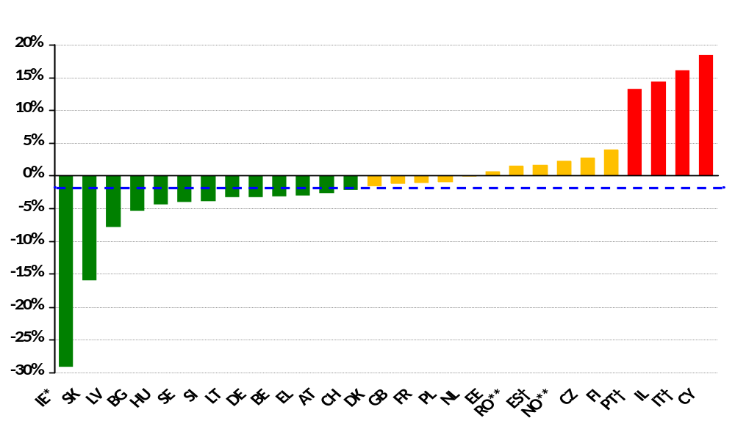
Progress against drink driving
Difference between the average annual percentage reduction in deaths attributed to drink driving from 2001 to 2010 and the corresponding percentage reduction for other deaths
Ireland
Slovakia
Latvia
Bulgaria
Hungary
Cyprus
Italy
Israel
Portugal
* 2004-2007 **2006-2010 †2001-2008

Slide 14
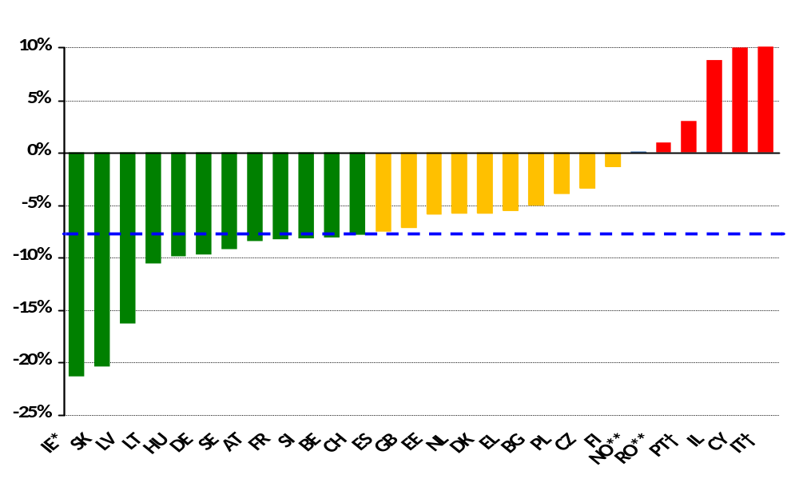
Reduction in drink driving deaths
Average annual percentage change in the number of road deaths attributed to drink driving from 2001 to 2010
* 2004-2007 **2006-2010 †2001-2008
Notes:
Deaths attributed to drink driving decreased by 7.6% each year on average across the 22 EU countries for which data is available for at least nine out of ten years. Other road deaths decreased by 5.3% over the same period in the same group of countries.

Slide 15
BAC limits across the EU
 | Standard BAC | BAC Commercial drivers | BAC Novice Drivers
Austria | 0.5 | 0.1 | 0.1
Belgium | 0.5 | 0.2 | 0.5
Bulgaria | 0.5 | 0.5 | 0.5
Cyprus | 0.22 | 0.22 | 0.22
Czech | 0.0 | 0.0 | 0.0
Denmark | 0.5 | 0.5 | 0.5
Estonia | 0.2 | 0.2 | 0.2
Finland | 0.5 | 0.22 | 0.22
France | 0.5 | 0.5 (0.2 bus drivers) | 0.5
Germany | 0.5 | 0.0 | 0.0
Greece | 0.5 | 0.2 | 0.2
Hungary | 0.0 | 0.0 | 0.0
Ireland | 0.5 | 0.5 | 0.2
Italy | 0.5 | 0.0 | 0.0
Latvia | 0.5 | 0.5 | 0.2
Lithuania | 0.4 | 0.2 | 0.2
Luxembourg | 0.5 | 0.2 | 0.2
Malta | 0.8 | 0.8 | 0.8
Netherlands | 0.5 | 0.5 | 0.2
Poland | 0.2 | 0.2 | 0.2
Portugal | 0.5 | 0.5 | 0.5
Romania | 0.0 | 0.0 | 0.0
Slovakia | 0.0 | 0.0 | 0.0
Slovenia | 0.5 | 0.0 | 0.0
Spain | 0.5 | 0.3 | 0.3
Sweden | 0.2 | 0.2 | 0.2
UK | 0.8 | 0.8 | 0.8
An increasing number of countries are lowering their BAC limits to be in line with EU recommendation 2001 on maximum BAC legal limit
18 EU countries apply lower BAC for novice drivers (0.0 – 0.2)
18 EU countries apply lower BAC for professional drivers (0.0 to 0.2 BAC)
Notes:
To come to the legislation across the EU:
As one can see here also the BAC limits vary greatly across the EU, starting with 0.0 for instance in Czech Republic, and ending at 0.8 in the UK for example.
In terms of EU legislation, there is currently only a legally non binding recommendation in force, which was adopted in 2001. It recommends a 0.5 BAC limit for all drivers and 0.2 BAC limit for commercial drivers.
But, what is also very important in this context is the fact that a limit needs to be enforced, because even a 0.0 limit doesn’t work if drivers know that nobody will check them.

Slide 16
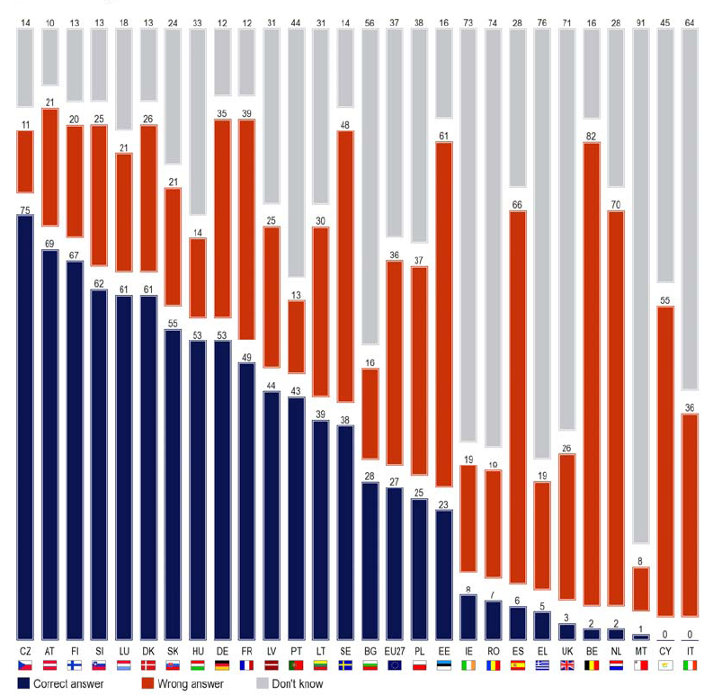
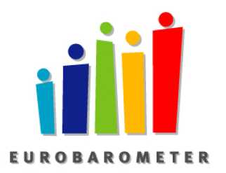
Awareness needs to be reinforced
On average only 27% of respondents knew the legal BAC limit
36% gave a wrong answer
37% did not know
Eurobarometer, Oct. 2010

Slide 17
Positive checks per 1,000 population
Numbers of positive checks per 1,000 population in the most recent year (2010)
CY
SI
FR
BE
AT
PL
HU
PT
FI
EL
BG
IE
ES
11.6
9.3
6.0
5.0
4.5
4.3
4.3
4.1
3.9
3.1
3.0
2.4
2.0
LV
SE
DK
RO
GB
IL
SK
LT
NO
CZ
EE
IT
1.9
1.8
1.8
1.7
1.6
1.2
1.2
1.1
0.9
0.8
0.7
0.7
Being checked for dring drink driving is the exception: maximum 1 in 5 drivers checked in one year
Sartre (2007): Only 26% of drivers in the EU were checked
Many drivers under the influence are hard core drinkers

Slide 18
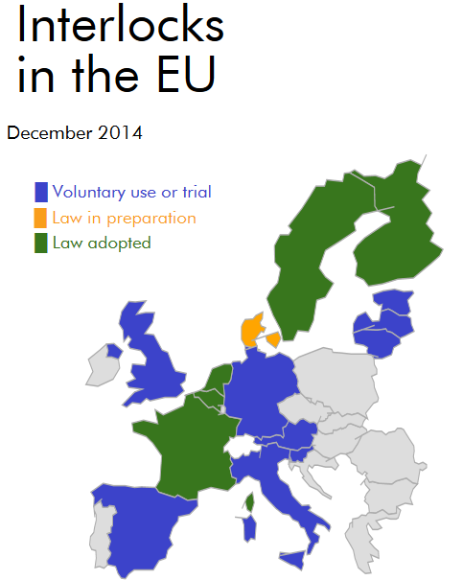
ETSC Alcohol interlock barometer
Pilots
Legislation
Legislation implemented
Good practices
Over 15 EU countries
http://etsc.eu/alcohol-interlock-barometer

Slide 19
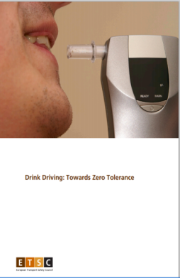
Recommendations to Member States
Adopt zero tolerance for drink driving
Intensify enforcement of laws by setting minimum targets for alcohol checks of the driving population (e.g. one driver in 5 should be checked each year)
Introduce systematic breath-testing in all Police checks related to driving or collisions
Strengthen rehabilitation programmes and higher penalties to address recidivism
Organise regular nationwide campaigns raising awareness of drink-driving risk
Develop use of alcohol interlocks
ETSC (2013) Drink-Driving, Towards Zero Tolerance

Slide 20
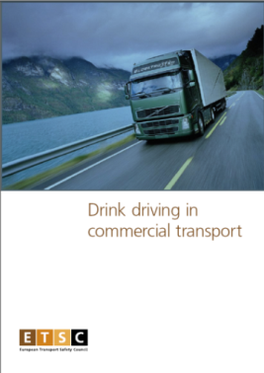
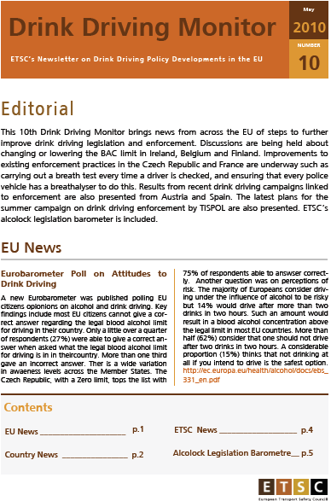

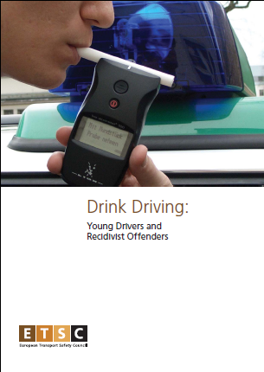
FIND OUT MORE www.etsc.eu
@etsc_eu
Notes:
Welcome participants, speakers…
Thank 10 colleagues
Theme of conference
Depending on how successful we are with this and other activities we might “decapitalise” the E and become the electronic transport safety council…

