Slide 1
When I Drive, I Drink Non-alcoholic Beer
Czech Beer and malt Association
30 April 2015

Slide 2
INTRODUCTION
For the fifth year now, the Czech Beer and Malt Association has been focusing on the activities to prevent drink and driving.
  This project includes:
    “When I Drive, I Drink Non-alcoholic Beer – field activities” (5th year now)
    “When I Drive, I Drink Non-alcoholic Beer - Festivals” (4rd year now)
  The campaign has been supported by online communication on the project’s website: www.ridimpijunealkopivo.cz and www.rpnp.cz
Objectives of the prevention project:
  Minimize drink and driving which is the cause of serious road accidents
  Raise awareness among drivers that non/alcoholic beer is a safe alternative drink with regard to law compliance and safety on the road
  Give consumers hands-on experience in how their motor skills deteriorate under the influence of alcohol
Partners of the project: associated brewers, Czech Police, BESIP

Slide 3
ON THE ROAD
We reward responsible drivers in conjunction with Czech Police
(a field activity)

Slide 4

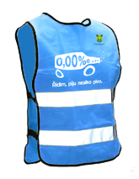
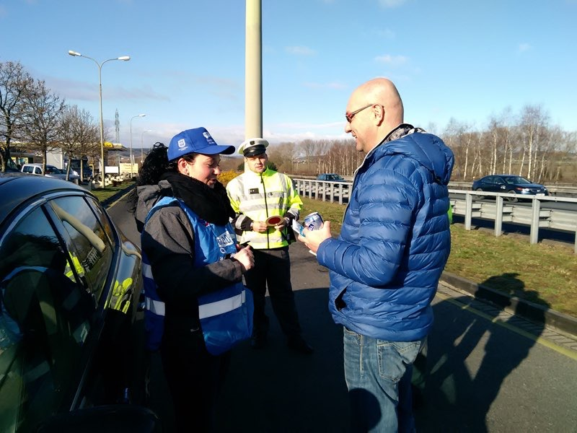
COORDINATION IN THE FIELD – PROMOTION ITEMS
      CZECH POLICE
        Easter weekend
        Summer holidays (July – August)
      BREWERS,
      which brew non-alcoholic beer proactively took part in the campaign and provided their products
      THE PROMOTERS
      acte on behalf of the Czech Beer and Malt Association and the ‘When I Drive, I Drink Non-alcoholic Beer’ project, and wore reflective vests featuring the project’s logo.
      Reflective vest
      Alcotester packaging

Slide 5
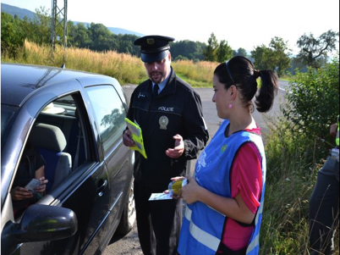
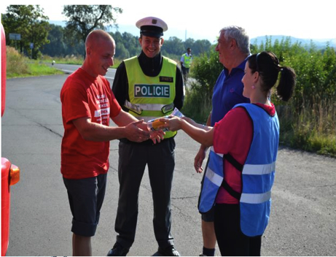
THE FIELD ACTIVITY
Promotion Day – the scenario
- In agreement with a brewery representative, the promoter collects non-alcoholic beer from the distribution depot.
- As per the preventive activity plan drawn up by Czech Police, the promoter arrives, on agreed time, at a police check point, or at a Police Station and travels to the check point together with the police.
- Once at the check point, the promoter pulls off at the place identified by the police and then follows instructions given by the policemen on the spot.
- Only one promoter is allowed at the check point. He/she is wearing a blue reflective vest, and has non-alcoholic beer and presents for drivers checked, a disposable alcotester that includes information about the project.
- The promoter rewards only those drivers who have passed the breath test.
- The promoter must NOT distribute brewery advertising items.

Slide 6
TREND ACTIVIETIS
 | 2011 | 2012 | 2013 | 2014 | 2015* | Total
NUMBER OF ALCOTESTERS DISTRIBUTED | 4437 | 5081 | 6186 | 7290 | 496 | 23490
NUMBER OF PROMO-DAYS | 151 | 146 | 170 | 199 | 13 | 679

Slide 7
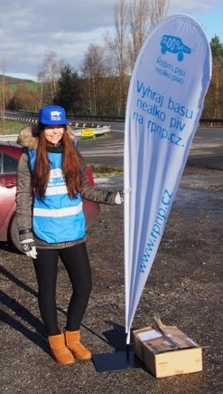
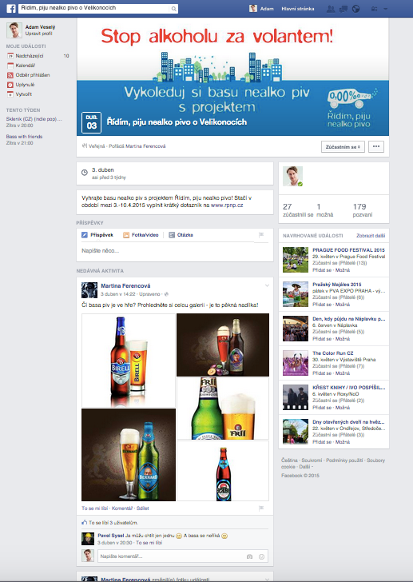
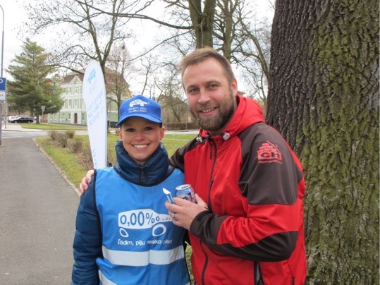
PLANS AND NEWS 2015 - VISIBILITY
Higher visibility on the roads
Promoters have new branding on the back, have a new hat with the logos of the project, the place is promoted by a flag with the logo of the project.
Facebook Comunication
invitations to the events
creating an event to call outs
promotion on breweries´s websites

Slide 8
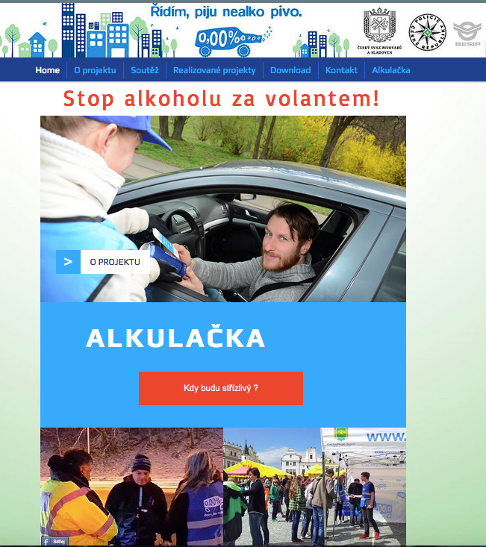
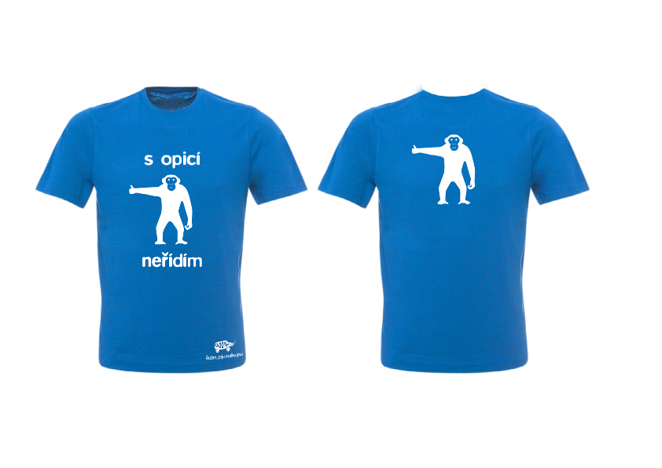
PLANS AND NEWS 2015 - VISIBILITY
New website project includes:
More information on the issue of drinking and driving competition for tray of nonalcoholic beer
questionnaire to gather information about the consumption of alcoholic and soft drinks among drivers
alkulačka
e-shop with T-shirts<

Slide 9
ON THE FESTIVAL EVENTS
MUSIC AND BEER FESTS

Slide 10
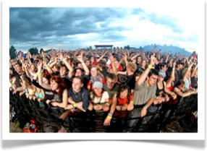
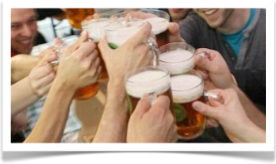
OBJECTIVES
The aim of the activity was to highlight the generally underestimated effects of alcohol on mental condition and behaviour among young people.
To positively influence the attitudes of the young, towards taking greater responsibility.
Get feedback via a questionnaire.
A one- or two-day promo activity focused on prevention and education in the area of risks involved in excessive drinking.
Visitors to the fests were offered to try on a special tool - ‘drunk glasses’ – which make you feel drunk in terms of sensory perception.
With these glasses on, the visitors tried to perform routine tasks while their vision deteriorated as if they had been drinking.
This is a truly unique experience in which you can soberly judge what it feels like to be drunk and how your perception skills are impacted.

Slide 11
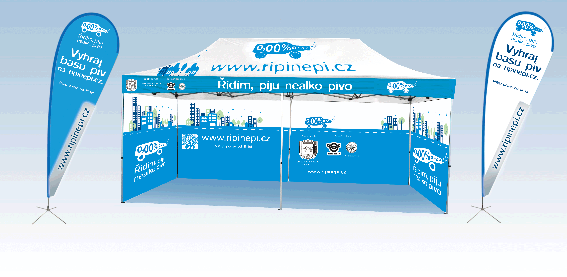
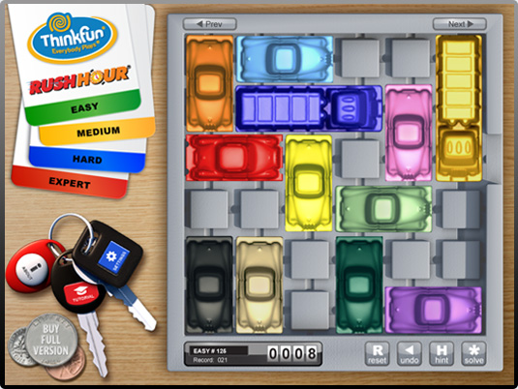
OBJECTIVES
The activity was presented at the fests mainly by using a branded tent (3x6 mtrs) and a roll-up banner.
Three experienced and trained promoters carried out the activity.
They proactively approached visitors to the fests and communicated with them on the topic of road safety and responsible driving. A set of specially-adjusted glasses (‘drunk glasses’) was used: the promoters led the visitors through a series of tasks. Thanks to this direct experience, the participants were able to fully realise how their reactions get influenced (whereas drunk people do not realise this), and it has been demonstrated that information gained in such way will be retained more strongly and in the longer term, so the participants are likely to behave with greater responsibility.

Slide 12

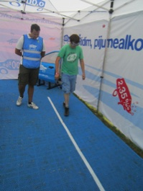

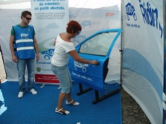
TEST OF MOTOR COORDINATION WITH “DRUNK GLASSES”
The participants were asked to: walk along a straight line; fit a key into a keyhole; and recognize some road signs. All the tasks were performed in a promo tent, to which only visitors over 18 years of age were allowed.
During all the tasks, participants were observed by experienced promoters to prevent an accident (injury or disorientation). The visitors were able to soundly and soberly judge what it feels like when their perception capabilities change due to alcohol. They experienced the danger of a loss of coordination and difficulty in decision making similar to the condition induced by alcohol.

Slide 13

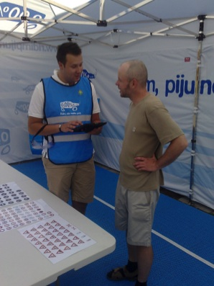
QUESTIONEIRE
The promoters collected data once the participant finished all the tasks.
The questionnaire was anonymous and voluntary.
Data was captured via iPad, in a pre-defined table.
There were only adult respondents as only people over 18 were allowed to carry out the tasks.
Questionnaire structure:
Sex (entered by the promoter)
Age
Q1: Do you think this was a useful activity?
Q2: How often do you drink non-alcoholic beer before or during driving?
Q3: How often do you drink beer?
Q4: Thanks to this activity, are you going to reconsider drinking alcohol before driving?

Slide 14
TREND ACTIVITIES
 | 2012 | 2013 | 2014
Number of visitors approched at festivals | 2616 | 3007 | 5216
INDEX |  | 115% | 129%

Slide 15
TOTAL SUMMARY 2011 -2015
TOTAL NUMBER OF DRIVERS APPROACHED DURING FIELD ACTIVITIES WITH POLICE:
23,490 (679 promodays)
TOTAL NUMBER OF DRIVERS APPROACHED DURING FESTIVALS:
10,839
TOTAL NUMBER OF DRIIVERS APPROACHED:
33,329

Slide 16
Thank you!
www.ceske-pivo.cz

