Slide 1
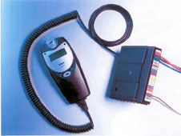
Application of Alcohol Interlock in Austria
07.05.2015, Prague
SMART
Dipl.-Ing. Sabine Kaulich

Slide 2
AGENDA
Drink driving accident occurrence in Austria
Road safety measures against drink driving
(1961 – 2015)
Introduction of pilot projects to implement
Alcohol Interlock in Austria
Target group: professional drivers
Target group: drivers prone to drink driving

Slide 3
Drink driving accident occurrence in Austria
Killed in drink driving accidents 2004 – 2013 with percentage of victims in total
Resource: Austrian Ministry of Transport, Innovation and Technology
(BMVIT)
High number of unknown cases
ESTIMATE:
160 killed in drink driving accidents
in Austria per year
Killed in drink driving accidents
Percentage of killed in drink driving accidents to total number of killed in traffic accidents

Slide 4
Traffic safety measures against drink driving
(1961 – 2015)
1961 Introduction of a standard accident data collection form in Austria
Breathalyser tests introduced
Probationary driving licence for cars
0.1 ‰ BAC for mopeds, buses and lorries
Maximum permitted BAC: 0,5 ‰
2006 Alcohol screening introduced
More stringent sanctions for drink driving
Further efforts:
2012/2013 Alcohol interlock pilot test (lorries, taxis, school buses, offenders)
2015 Creation of a draft law for alcohol interlock for drink driving offenders

Slide 5

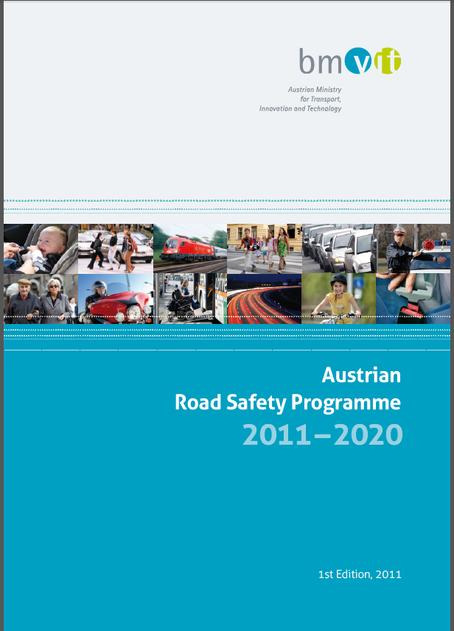

Application of Alcohol Interlocks to drivers prone to drink driving
Priority measure in the following programmes:
EU Road Safety Programme 2011 – 2020
Austrian Road Safety Programme 2011 – 2020
Work programme of the Austrian Federal Government 2013 – 2018

Slide 6
Pilot-Project:
Alcohol Interlock for Quality Assurance
Target Group:
Professional drivers (transport economy/school bus/taxi)
http://www.bmvit.gv.at/verkehr/strasse/publikationen/sicherheit/vsf/13_alkoholinterlock.html

Slide 7
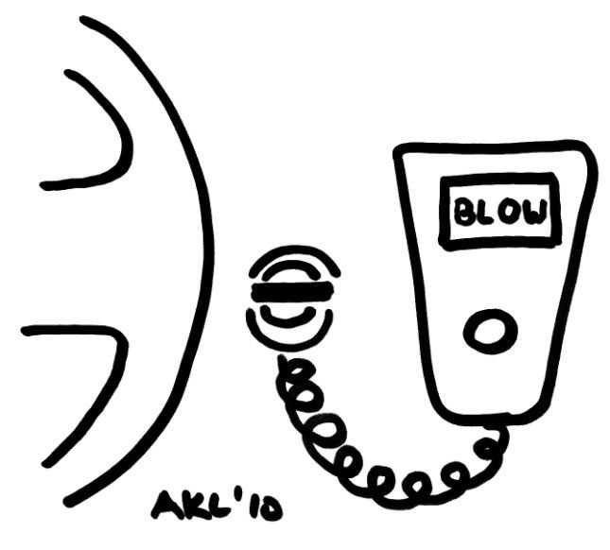
Pilot-Project:
Alcohol Interlock for Quality Assurance

Slide 8
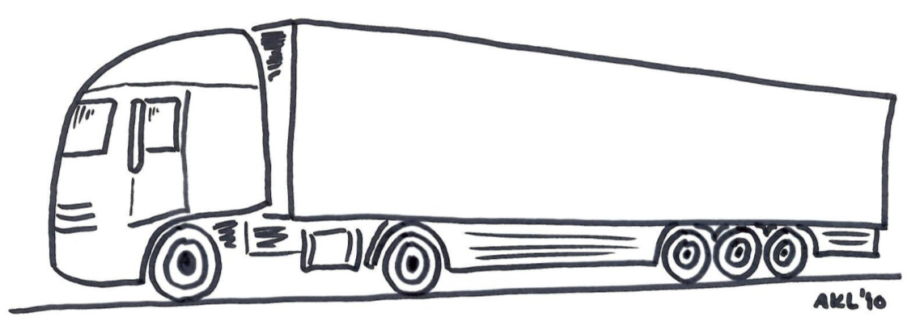
Pilot-Project:
Alcohol Interlock for Quality Assurance
Transport economics
Professional Drivers
Survey: Alcohol Interlock for Quality Assurance
Sept ´11 – Feb ´12
Drivers
60% described the devices as very easy to manage
70% see Alcohol Interlock as a possible improvement of road safety
Period of adaptation amounts to only a few days
Companies
50% are in favour of legal regulations
34% are in favour of voluntary application
16% are in favour of application as standart in busses and lorries
http://www.bmvit.gv.at/verkehr/strasse/publikationen/sicherheit/vsf/13_alkoholinterlock.html

Slide 9
Pilot-Project:
Alcohol Interlock against re-offending
Target group:
Drivers prone to drink driving

Slide 10
Application of Alcohol Interlock for drivers prone to drink driving
WHY ? (1)
Effectively prevent drink driving !
(1/4 of drink drive offenders still drive after revocation of driver‘s licence;
ca. 240 drunk drivers without a driver‘s licence per day)

Slide 11
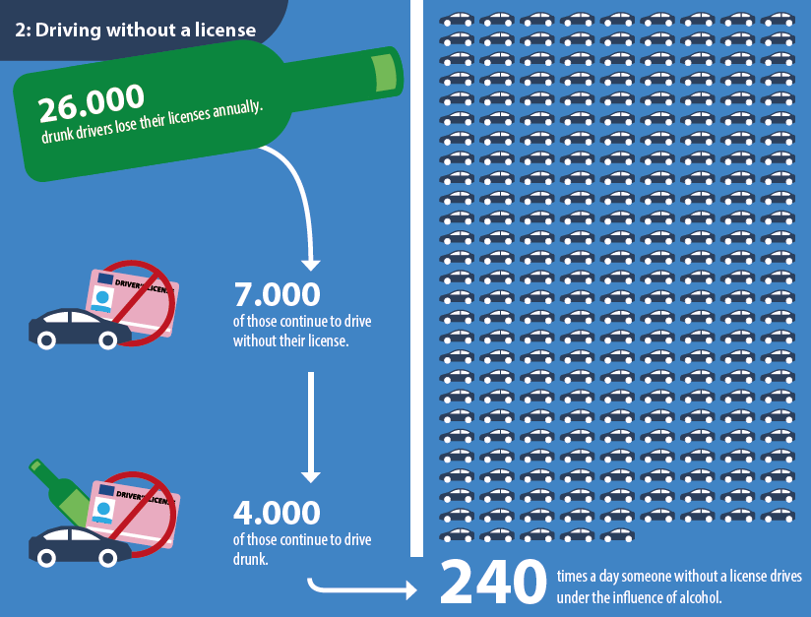
Application of Alcohol Interlock for drivers prone to drink driving

Slide 12
Application of Alcohol Interlock for drivers prone to drink driving
WHY ? (2)
Sustainability of the strategies to separate driving and drinking !
(to cement a change in behaviour; longer support)
Avoid unexpected social problems !
(job loss, mobility loss, …)

Slide 13
Application of Alcohol Interlock for drivers prone to drink driving
The pilot project – goals:
Trial of the entire process: Organisation of Alcohol Interlock devices, installation, instruction, driving experience with Alcohol Interlock, screening of data, mentoring
Plan and organise general framework for supervision
of all participants throughout Austria
6 month pilot phase
Fine-tune mentoring
Evaluation of the mentorings in connection with the pilot project

Slide 14
Application of Alcohol Interlock for drivers
prone to drink driving
The pilot project – outcomes:
The Alcohol Interlock device and bespoke mentoring programme showed
very positive results
The participants see the Alcohol Interlock device as functional and convenient
Participants see the Alcohol Interlock programme as a genuine alternative to licence revocation
The social circle of the participants reacts positively and with interest to the programme
Routine feedback loops and narrow collaboration between the participants, companies and agencies are compulsory

Slide 15
Application of Alcohol Interlock for drivers
prone to drink driving
WHO ?
First time and repeated drunk driving offenders
Only category B for the time being
But not: drivers involved in accidents or hit-and-run …

Slide 16
Application of Alcohol Interlock for drivers
prone to drink driving
WHEN ?
As early as possible after delict
Alcohol Interlock duration is 2 times longer than the duration of licence revocation

Slide 17
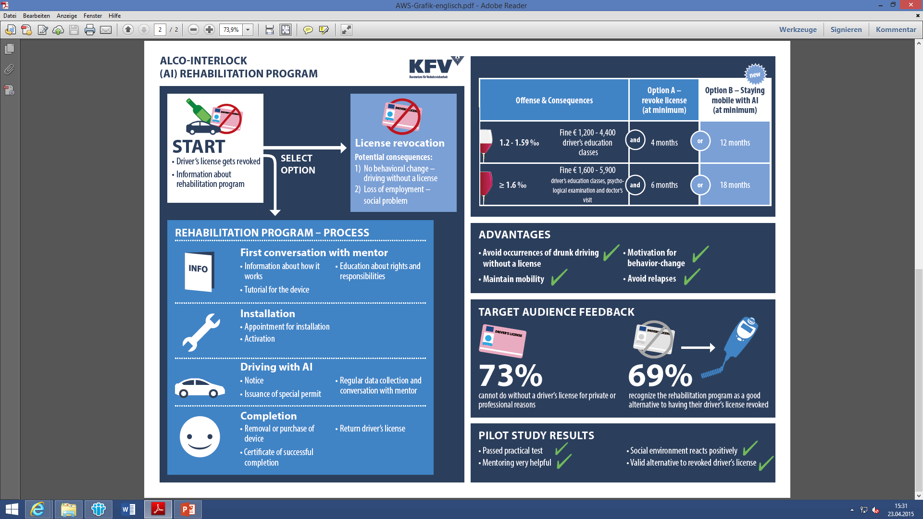
Application of Alcohol Interlock for drivers
prone to drink driving
Proposal for an Austrian model

Slide 18
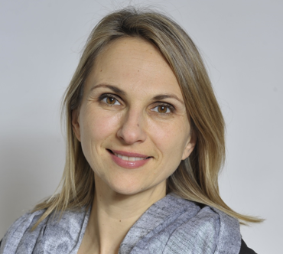
Thank you!
Dipl. Ing. Sabine Kaulich
Austrian Road Safety Board (KFV)
Communication & Project Development
sabine.kaulich@kfv.at

