Slide 1
Safe mobility for youngsters in Germany
YEARS
Athens, 12th June 2017

Slide 2
Content
The dimension of lack of road safety regarding
young persons in Germany
Legislative measures directed to young drivers
Programs, activities and measures

Slide 3
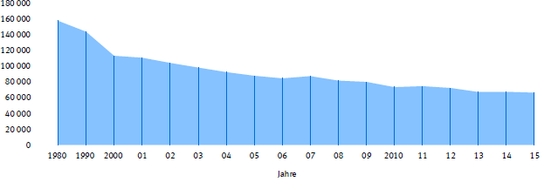
Road crash victims aged 18 to 24 years in Germany 1980 - 2015
Source:
Destatis

Slide 4
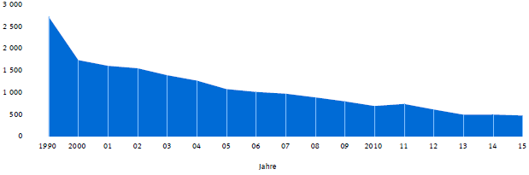
Killed young road users between 18 and 24 years 1990 - 2015
Source:
Destatis

Slide 5
Young persons between 18 and 24 years represent 7,7% of the population in 2015, but 16,7% of all injured road accident victims and 13,7% of all killed persons in traffic.
Source:
Destatis

Slide 6
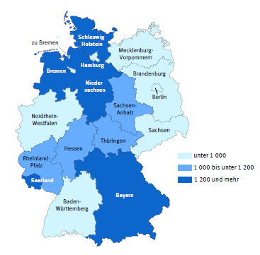
Road accident victims between 18 and 24 years in the Federal States of Germany 2015
Source:
Destatis

Slide 7
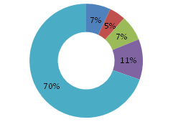
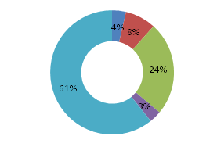
Road accident victims between 18 and 24 years by road participation 2015
Injured and killed
killed
Source:
Destatis

Slide 8
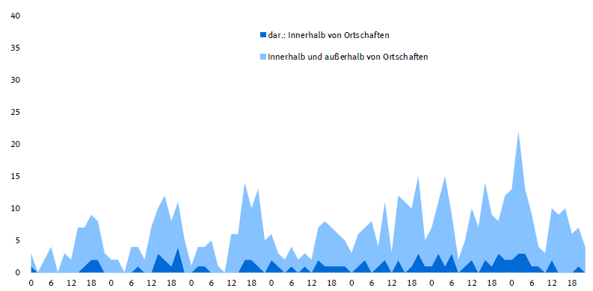
Killed young persons between 18 and 24 years by day time, day of week and location
urban roads
K
I
L
L
E
D
L
M
Mi
J
V
S
D
Source:
Destatis
day of week and hour

Slide 9
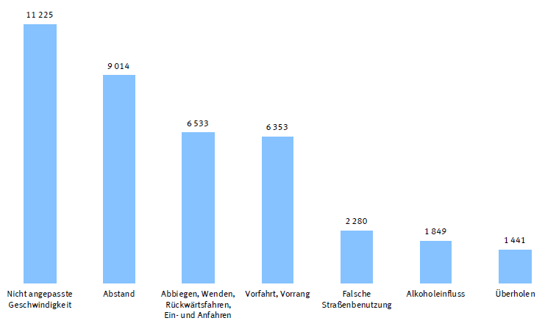
Causes of accidents 2015 young persons
Speed distance turning, starting and give priority false road lane alcohol overpassing
reverse driving
Source:
Destatis

Slide 10
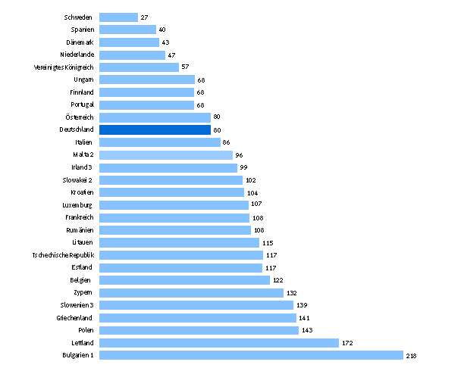
European Ranking (18-24 years) 2015
Source:
Destatis

Slide 11
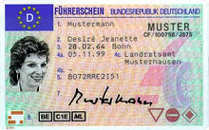
Legislative measures
§
§
§
Probationary driving licence since 01/01/1986
probationary period: 2 years
Rehabilitation courses for novice drivers since 01/01/1999 in
case of traffic offence or accident
Extention of the probationary period from 2 to 4 years
In case of recidivism compulsory attendance to
rehabilitation courses and sessions with specialized traffic
psychologists
Notes:
Diese Hilfestellungen sollen bewirken, dass der auffällig gewordene Fahranfänger die Defizite in seiner Einstellung zum Straßenverkehr erkennt, sein auffälliges Verhalten überdenkt und ändert. Jährlich verlieren 20.000 Fahranfänger ihre Fahrerlaubnis vor Ablauf der Probezeit.

Slide 12
Legislative measures
Zero alcohol tolerance for novice drivers in the probationary period
up to 21 years since 01/08/2007
BF 17 model – accompaigned driving licence from 17 years on since
01/01/2011

Slide 13
Recommendations by DVR
Increase the efficiency of the contents given by the driving schools by
including a learning monitoring tool
Improve the qualification of driving school teachers/trainers
Allow the accompanied driving licence scheme from 16 years on
Development and implementation of a „monitoring“ phase after
obtaining the driving licence
Introduction of a feedback system, also with technical support
Introduction of specific vehicle plates for novice drivers

Slide 14

Programs & Activities
Information and advice regarding the BF 17 scheme
https://www.bf17.de/startseite.html

Slide 15

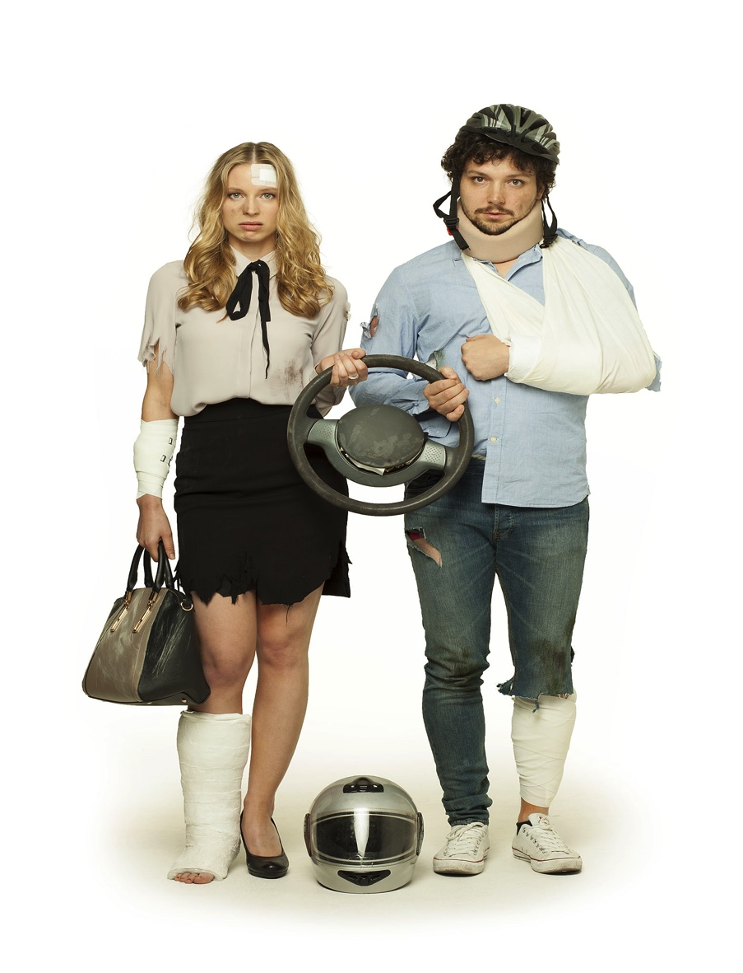
Programs & Activities
http://risikocheck.me/
Educational program for apprentices
Teaching material for trainers/teachers
Competition for pupils
Videos and games

Slide 16



Materials

Slide 17

Communication
http://www.jungesfahren.de/

Slide 18

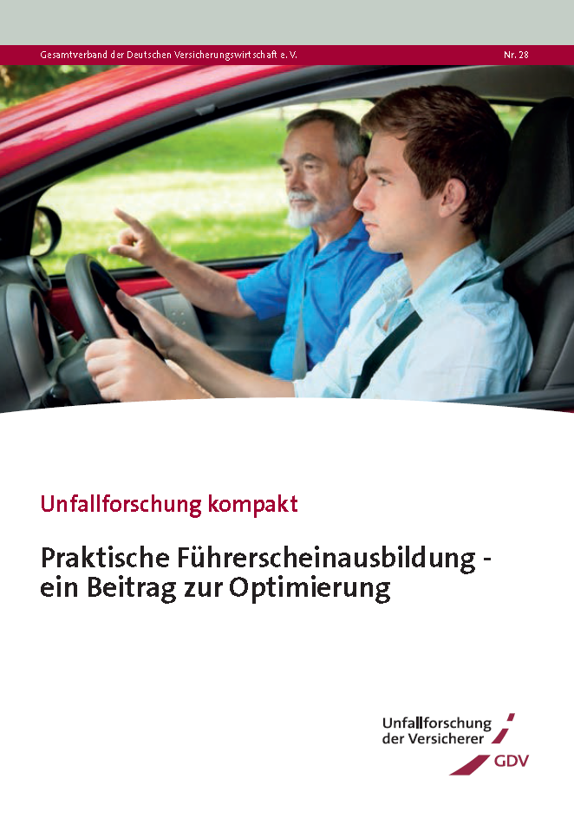
Research
Mayo 2016

Slide 19
Thank you very much for your attention!
Efaristó parapolí!
jlacroix@dvr.de

