Slide 1

Awareness Raising campaigns
& the CAST approach

Slide 2
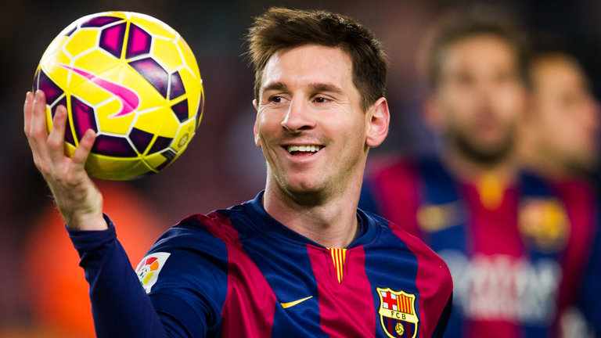
How to become lionel Messi?
Notes:
Doelgroepen:
Opleiden van ambtenare
Werknemers

Slide 3
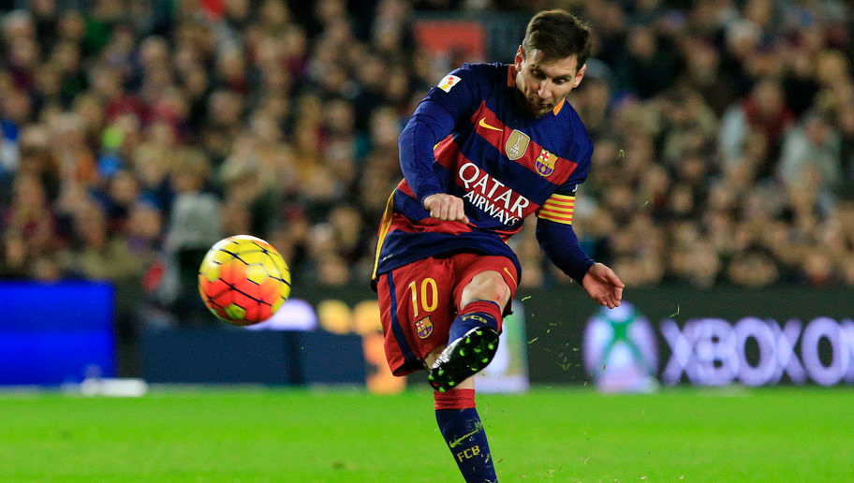
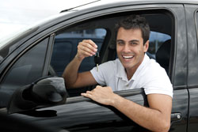
We need Messi’s on the road
Systematic training:
Skills
Knowledge
Attitude
Result:
Minimize mistakes
Good decisions
Notes:
Doelgroepen:
Opleiden van ambtenare
Werknemers

Slide 4
presentation
VSV (Flemish Foundation of Traffic Knowledge)
Importance of Road Safety Campaigns
CAST-project
Succes Factors
Recomandations & examples
Discussion & Questions
Notes:
Doelgroepen:
Opleiden van ambtenare
Werknemers

Slide 5
VSV
Flemish Foundation for Traffic Knowledge

Slide 6
VSV
1990 by the Flemish Parliament
Training and refresher courses
Higher education
Education in primary and secondary schools
Advice and research
Public awareness campaigns
Congresses
Notes:
Doelgroepen:
Opleiden van ambtenare
Werknemers

Slide 7
What do we do?

Slide 8
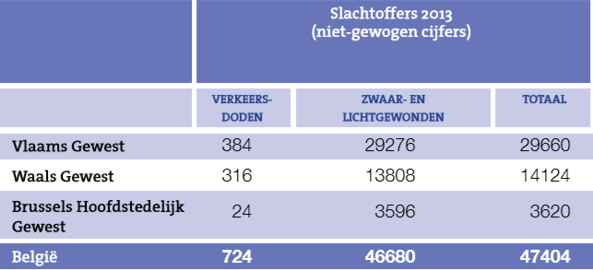
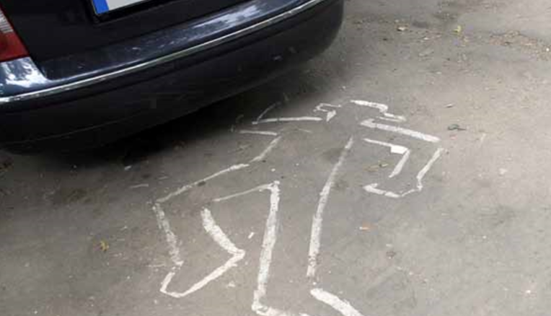
Saving lives
Bron: Carpentier A., Schoeters A., Nuyttens N., Declercq K. & Hermans E. (2014) Jaarrapport Verkeersveiligheid 2013

Slide 9

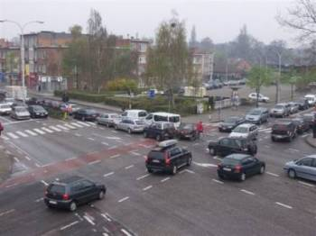
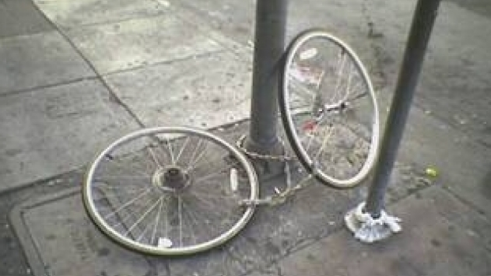
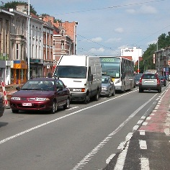
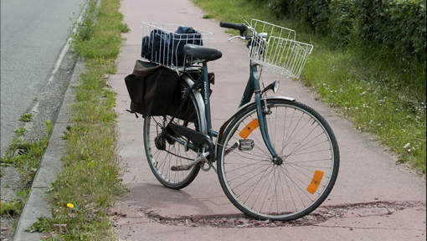
smart road users

Slide 10
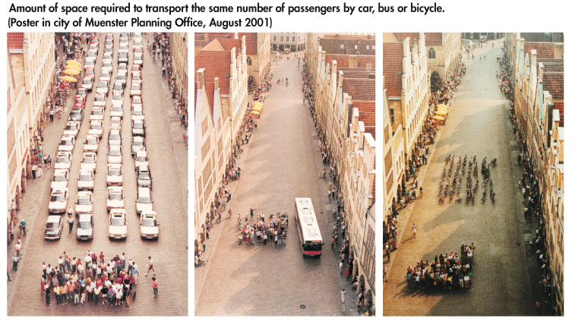
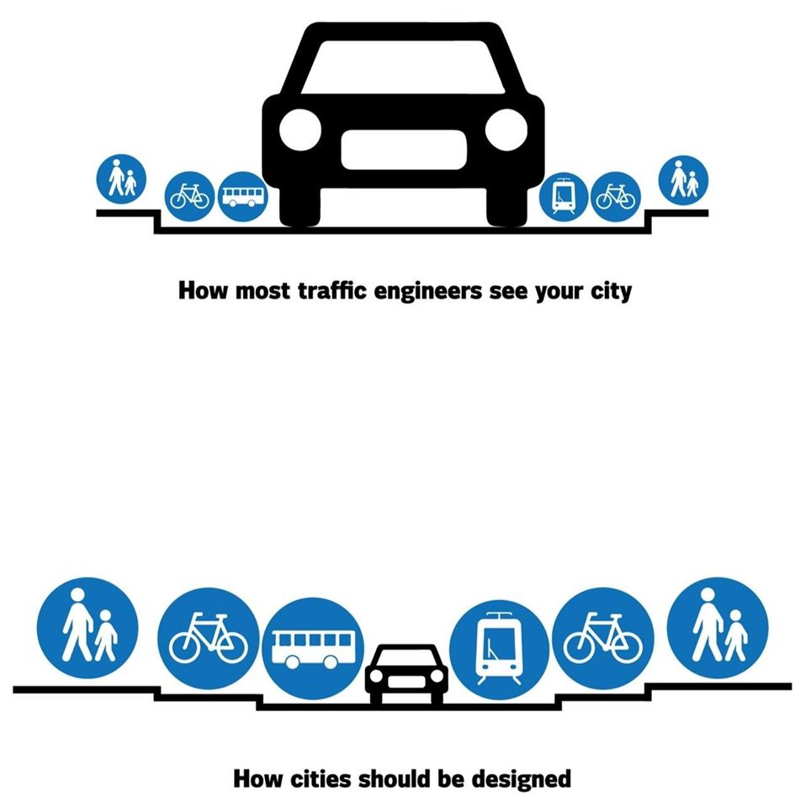
smart decision makers

Slide 11
Road safety Campaigns importance & objectives

Slide 12
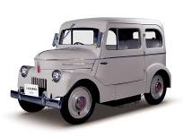
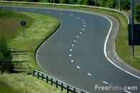
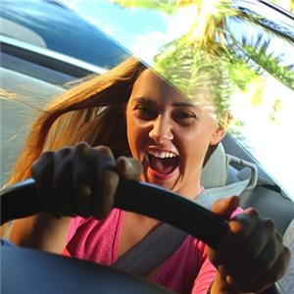
Accident causes
1%
1%
1%
2%
2%
2%
2%
5%
25%
65%

Slide 13
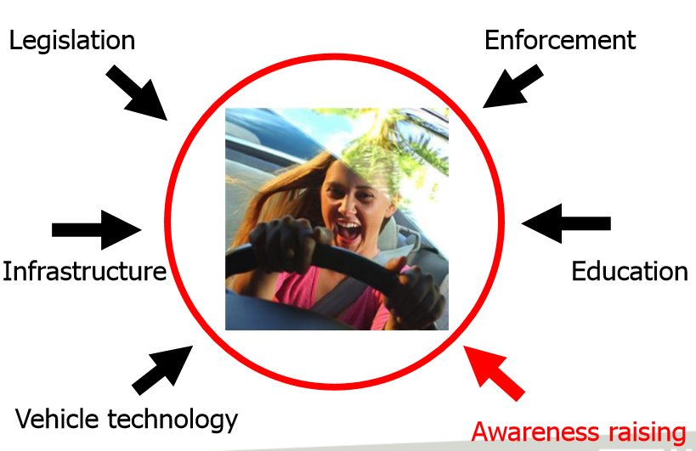
Impact on young drivers

Slide 14
Influencing behaviour
Legislation
Enforcement
Infrastructure
Education
Vehicle technology
Awareness raising

Slide 15
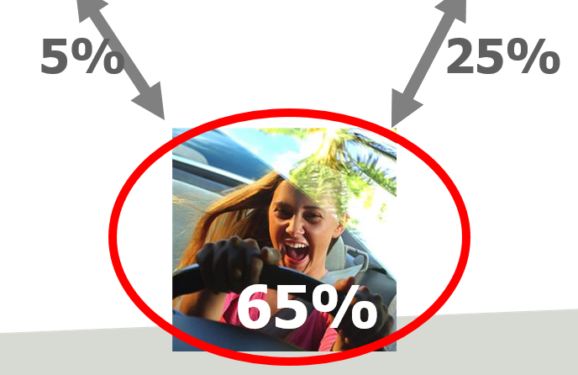
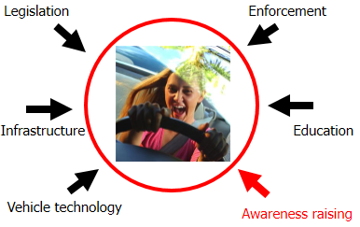
Importance of awareness raising
Fewer accidents/victims by addressing behavioural factors
Part of system approach
→ in combination with other measures

Slide 16
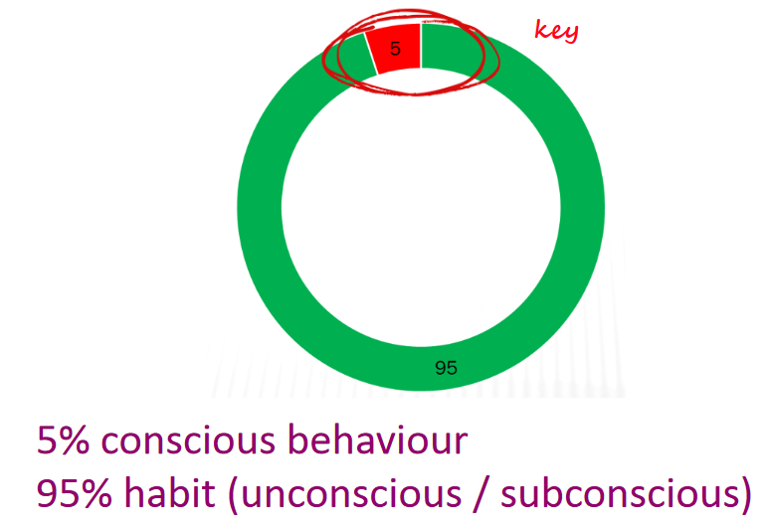
Bad news

Slide 17
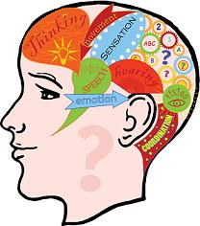
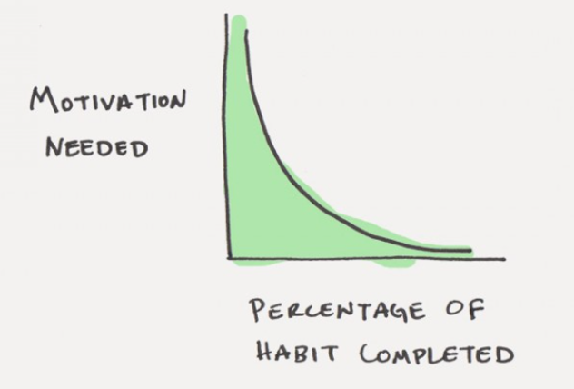
more bad news

Slide 18
objectives
General (ultimate) aim: less victims
  Eliminating unsafe behaviour
  Lasting behavioural change
How?
→ By influencing
  Knowledge
  Attitudes
  (Behaviour)
intermediairy / specific objectives

Slide 19
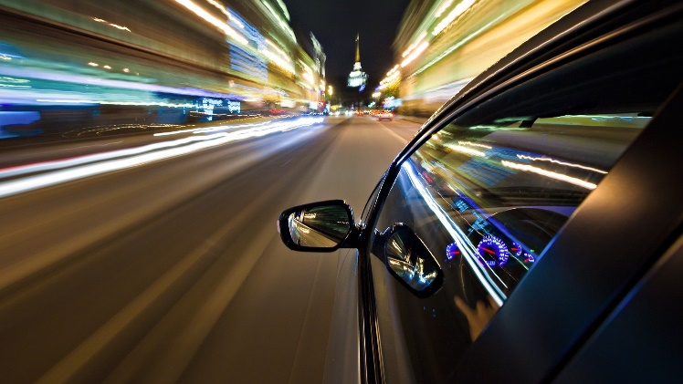
example: speeding
General (ultimate) aim: less road victims due to speeding
Target group: young car drivers
  Eliminating risk behaviour (speeding) in young car drivers
  Lasting behavioural change: target group adapts speed according to circumstances + keeps to speed limit
→ influencing
  Knowledge
    Speed limits
    Risks of speeding
    …
  Attitudes
    Personal risk perception (‘what can happen to me?’…)
    Perceived social norm (‘how do others think about…’)
    …
  Behaviour
    Intention to keep to the speed limit
    Speed choice in specific circumstances
intermediairy / specific objectives

Slide 20

Challenges
Mindset
‘Common good vs. individual freedom’
  Advantages of unsafe behaviour: clear
    Often direct
    Often tangible & concrete
    Often personal (speeding → ‘gaining time’)
  Advantages of safe behaviour:
  less clear
    Often indirect
    Not tangible, less concrete (‘reduced risk’)
    Less personal (‘wellbeing of others’)
Organisational
  Small budgets
  Not all knowledge in-house
  → Need for cooperation

Slide 21

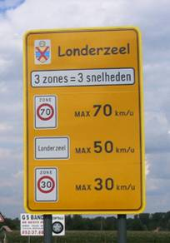
obstacles
  Information overload
    Daily news avalanche → habituation
    Too many messages → lack of clarity
  Social trends
    E.g. speed as highly positive quality
    E.g. being permanently available
  Problems to understand the message
    Too difficult, too abstract (icons, symbols)
    Double meanings, humour, mindbreakers…

Slide 22
Cast- project the campaign cycle

Slide 23
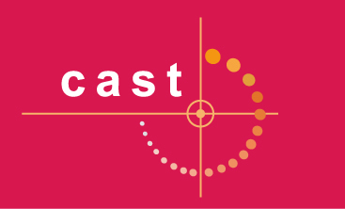


CAST
Campaigns and Awareness-raising Strategies in Traffic Safety
European research project
19 partners, 15 countries, 2007-2009
Co-financed by European Commission
Coordinator: Belgian Road Safety Institute (IBSR-BIVV)
Objectives:
  Increase effectiveness of road safety awareness raising campaigns
  Provide practical tools for campaign practitioners

Slide 24

CAST – core questions
Do campaigns work?
How well do they work?
What factors influence this?
How to design and implement effective
campaigns?
How to measure the effects of campaigns?
→ clear guidelines

Slide 25

CAST – research
Database: 221 campaign evaluation studies, 1980-2007
  Europe (40%), USA (40%), Au/NZ (20%), other
  (0,01%)
433 individual campaign effects identified
  effect = change in accident counts or % behaviour coinciding with campaign
Meta-analysis: weighted average of effects
  E.g.
  Campaign 1: 1000 accidents before, 900 after
  (-10%)
  Campaign 2: 10 accidents before, 5 after (-50%)
  → Campaign 1 receives greater weight

Slide 26
Campaign cycle: 6 steps
1 Getting Started
2 Analysing the Situation
3 Designing the Campaign and the Evaluation
4 Before-period Evaluation + Campaign Implementation
5 Completing the Evaluation and Drawing Conclusions
6 Writing the Final Report

Slide 27
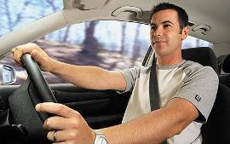
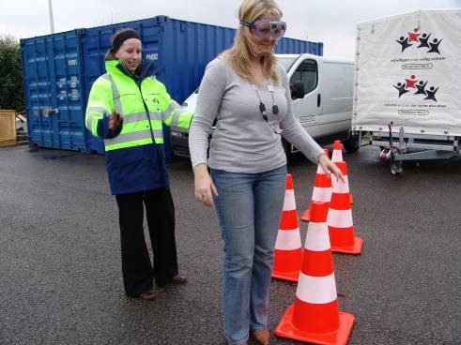
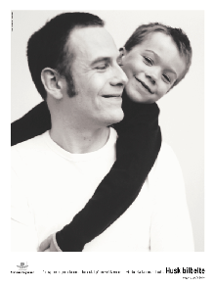
Success factors / CAST
More chances of success if…
  Clearly defined target audience
    e.g. ‘male car drivers aged 18-25’
  Personal approach / influence
    e.g. field actions, ‘tell a friend’, facebook…
  Combination of emotional and rational content
    e.g. ‘seat belt protects yourself and your family’

Slide 28
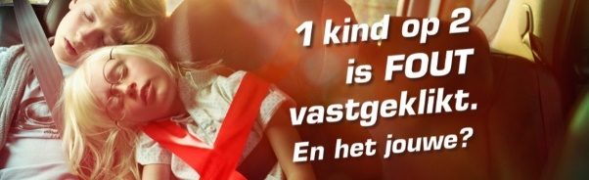
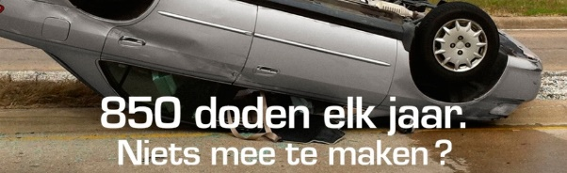

Success factors / CAST
More chances of success if…
  Focus on social norms or chance of being caught
  Short & personal messages
  (intimacy, trust)
  Communication along the road (direct, adapted to the situation)

Slide 29
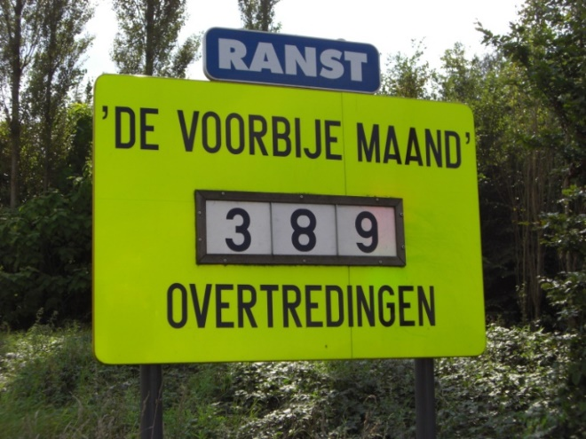
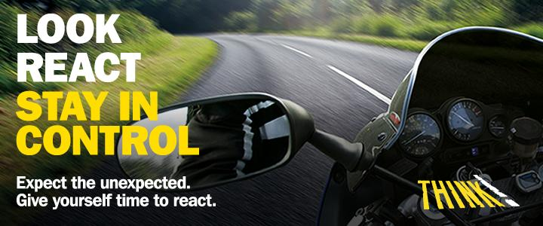
Success factors / CAST
More chances of success if…
  Enforcement with feedback
  Focus on risk perception
    (>< humour, fear appeal, confrontation)

Slide 30
Recommendations &
Examples

Slide 31
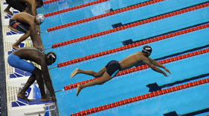
Avoid a false start
Notes:
Doelgroepen:
Opleiden van ambtenare
Werknemers

Slide 32
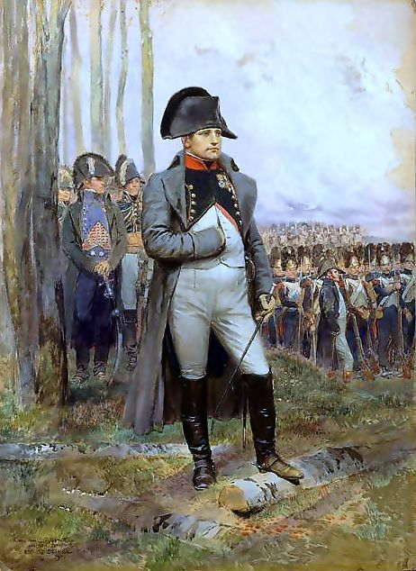
Start out with a strategy
The message
The target group
Tone of voice
Approach
Media plan
Evaluation
Reporting

Slide 33
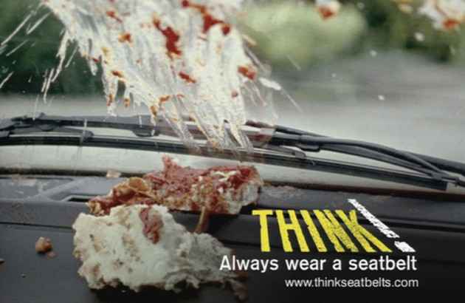
The message: KISS
Positive or negative framing
Only arguments pro,
or pro + contra
Must get noticed, be understood and accepted
    specific
    unambiguous
    short
    convincing
    credible
    clear
    easy to understand
    attention-grabbing
    concrete
    realistic

Slide 34
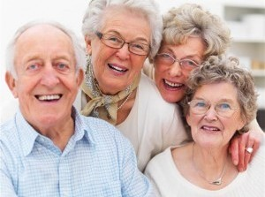
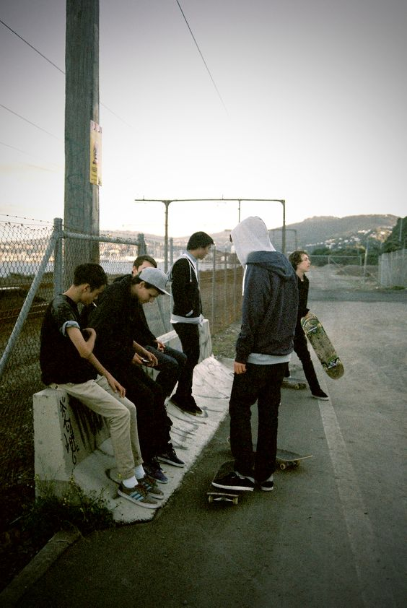
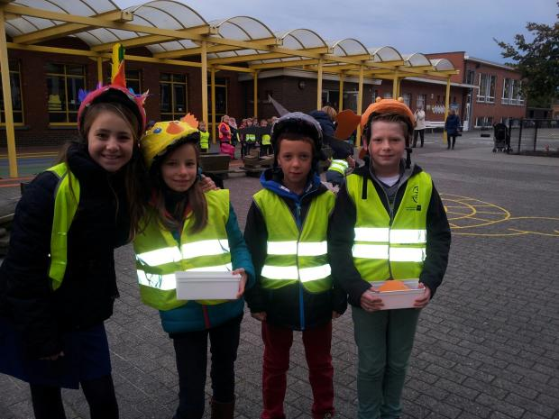
target GROUP
Notes:
Doelgroepen:
Opleiden van ambtenare
Werknemers

Slide 35
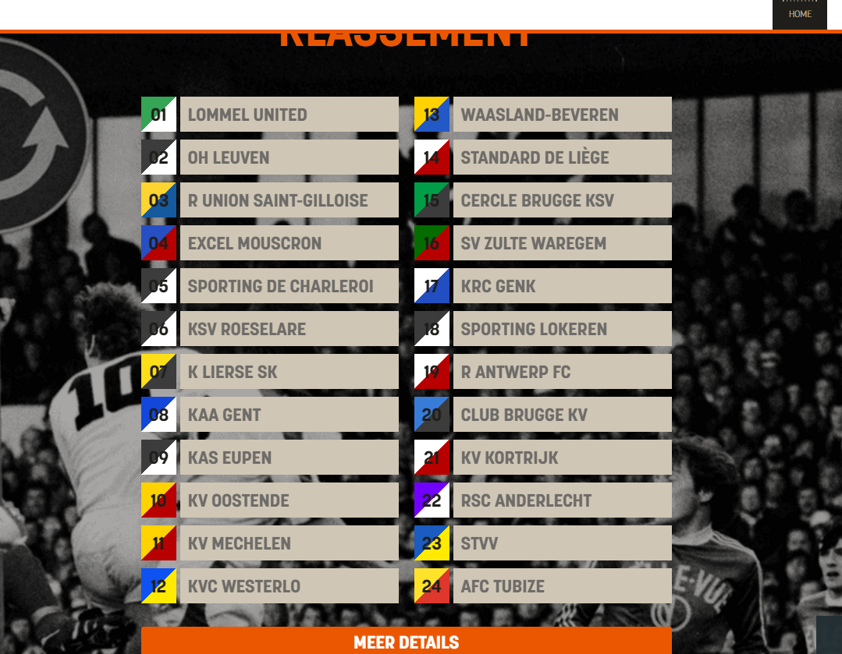
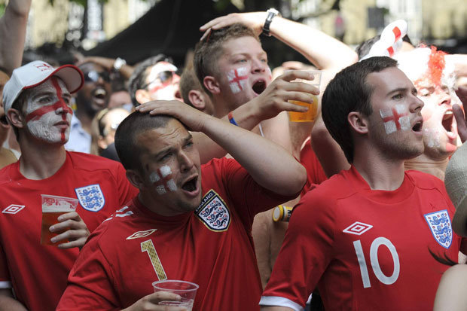
Custom made campaign
www.degroteverkeersquiz.be
Target group: football fans
www.de groteverkeerscup.be
Competing against other football teams

Slide 36
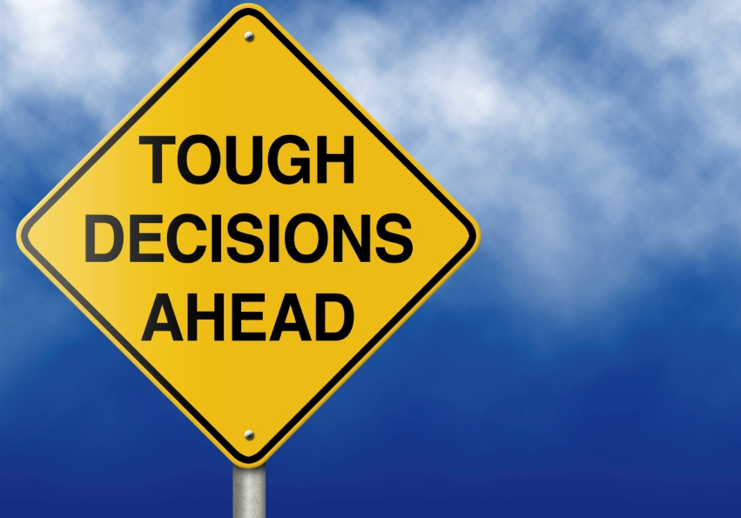
Tone of voice: make a choice
Fear appeal (!)
Moralising (!)
Emotional
Confronting
Humour, irony
Positive, stressing desired behaviour
  Humour, emotion, identification
  Social disapproval of risk behaviour

Slide 37
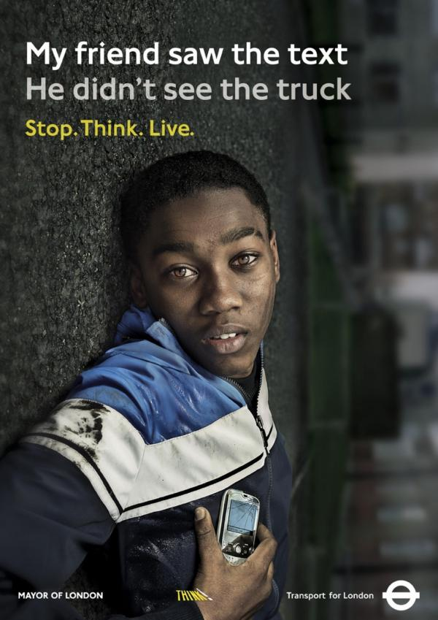

Slide 38
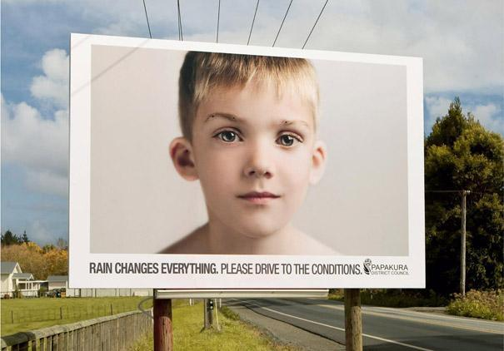

Slide 39
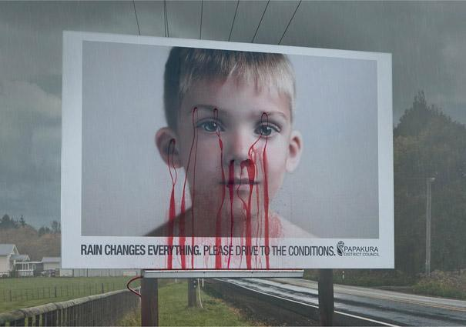
‘bleeding billboard’ (Pakapura, New Zealand)

Slide 40
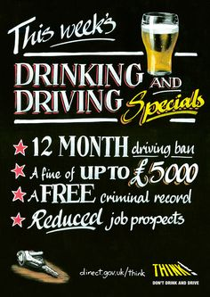

Slide 41
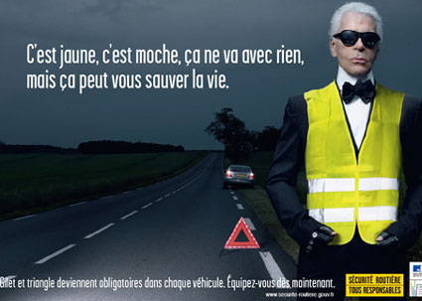
It’s yellow, it’s ugly and it doesn’t fit any look, but it can save your life (Karl Lagerfeld, fashion designer)

Slide 42
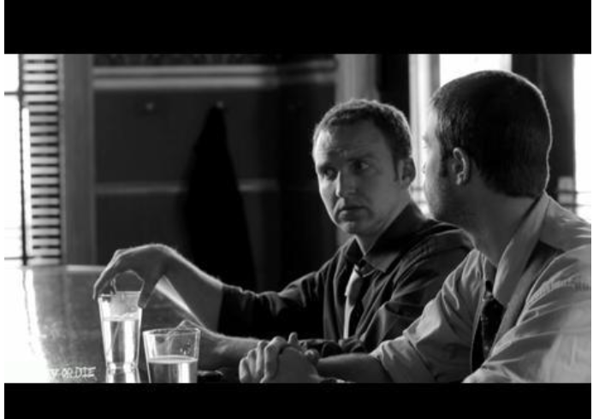
Personal approach

Slide 43
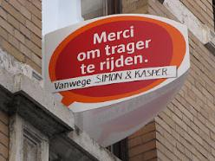
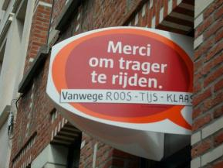

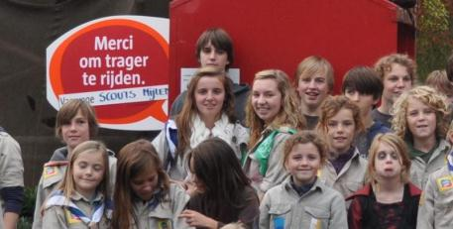
Approach: personal

Slide 44
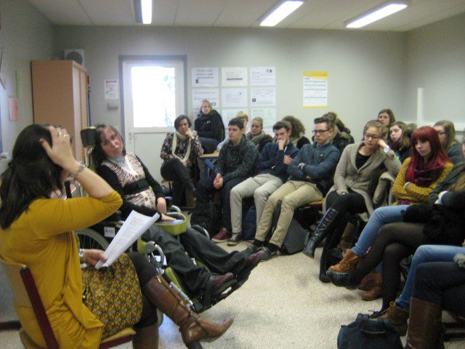
Personal approach

Slide 45

Media: Choose your weapon
Media choice
  Defined by
    Target audience
    Specific objectives (reach,…)
    Budget
  Options
    Billboards & posters
    TV adverts
    Radio adverts
    Cinema adverts
    Printed press adverts
    Flyers, brochures
    Online / viral
    Direct mail
    Field actions
    …

Slide 46
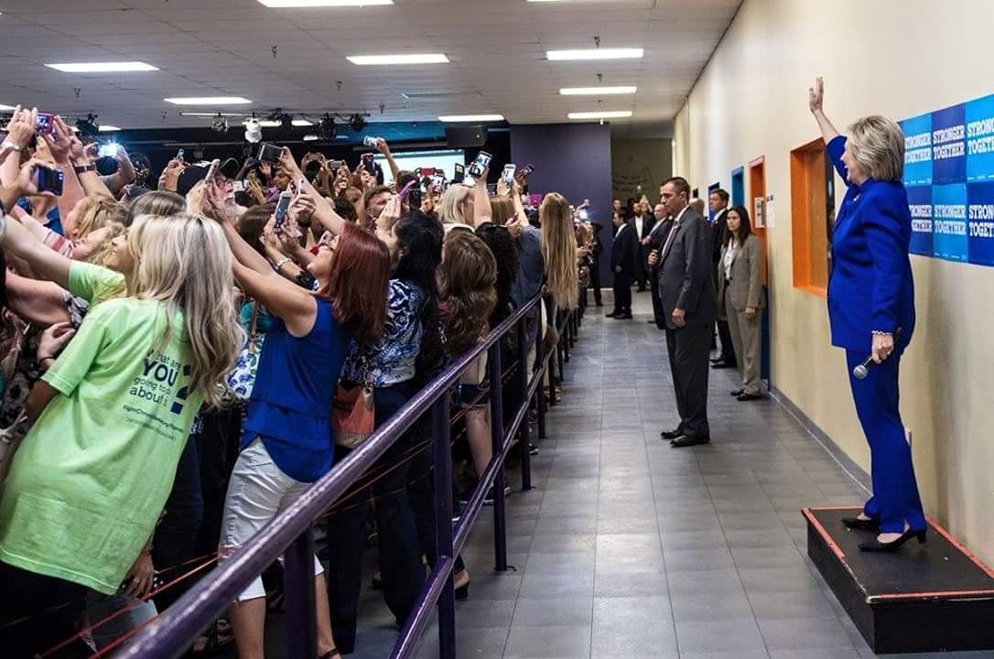

The World is changing
Notes:
Doelgroepen:
Opleiden van ambtenare
Werknemers

Slide 47








Sociale media

Slide 48

Stand out: be creative
Notes:
Doelgroepen:
Opleiden van ambtenare
Werknemers

Slide 49
Smoking campaign

Slide 50

GrassRoots: Education!
Notes:
Doelgroepen:
Opleiden van ambtenare
Werknemers

Slide 51

Evaluation
Why evaluate?
  Know if campaign has effects or not, and why
  Input for future campaigns (improvement)
  Justification for commissioners / sponsors
Thorough evaluation = at least:
  Process evaluation (reach, appreciation)
  → methods: counting systems / questionnaires
  Outcome evaluation (effects on knowledge, attitudes, behaviour)
  → methods: questionnaires / police reports / counting systems
  Before and after measurement
  Nice to have: control or comparison group (similar audience not subjected to campaign messages)

Slide 52
conclusion

Slide 53

Yes, We can be messi!
YES, campaigns have effect!
  A good strategy increases the effects
  Integrated approach is preferable
Influencing behaviour takes TIME
  Importance of repetition, setting intermediary targets
Evaluate and evolve!
Notes:
53

Slide 54

Notes:
Doelgroepen:
Opleiden van ambtenare
Werknemers

Slide 55
VSV
Stationsstraat 110
2800 Mechelen
T 015 44 65 50 steve.dhulster@vsv.be

