Slide 1
Best practices in tackling drink driving - Sweden
14th October 2015, London, UK
SMART event
Pär-Ola Skarviken

Slide 2
Long tradition of alcohol restrictions
State monopoly for the sale of all beverages with more
than 3,5% alcohol.
Drinks are expensive because of high taxes.
BAC limit is 0,02 percent.
Driving licence suspension if violated.
Zero tolerance for DUI of illegal drugs and narcotics.

Slide 3
Vision Zero
When the concept of Vision Zero was introduced in 1995, it turned the traditional view of road safety work upside down. From a focus on the prevention of accidents, the present direction is that no-one should die or be seriously injured in traffic.

Slide 4
A brief overview of the drink driving situation in Sweden
In 2014, 26 200 DUI offences were reported by the Police. 12 500 of these were under the influence of narcotics.

Slide 5
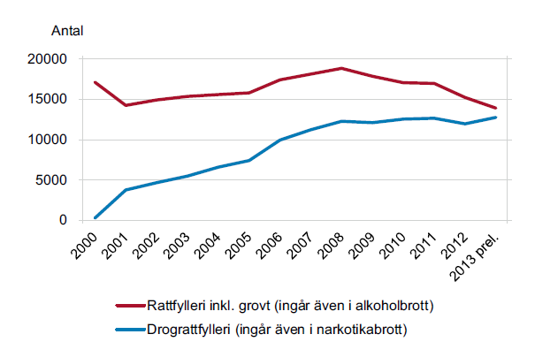
A brief overview, continued

Slide 6
A brief overview, continued
The number of reported DUI offences can be related to the number of exhalation tests executed by the Police.
The number of exhalation tests increased every year during the last decade (2,7 million at the most) but are now decreasing and in 2014 the number was 1,9 million.

Slide 7
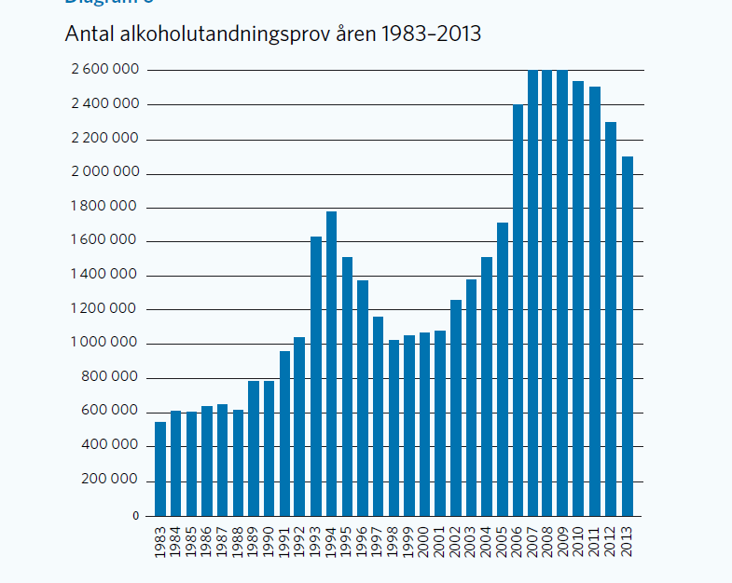
A brief overview, continued

Slide 8
A brief overview, continued
About every 500 driver on the road in Sweden is estimated to be under the influence of alcohol. That is equivalent to 0,2 percent of the Swedish population.
EU assessements show that 25 percent of all road accidents with a deadly outcome are related to alcohol. In Sweden that figure is slightly lower.
In 2014, 54 persons died in a traffic accident related to alcohol (BAC > 0,02 %) and 21 related to narcotics.

Slide 9
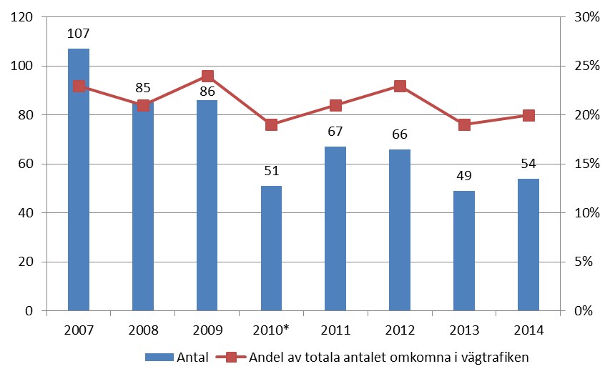
A brief overview, continued
Notes:
Antal och andel omkomna personer i alkoholrelaterade (alkohol > 0,2 promille) vägtrafikolyckor, 2007-2014.

Slide 10
Strategies undertaken to tackle drink driving in Sweden
Strong political commitment from the Swedish government by making drink driving one of its highest priorities.
Alcohol ignition interlocks ”Swedish strategy 2007”
The ministry of Enterprise Energy and Communications
There is a strong and wide public awareness of drink driving.

Slide 11
Strategies undertaken to tackle drink driving in Sweden
Sweden has a cohesive strategy that include preventive work in the whole society, (ANDT policy). http://www.government.se/information-material/2011/05/a-cohesive-strategy-for-alcohol-narcotic-drugs-doping-and-tobacco-andt-policy

Slide 12
Strategies undertaken to tackle drink driving in Sweden
There is a mandatory education on negative effects of alcohol and drugs in the process to obtain a driving license.
Alcohol Interlocks is used in most traffic school vehicles and in all test vechicles.

Slide 13
Strategies undertaken to tackle drink driving in Sweden
In Sweden you can find alcolocks in vechicles, lorries, taxis, buses, trams, locomotives, snow-mobiles and motorcycles.
Started in 1999 with a national wide trial.
Alcolocks is also used in commercial transports, government vehicles and school transport vehicles.
Alcolocks is used in 95% of all buses in local and regional public transport.

Slide 14
Strategies undertaken to tackle drink driving in Sweden
Assignment to investigate and analyze the conditions for introducing alcogates in ports
* legal, financial and practical conditions
* propose a timetable for which ports
Consultation with other actors
To be reported November 2015

Slide 15
Strategies undertaken to tackle drink driving in Sweden
Alcohol Interlock Program

Slide 16
Alcohol interlock program for DUI-offenders – a brief history
Trial-program (for cars) 1999
Extension of the trial-program (now includes cars, busses and trucks) 2003
Law regarding a permanent program for DUI-offenders since the 1st of January 2012 (implemented on the 1st of January 2012)

Slide 17
Driving license and criminal charges in Sweden - overview
Police detects DUI
Driver license sent to Swedish Transport Agency
License revoked
1 or 2 years
Interlock granted after application
for 1 or 2 years
Report sent to the prosecutor
Criminal charges settled by prosecutor or in court

Slide 18
Application procedure
The program is open for all DUI (of alcohol) -offenders
Differentiated conditional time
  Two years
    BAC ≥ 0,1%
    Repeated DUI during a five year period
    DUI in combination with a diagnosed addiction or abuse of alcohol
  Otherwise one year (BAC 0,02-0,09%) - prolonged to two years in case of diagnosis
Cost: 1-year: 2 150-2 700 EUR, 2-years: 2 850 - 4 150 EUR

Slide 19
Obligations during- and after the program
During the program
  Data transmission
  Breath test at start and during driving
  Doctors certificate of drug and alcohol use
  Conditional license is invalid after the determined conditional time
Regular license after conditional time
  Application procedure
  Two year participants needs to verify sobriety
Follow up
  Two year participants are followed after a regular licence is granted
  Medical certificate of drug and alcohol use after 6 months and after an additional 12 months (18 in total)

Slide 20
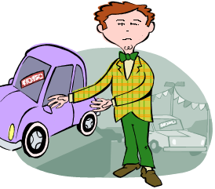



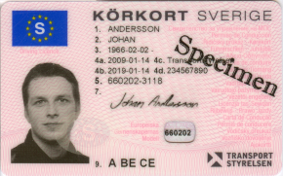
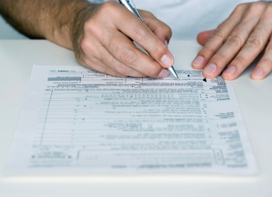


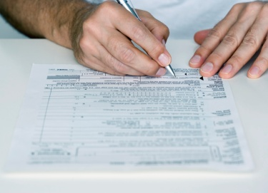

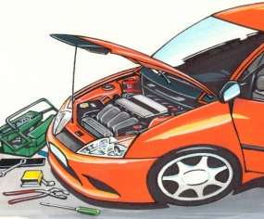


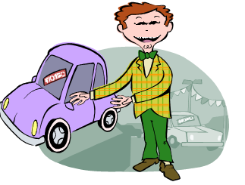

Alcohol Interlock Process
Banperiod at least
1 or 2 years
Application
Medical check
Conditional period 1 or 2 years
Conditional driver’s licence
Application for a license without condition at the end of the period

Slide 21
The Swedish system in numbers 2012-2014
 | 2012 | 2013 | 2014
Revoked licenses because of DUI (incl. drug use) | 6850 | 7396 | 6438
Applications | 1650 | 2374 | 2196
Denied | 133 | 286 | 288
Conditional licenses granted | 1517 | 2088 | 1908
Valid conditional driving licenses | 1409 | 2836 | 3256

Slide 22
Underway
Evaluation of the (new) alcohol interlock program
The program as a whole – good/changes?
The alcohol interlock itself – technical difficulties?
Participation in the program vs. not participating – consequences for a persons health, work, family, social life etc.?
Integrity issues
Request (to the Ministry) for changes in the law regarding participants with a prescribed use of narcotic substances

Slide 23
Good experiences of the Pilot program
Successful for those who fulfilled the program
Lasting changes in alcohol and driving habits
Less relapse to DUI
Reduced number of traffic accidents
Reduces alcohol consumption
Reduced need for hospital treatment
Reduced sick-leave
Saved jobs
Saved marriages

Slide 24
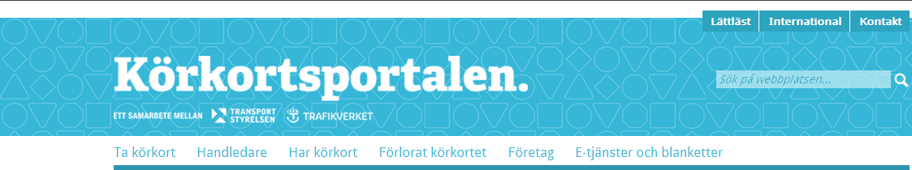
www.korkortsportalen.se
”Everything you need to know about drivers license in one webpage”
Application forms
Information brochures
FAQ about the alcohol interlock program
Film describing the process behind the alcohol interlock program
www.korkortsportalen.se

Slide 25
Questions?
Pär-Ola Skarviken
par-ola.skarviken@transportstyrelsen.se
Direct: +46 10 495 76 55
Mobile: +46 767 24 77 20
www.transportstyrelsen.se
+46 (0) 771 503 503

