Slide 1

Young Europeans Acting for Road Safety - YEARS
European Transport Safety Lecture
Brussels - 19 October 2015
Antonio Avenoso
Notes:
Welcome participants, speakers…
Thank 10 colleagues
Theme of conference
Depending on how successful we are with this and other activities we might “decapitalise” the E and become the electronic transport safety council…

Slide 2



















































ETSC Network

Slide 3
Young people have always been risk-takers
”I see no hope for the future of our people, for certainly all youth are reckless beyond words”
Hesiod (700 bc)

Slide 4
Young people at higher risk than the rest of the population
140,000 young people (15-30) were killed in road collisions in the EU- 27 over the past ten years
9,000 were killed in 2010
A reduction of 44% between 2001 an 2010
81% of those killed are male
Young people represent 20% of the population but 30% of all road deaths
Road collisions: the first cause of mortality among young people. One young person’s death in four results from a road collision.
ETSC (2012), 6th PIN Report, A challenging Start Towards the EU 2020 Target
Notes:
Out of 4 deaths from all causes, one is due to a road collision.

Slide 5
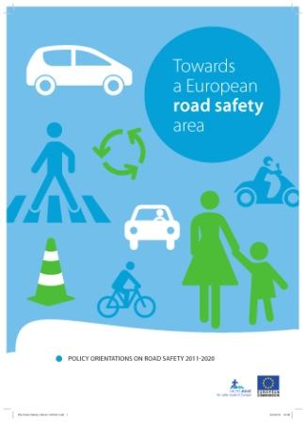
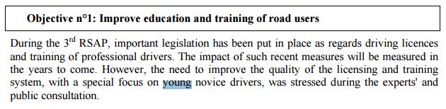
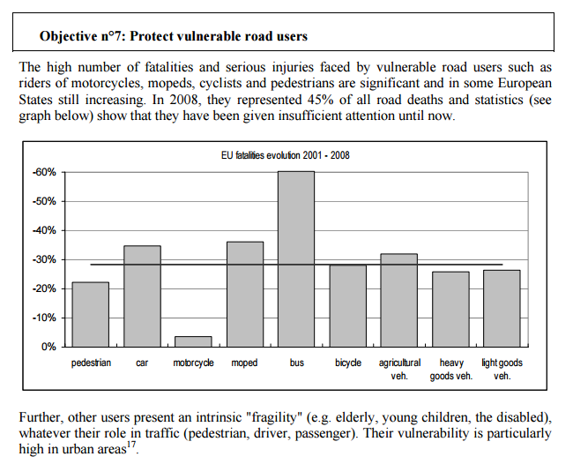
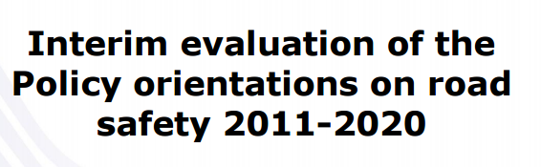
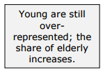
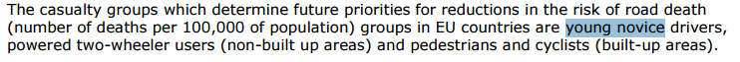
EC Road Safety Policy Orientations
Published in May 2015
EC Road Safety Policy Orientations 2011-2020 published in July 2010

Slide 6



YEARS project
A three-year project which aimed to:
Promoting good practice case studies and policies in tackling young and novice drivers road risks
Disseminate knowledge to decision-makers and key stakeholders through National events
Motivate students to take action at local level
Design, develop and implement local, cost-effective road safety and communication activities: an EU road safety competition!
Award Ceremony + Final Conference

Slide 7
FIND OUT MORE
www.etsc.eu
@etsc_eu
antonio.avenoso@etsc.eu
Notes:
7

