Slide 1






Young Europeans Acting for Road Safety
Athens, 12th of June 2017
Antonio Avenoso
ETSC Executive Director

Slide 2



























































NETWORK

Slide 3
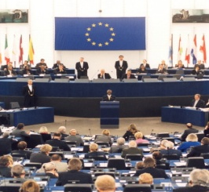





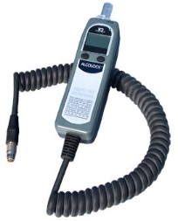

Road Safety Performance Index (PIN)
Ranking EU countries‘ performances
Monitoring EU transport
safety policy
SAFE & SOBER

Slide 4
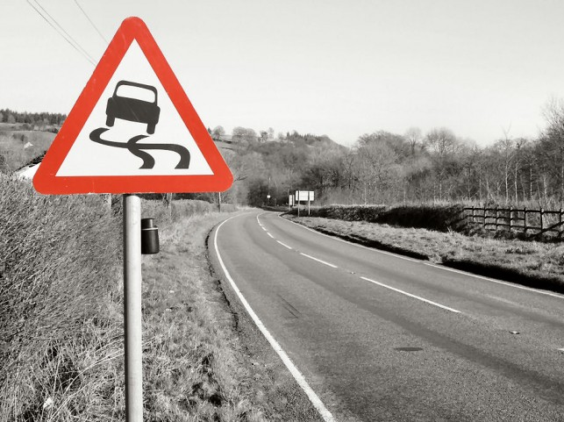
2014-2016
bad years for road safety
Notes:
The PIN annual report for this year, published today reveals a worrying picture.
2014 was a bad year for road safety in the EU

Slide 5
25,671
people died in road traffic in the EU in 2016
Notes:
2015 was the second consecutive poor year for road safety; 26,300 people lost their lives on EU roads in 2015 representing an increase of 1% compared to 2014. Out of the 32 countries monitored by the PIN Programme, as many as 22 saw an increase in the number of road deaths between 2014 and 2015.

Slide 6
135,000
seriously injured in road traffic in the EU in 2014 according to MAIS3+ definition
Notes:
At the same time, 135.000 people were seriously injured in 2014. Exceeding speed limits, drink or distracted driving and failure to wear a seat belt are still the leading causes of death and serious injury on European roads.

Slide 7
THE EU TARGET IS AT STAKE
-19%
Notes:
EU target: to reduce road deaths by 50% between 2010 and 2020
A 6.7% reduction per year on average is needed to be on track
2014 : only 0.6% reduction compared to 2013, worst annual reduction since 2010
2015: 1% increase in road deaths compared to 2014, worst annual result since 2001

Slide 8
CHANGE IN ROAD DEATHS (%) 2015-2016
1. LITHUANIA -22%
2. CYPRUS -19%
3. CZECH REPUBLIC -17%

Slide 9
ROAD DEATHS PER MLN. INHABITANTS in 2016 and 2010
Notes:
Greece 75 in 2016
112 in 2010

Slide 10
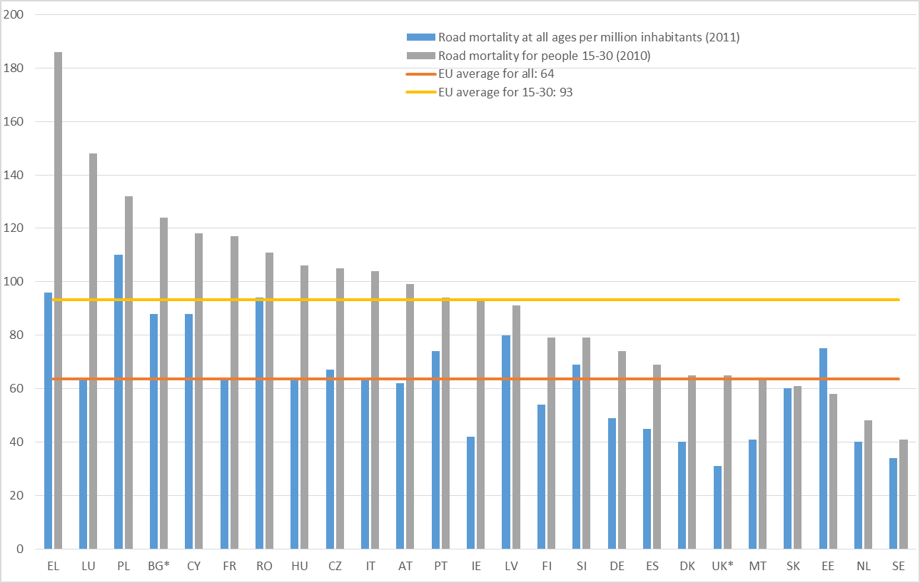
YOUNG PEOPLE MORTALITY
Young people road deaths per million young inhabitants (with road deaths per million inhabitants at all ages for comparison)

Slide 11
ETSC RECOMMENDATIONS
Continue to research the causes of young, novice driver risk with a view to designing more effective countermeasures
Ensure effective legislation and enforcement
Improve training and licensing systems
Ensure high levels of experience, via accompanied driving, prior to licensing for solo driving
Reduce exposure to risk immediately following licensing for solo driving
Provide appropriate incentives and disincentives, e.g. stricter demerit point systems, lower alcohol limits, good information campaigns

Slide 12


YEARS – Young Europeans Acting for Road Safety

Slide 13

YEARS PROJECT
A three-year project which aimed to:
Promoting good practice case studies and policies in tackling young and novice drivers road risks
Disseminate knowledge to decision-makers and key stakeholders through National events
Motivate students to take action at local level
Design, develop and implement local, cost-effective road safety and communication activities: an EU road safety competition!
Award Ceremony + Final Conference

Slide 14
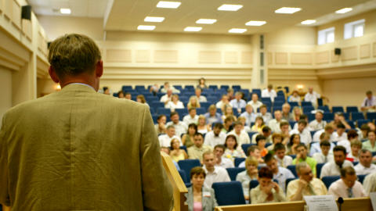

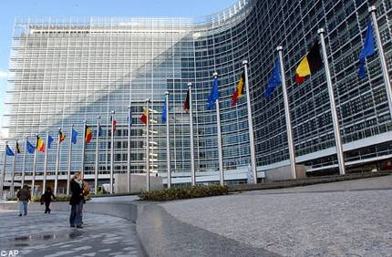


GETTING STUDENTS TO IMPROVE SAFETY
Students applied online to take part in YEARS
CAMP: 11 groups with the best project ideas attended a one-week training course in Brussels, to discuss their ideas with experts (last October)
Challenge: after returning to their home country in groups of two, students carry a safety activity with the support of ETSC and its partners
European Award Ceremony:
Best projects receive award and proper promotion and follow-up is ensured
Notes:
But let’s remind ourselves of the fatality figures.

Slide 15
















YEARS LECTURES
A Lecture tour across universities: 20 lectures in selected universities across Europe to motivate students (engineering but not only) to take action and come up with ideas for local road safety projects targeting young road users.

Slide 16
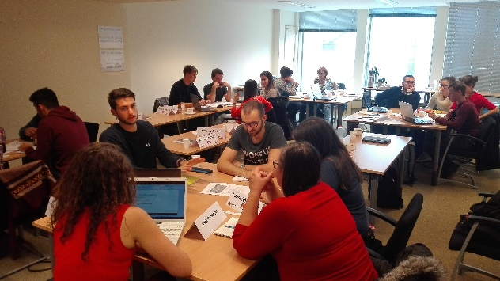
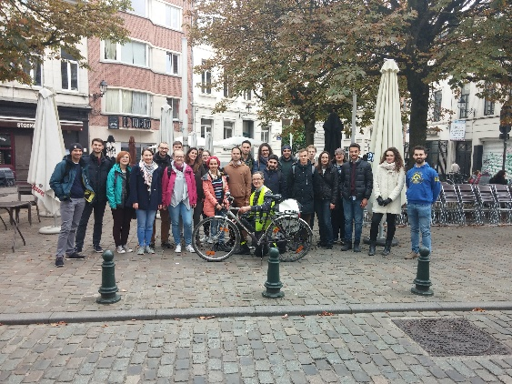
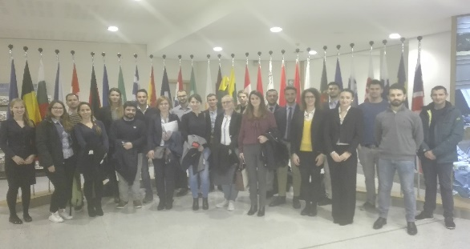
YEARS CAMP
Lectures:
Road Safety Engineering
Road Safety Campaigning
Group exercises
Other activities:
EU Institutions: Parliament visit
Guided cycling tour

Slide 17
YEARS CAMP OBJECTIVES
Conclusions
Improve technical knowledge on road safety infrastructure
Learn how to run a communication campaign, involving media and public authorities
Have a more structured idea on the project students are going to manage
Get more motivation to start the YEARS campaign

Slide 18

YEARS PROJECT SCHEDULE
By end of 2017: final report from students that will follow a mid-term visit by ETSC to meet the local authorities
By Mid-2018: the groups of winners will be selected by the jury
By end of 2018: Award Ceremony organized in Brussels
Notes:
18

Slide 19
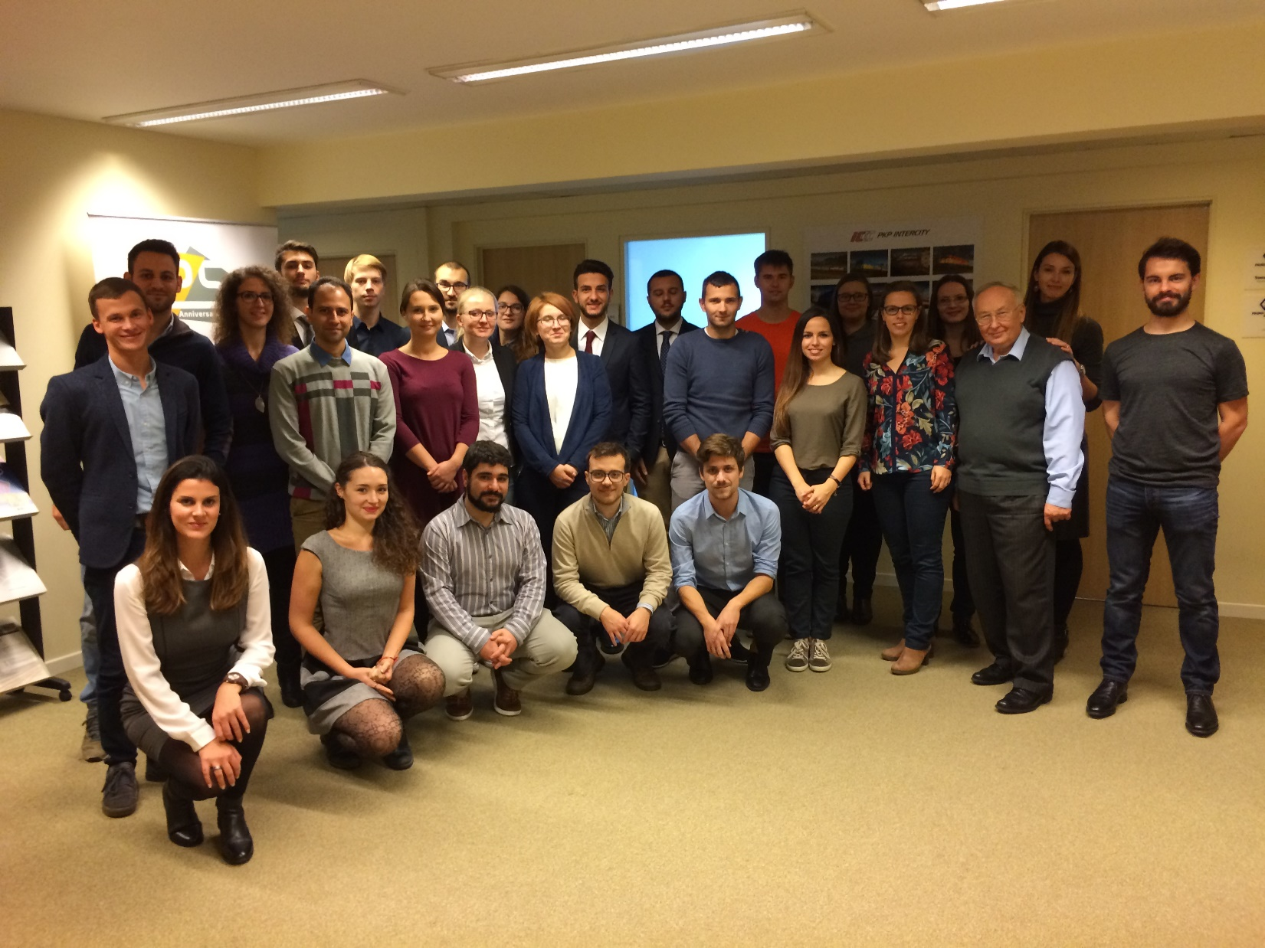

Slide 20




THANK YOU FOR
YOUR ATTENTION
www.etsc.eu @etsc_eu
antonio.avenoso@etsc.eu

